Slide 1
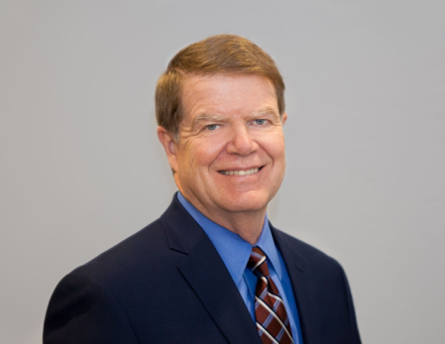
PROSPER, HELP AND PERKINS: A WASHINGTON UPDATE PacWest SFS Conference
Harrison M. Wadsworth III
COHEAO/Bose Washington Partners
May 16, 2018

Slide 2
The 115th Congress
House
Senate
235 Republicans
193 Democrats
7 Vacancies
Majority controls agenda
Majority always rules unless it is divided
Which it often is!
51 Republicans
49 Democrats
Majority sets agenda
60 votes needed to move legislation forward
Major exception: “Budget Reconciliation”
Notes:
2

Slide 3
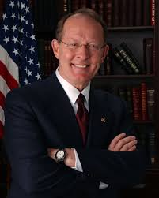
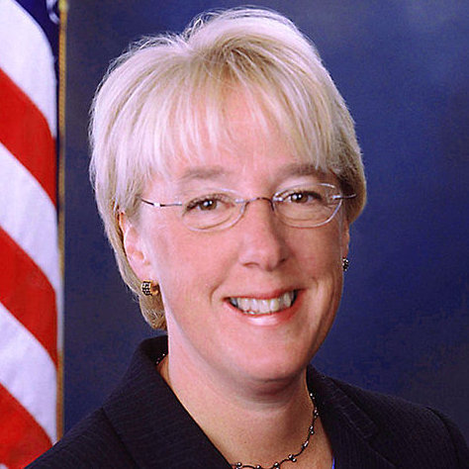
Key People In 115th Congress
Senate HELP Committee, 12 Republicans, 11 Democrats
(Health, Education, Labor and Pensions)
Key HELPers:
Collins (R-ME)
Baldwin (D-WI)
Burr (R-NC)
Casey (D-PA)
Isakson (R-GA)
Bennet (D-CO)
Enzi (R-WY)
New:
Doug Jones (D-AL)
Tina Smith (D-MN)
Todd Young (R-IN)
Maggie Hassan (D-NH)
Chairman
Ranking Democrat
Lamar Alexander (R-TN)
Patty Murray (D-WA)

Slide 4
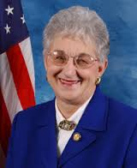
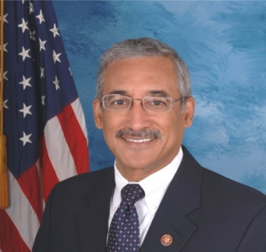
Key People In 115th Congress
House Education & Workforce Committee
22 R, 17 D
Some Key Members:
G.T. Thompson (R-PA)
Luke Messer (R-IN)
Todd Rokita (R-IN)
Phil Roe (R-TN)
Susan Davis (D-CA)
Jared Polis (D-CO)
Alma Adams (D-NC)
Chairwoman
Virginia Foxx (R-NC)
Ranking Member
Bobby Scott (D-VA)
Subcommittee on Higher Education and Workforce Training
Chairman: Brett Guthrie (R-KY)
Ranking Democrat: Susan Davis (CA)
New to Committee:
6 Republicans, 6 Democrats

Slide 5
Changes at Department of Ed
Chief Operating Officer:
Wayne Johnson leads new “Office of Strategy and Transformation” at FSA
Jim Manning is Acting COO, remains Acting Undersecretary = key player for higher ed
Deputy COO: Kathleen Smith, formerly acting Asst. Secretary for Postsecondary Education
Next Gen: Next Generation Processing and Servicing Environment coming soon?

Slide 6
Office of Postsecondary Education
Lynn B. Mahaffie: Delegated Duties of Assistant Secretary for Postsecondary Education
Linda Byrd-Johnson: Acting Deputy Assistant Secretary for Higher Education Programs
Gail McLarnon: Acting Deputy Assistant Secretary for Policy, Planning and Innovation
Daniel J. Miller: Deputy Assistant Secretary for Management and Planning
George Alan Smith: Chief of Staff

Slide 7
Servicing and Collections at ED
Johnson is revamping DL servicing contracts under Next Gen concept
New TIVAS contract/s still to come
ED’s collection contracts: procurement stalled again; ED cancelled the federally owned procurement for larger contractors, which will now have to subcontract for smaller ones.
What’s next? More court battles most likely…

Slide 8
Perkins Loans 2018
Despite much support, Perkins remains expired
H.R. 2482 – Introduced on 5/17/17 – two year extension through 9/30/19.
253 cosponsors, a majority of the 435 members of the House of Representatives – 51 Rs and 192 Ds.
S. 1808 – Introduced 9/14/17 – same as House bill. 22 cosponsors -- 4 Rs and 18 Ds.
Not sponsoring: House Education and the Workforce Committee Chairwoman Virginia Foxx (R-NC)
Senate HELP Committee Chairman Lamar Alexander (R-TN).
This is most unfortunate.
8
Notes:
Maria

Slide 9
Perkins Status
COHEAO fought for an extension in the Omnibus Appropriations Bill that passed in March.
House Congressional allies got 99 signatures on Dear Colleague letter seeking inclusion of Perkins in Omnibus
Not included due to opposition from Sen. Alexander, who is also on the Appropriations Committee, and Rep. Foxx
BUT Work Continues
HEA reauthorization still underway, very slowly
Hearings in Senate & "PROSPER Act" in the House
Alternative Perkins Proposal from COHEAO
Creates new directly funded, campus managed program. More on that later.
9

Slide 10
Perkins Status
Just because the program has expired doesn’t mean it can’t be resurrected.
COHEAO will work to ensure institutions receive the money they are due
ED should permit campuses to retain their share of unreimbursed cancelled loans.
Also, there is a need for ACA to be paid to
support servicing!
A lot of campus money remains on the table

Slide 11
HEA Action in Congress
HEA reauthorization process activated in late 2017 – House Education and Workforce Committee action in December, more Senate HELP Committee hearings.
Chairwoman Foxx working to get votes to pass PROSPER Act before full House.
Needs almost all Republicans since bill has no Democratic support.
She is determined but not there yet.
Senate stalled; maybe a Republican bill introduced this summer, but it won’t go anywhere

Slide 12
HEA in House – PROSPER Act
House bill: “PROSPER Act” Replaces Direct Loan Program with new Federal One Loan Program
No Perkins or SEOG, major changes to direct loan program
No Grad PLUS, Parent PLUS capped,
Subsidized Direct loans eliminated for undergrads
Unsubsidized Direct (Stafford) limits increased to make up for loss of Perkins
Streamlines Repayment Plans
Standard 10-year, with longer periods permitted for consolidation loans
Income Derived – payments = 15% of discretionary income, but all principal and 10-years-worth of interest have to be repaid before forgiveness allowed
Increases Pell Grants -- $300 bonus if taking 15 credit hours
Eliminates Public Service Loan Forgiveness

Slide 13
PROSPER Act
Forces Ed to provide initial finding of program reviews within 90 days
Expands FWS with revised funding formula and eliminates graduate eligibility
Repeals Teach Grants, other grant programs
Pay checks for Students
Credit balance refunds would be paid to student in equal monthly or weekly installments
Deposited on a debit card
First installment may be paid as early as 30 days first day of classes, no later than 30 days after the start of classes

Slide 14
PROSPER Act
Risk Sharing and Accountability
Replace cohort default rate with loan repayment rate (calculated by program of study)
Programs where fewer than 45 percent of former students are making required payments could lose Title IV eligibility.
90-10 Rule repealed.
Gainful employment requirement repealed.
Tighten rules on “earned aid” under R2T4 for withdrawn students, so schools bear more cost.
Require schools to repay ED for some portion of defaulted loans.

Slide 15
Senate
Hearings in HELP Committee in early 2018, also in 2014, 2016, but done for now.
Chairman Alexander and top Democrat Patty Murray of Washington have worked together in the past, but relations currently strained.
Republicans’ narrow majority and requirement for 60 senators to end debate means bills have to be bi-partisan. PROSPER would have no chance.

Slide 16
Perkins 2.0 – 21st Century Perkins
COHEAO proposal for HEA Reauthorization includes a new Perkins Loan Program:
One for One Replacement – New federal funds replace the existing revolving loan funds
School match – level to be determined
Updates the allocation formula, phases out the base guarantee
No in-school interest
No origination fees and loans remain low interest
Maintains cancellations for public service
Servicing remains school based subject to current regulations

Slide 17
Perkins Reauthorization Themes
Unify allocation formulas, broaden availability to more campuses
“Skin in the game”: Perkins is a long-established risk-sharing program where campuses put up their own money
Local Control of Funding: Campuses allocate loan funds to students with need on an individual basis according to the situation on the campus and with the student
Local Responsibility for Management: Perkins is managed by campuses in every state
Reduced Role for Washington: Campuses can manage Perkins portfolios without the need for large numbers of Department of Education staff involved

Slide 18
Some Perkins Wind-Down Issues
On October 6, the Department issued DCL GEN-17-10:
Institutions may continue servicing their Perkins Loans and distributing the assets to the Department on a regular basis until all outstanding Perkins Loans have been:
Paid in full
Otherwise fully retired (Cancelled, written off, etc.)
Assigned to the Department
Institutions are not required to assign Perkins loans to the Department or liquidate their Perkins loan revolving funds
Institutions that continue servicing their Perkins loan portfolios must continue to:
Service the loans in accordance with the Perkins regulations
Report their outstanding loan portfolio using the FISAP.

Slide 19
Key Perkins Wind-Down Points
Institutions may choose to liquidate at any time in the future and may assign non-defaulted and/or defaulted Perkins Loans to the Department at any time.
The institution loses all rights to assigned loans and will not receive any share of future amounts collected by the Department.
An administrative cost allowance cannot be charged against an institution’s Perkins Loan Revolving Fund because institutions will no longer be advancing funds to students after June 30, 2018.
The Department will begin collecting the Federal share of institutions’ Perkins Loan Revolving Funds following the submission of next year’s FISAP due October 1, 2018.

Slide 20
Perkins Wind-Down Points
The calculation of the FCC to be returned to the Department and the ICC, which remains at the institution, will be similar to the Excess Liquid Capital (ELC) process currently in place.
The ELC process accounts for changes in the ICC matching requirements that occurred over time, as well as any overmatching.
Any FCC previously returned to the Department, and any ICC that was previously returned to the institution will be taken into account.
Unreimbursed cancellation amounts will not be considered in determining the Federal share to be returned because HEA Section 465(b) (used to) prohibit the use of funds appropriated for FCCs from being used for cancellation reimbursement. Note: that section was changed in 2015!
The Department will provide more information on the distribution of the assets of institutions’ Perkins Loan Revolving Funds, including deadlines, prior to the October 1, 2018, FISAP submission deadline.

Slide 21
Reasons Not To Liquidate
There is no rush because ED has not issued final guidance
You lose your Institutional Capital Contribution (ICC) for assigned loans
You would also likely forfeit any ICC reimbursements for cancelled loans
The additional cost to your school could be tremendous:
You could be liable for $100k’s in “bad loans”
Human resources required to complete liquidation are tremendous
Of Note: COHEAO is advocating for an Administrative Cost Allowance to allow schools to continue servicing loans
Liquidation could be incredibly disruptive to current and former students
You can reassign problem loans without liquidation – schools should regularly be reviewing old portfolios to determine the best place for a loan

Slide 22
You Can Still Make a Difference
What You Can Do:
Continue to communicate with Congress about harm to students from loss of campus-based loans
Share Perkins info with colleagues: Upper Administration, Financial Aid/Student Accounts & Government Relations
See COHEAO’s Advocacy Page & Media Center (COHEAO.org)
Continue to service your loans
Advocate for ACA
Advocate for unreimbursed cancellation benefits.
Join COHEAO – new institutional loan task force created – Look at ways to make use of Perkins funds

Slide 23
Contact Information
Harrison Wadsworth
Executive Director, COHEAO
Principal, Bose Washington Partners
202-349-2303
hwadsworth@bosewashingtonpartners.com
Jared Solomon
Associate Director, COHEAO
Assistant Vice President, Bose Washington Partners
202-289-3910
jsolomon@bosewashingtonpartners.com
Greg Marak
Director of Publications and Membership, COHEAO
Public Policy Specialist, Bose Washington Partners
202-289-3910
gmarak@bosewashingtonpartners.com

Slide 24
Any Questions???

