Slide 1
International Student Payment, Outreach & Collection
PacWest SFS, 2019

Slide 2
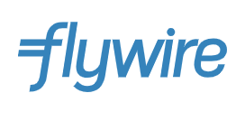
Presented by:

Slide 3
Who are we? USD
Luisa Serna
Associate Director, Student Financial Services
Luisa Serna supervises the Student Accounts operations focusing on customer service and outreach. She has worked for Higher Education for close to thirteen years. Prior to working at University of San Diego, she worked at UC San Diego oversighting the Student Business Services, Customer Service Center operations.

Slide 4
Who are we? USD
Nancy Doan
Director of Budget & Administration Student Academic Support Services
Nancy Doan works with UCSB Business & Financial Services and international student organizations to ensure international students are aware of campus approved payment systems, encouraging international students to utilize a safe and secure payment process to pay their bills.
Nancy also works with and supports the Assistant Vice Chancellor for Student Academic Support Services and the Student Academic Support Services eight cluster departments/units: Student Academic Support Services, Undocumented Student Services, International Students & Scholars, Student Affairs Academic Initiatives, Campus Learning Assistance Services, Disabled Students Program, Early Childhood Care & Education Services, and Educational Opportunity Program.

Slide 5
Who are we? USD
Erik Williams
International Student Programs Coordinator, International Students & Scholars
Erik Williams works with international students to ensure that students can navigate campus life, overcome challenges of a personal or cross-cultural nature. He develops programs and workshops to meet specific needs of international students with a focus on undergraduate degree students. He also addresses questions regarding maintaining F-1 or J-1 student status, including deferring or extending I-20/DS-2019 program dates, requests to drop below full-time enrollment, on-campus and off-campus employment, especially the OPT application process, reinstatement of immigration status following disciplinary action or leaves of absence.

Slide 6
Who are we? USD
Paul Boston
Relationship Manager, Flywire
Paul Boston has been a Relationship Manager for Flywire for two years. As a RM, Paul leads staff trainings, manages on-boarding processes, creates communication campaigns and more to ensure universities and students have the most effortless international payment experience possible.

Slide 7
Agenda
International student trends
Payment options & best practices
Fraud & Security
Student outreach and communication
Collection
Summary / Q&A

Slide 8
Why international payments matter...

Slide 9
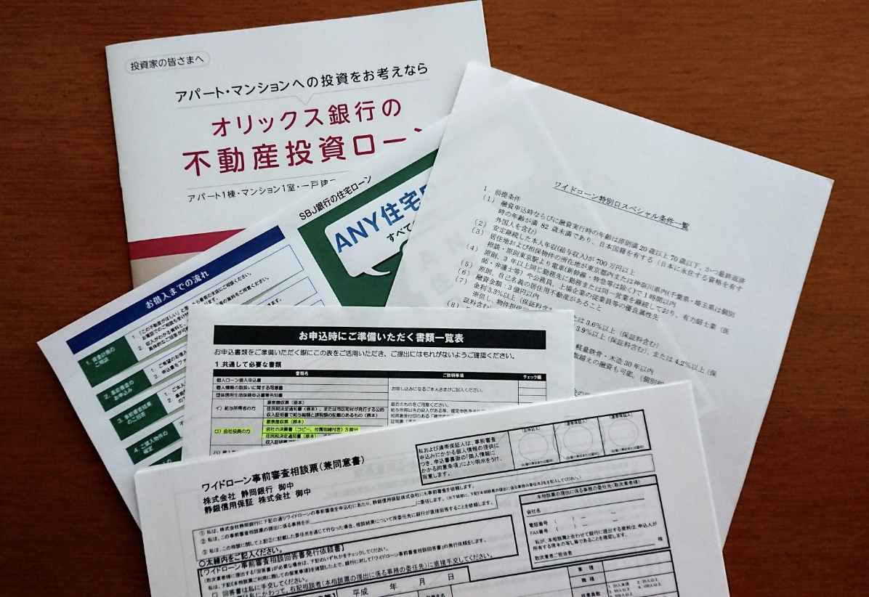
Why international payments matter...

Slide 10
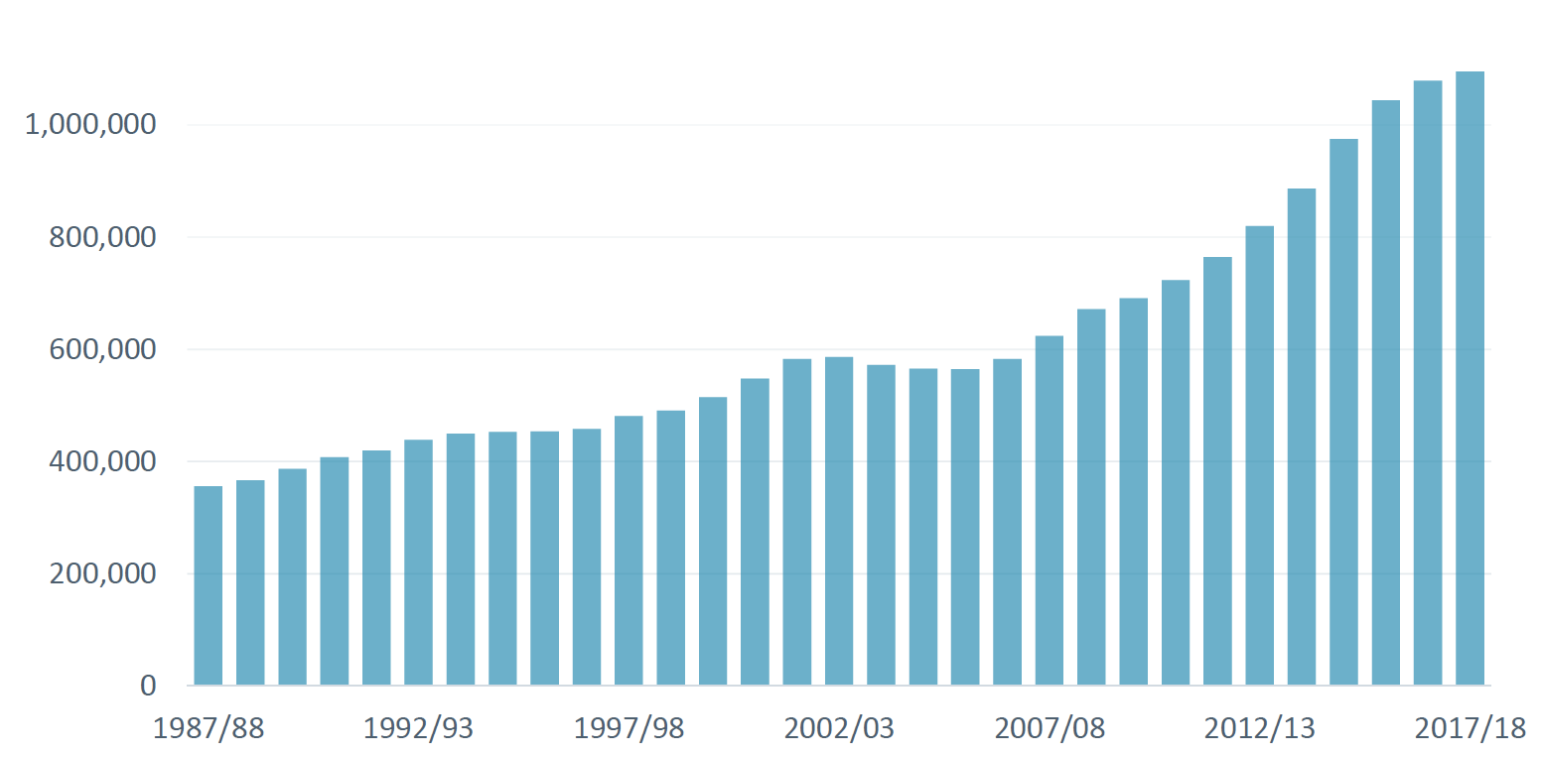
Why International payments matter…
- 1,094,072 International Students in the US in 2017/18, an increase of 1.5%
- International students make up 5.5% of all students in the US
Source: Open Doors

Slide 11
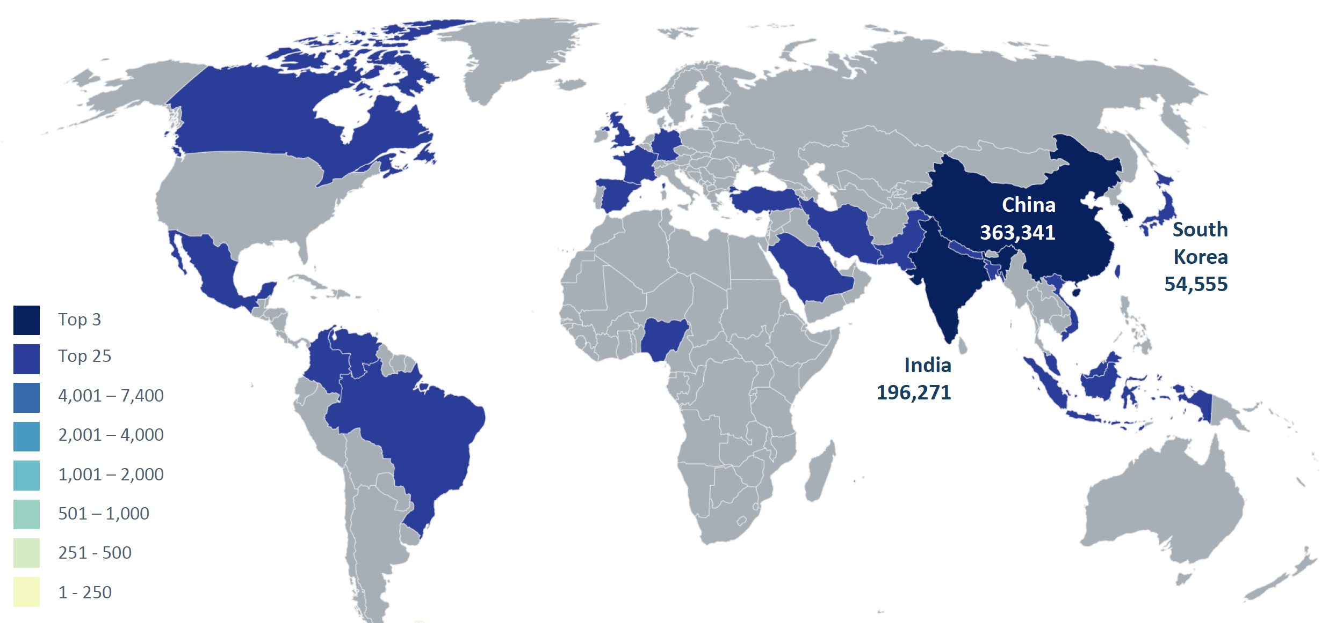
International student trends
Source: Open Doors

Slide 12
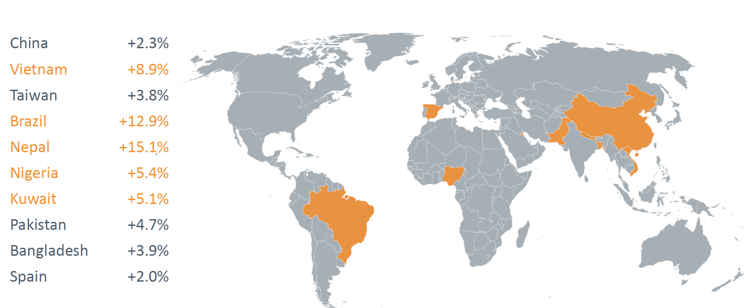
International student trends
Source: Open Doors

Slide 13
Who are we? USD
International Student Profiles
Total Enrollment:
International Enrollment:
Top Countries:
Total Enrollment:
International Enrollment:
Top Countries:
9,073
600 + from 73 countries
Saudi Arabia, Kuwait, China, Mexico, and Canada
21,574
3,678
China, Japan, India

Slide 14
Discuss: International Payments
How does your institution receive international payments?
What are challenges has your school had with receiving international payments?
Do you still receive many direct international wires? Do you make your banking info available online or otherwise?

Slide 15
Discuss: Fraud & Security
Has fraud occurred with your International population? What happened?
What steps do you take to prevent Fraud?
What other security measures are important for international students?

Slide 16
Discuss: International Payments
What were the important considerations when choosing an international payment provider?

Slide 17
International Payment Providers
Questions to consider when selecting a payment processor…
Do they facilitate easy payment reconciliation and refunds?
Do they charge consistent foreign exchange rates across all of their educational clients?
Do they offer dedicated customer service for education payments? Is this available it student families’ native language / time zone?
- Do they maintain dedicated accounts for educational payments?
Do they provide a clear, simple payment experience?

Slide 18
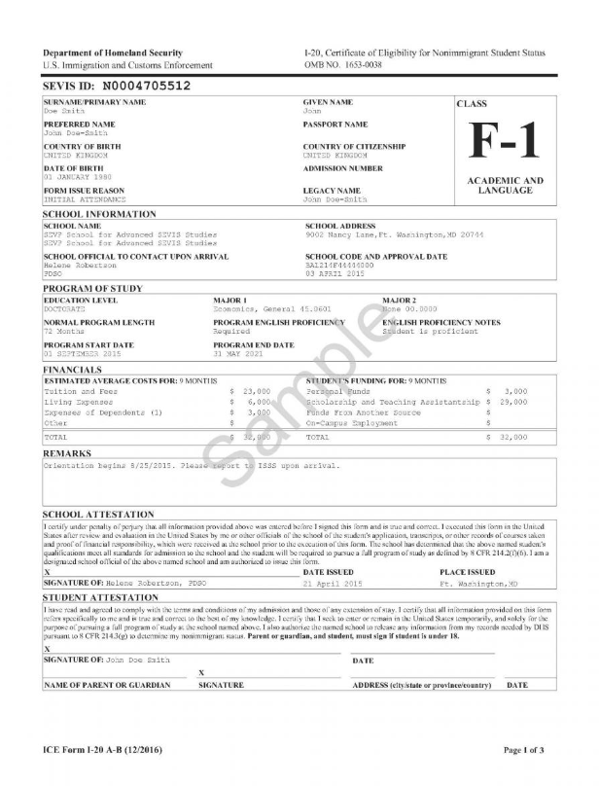
International Student Outreach

Slide 19
Discuss: International Student Outreach
What are best practices for international student outreach and guidance?
What communication campaigns do you have with students prior to arrival in the US?
What other methods (orientations, etc) do you have for educating students and parents?

Slide 20
Student Outreach Best Practices/Tips from USD:
Undergraduate Get Down to Business Webinar – Student Accounts representatives participate in the webinar and make sure payment options are provide it to incoming class, including International wire payment information.
Mandatory International Orientation: International Center has a mandatory session for first-year and transfer students cover topics including: maintaining your student immigration status, navigating the U.S. healthcare system, and important resources that can support your success at USD. Payment options is share including flywire marketing material.
International Parent Information Session: This event is for all parents of new incoming international students. USD’s International Center, Office of Parent Relations and Career Development Centers co-host this event and present key information and answer parent question. Payment options is share including flywire marketing material.
Mandatory International Law Student Immigration & Wellness Orientation: All incoming international Law students are expected to attend including LLM, JD and J-1 exchange Law students.
Additional Resources: Video tutorial: How to submit an International payment, MySanDiego portal, Student Accounts has an International Payment Channel. Student Accounts website has information on- How to Pay, International Payments. Student Accounts collaborates with the International Office and One Stop Center to make them knowledgeable of the International Wire payment process and Flywire marketing material.

Slide 21
Student Outreach Best Practices/Tips from UCSB:
Mandatory CALI Training (OISS Orientation) – All international students are required to attend OISS CALI Training http://oiss.sa.ucsb.edu/programs/cali-training
Payment Method & Security Tips outlined online: Including tips for staying away from scams & fraud: http://oiss.sa.ucsb.edu/student/paying-tuition-and-fees-at-ucsb
Email messaging & Student Guides: Over the past year we have been working with student organizations to update the guides they share with international students to ensure they are in compliant with international payment systems. The billing office also has included messaging in emails and statements about international payment options, in addition to maintaining the information on their website.

Slide 22
China Particularities
Student communications, CSSA’s, and managing unvetted 3rd-party payment providers
What you can do:
- Work with your CSSA. Provide messaging, support, etc.
- Consider having designated WeChat channel for your school
- Provide safety education for Chinese students/families to not sure sensitive info with anyone

Slide 23
China Particularities
Chinese student payments & document collection
- Chinese students required to submit supporting documentation with payment proving purpose of their payment
What you can do:
- Ensure students know how to access billing statements, tuition invoice, etc. for a seamless payment experience.

Slide 24
Other Countries of Note:
Sanctioned countries and territories:
Up-and-coming countries:
Ongoing Challenges:
Cuba
North Korea
- Iran
Sudan
Syria
Crimea Region
Nigeria
Brazil
Vietnam
Nepal
Venezuela
Nigeria
Zimbabwe

Slide 25
Discuss: Refunds
How does you send send international refunds?
What are best practices for refunding international students?

Slide 26
International Student Collection
How do you prevent international students from having overdue balances?
What is your process for collecting on international students?
What methods are effective for collecting from students with small balances remaining?

Slide 27
In Conclusion – what to consider:
- Communicate often, clearly and in advance to international students about approved, secure and convenient payment methods available to them.
Consider the risks and hassles of cash payments & international wires.
Work creatively with large/distinct international student populations (such as China & India) to have messaging that’s clear for them.
Keep the big pictures (support, reconciliation & refunds, security, etc) in mind when choosing an international payment provider.

Slide 28
Extra tips by USD…
International Payments are submitted consistent with regular patterns of billing activity.
Treasury Department has direct access to Flywire dashboard to helps identify the student account where the money should be posted.
MySanDiego Portal displays a flywire link to admitted students without a US bank account to make a deposit.
I-9 package includes instructions on how to make a deposit using flywire.
Flywire Refund of Payments: Eliminate transactions and activities that may indicate potential money laundering. Wire transfers with no apparent business reason will be refund via flywire to original wire account.
Issuing refunds of students’ overpayments via flywire has reduce the amount of unclaimed funds in the Unclaimed Property report for USD.

