Slide 1
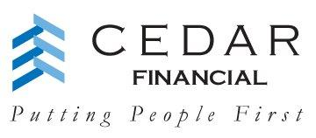

Managing the Complexities of Collecting from International Students
The first step to solving your
international debt recovery needs.
Notes:
CHAT

Slide 2
AGENDA
Rise in International Students
Understanding the International Student
Challenges & Risks
Questions and Answers
Notes:
Main Points
Introduce each subject without going into too much detail
Set the rules/guidelines for questions and discussion

Slide 3
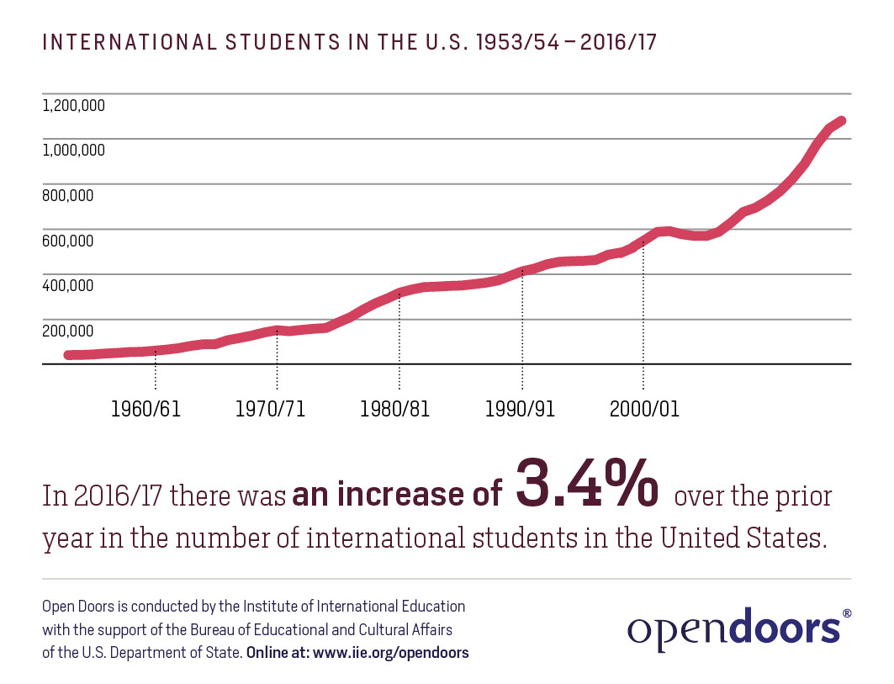
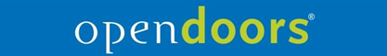
Rise in International Students
Enrollment
Notes:
FED AGENCY…INTERNATIONAL INSTITUTE OF EDUCATION, AKA OPEN DOORS
The results of the following information was provided by Open Doors. They conducted an annual survey of U.S. Campuses’ international student enrollments.
Those ( 380 who responded) are accredited higher education institutions that host international students.
Enrollment 2012/13 academic year.
Non-immigrant international students in the U.S. on temporary visas at the postsecondary level.
55k more enrollees this year over last

Slide 4
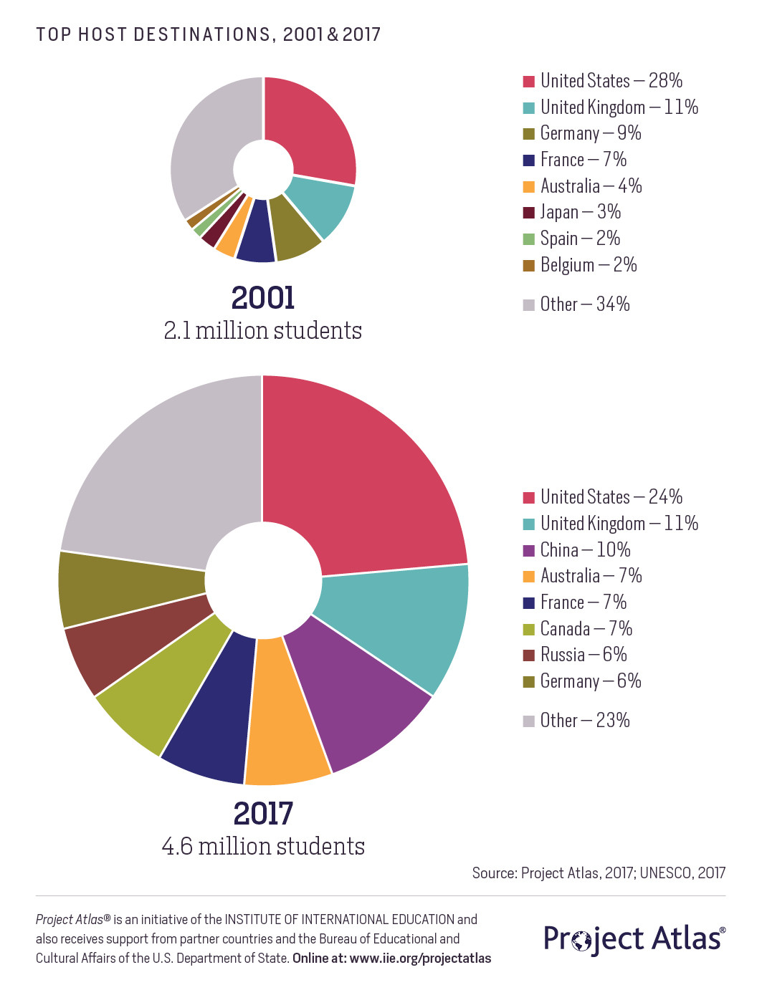
Rise in International Students
Enrollment
Notes:
FED AGENCY…INTERNATIONAL INSTITUTE OF EDUCATION, AKA OPEN DOORS
The results of the following information was provided by Open Doors. They conducted an annual survey of U.S. Campuses’ international student enrollments.
Those ( 380 who responded) are accredited higher education institutions that host international students.
Enrollment 2012/13 academic year.
Non-immigrant international students in the U.S. on temporary visas at the postsecondary level.
55k more enrollees this year over last

Slide 5
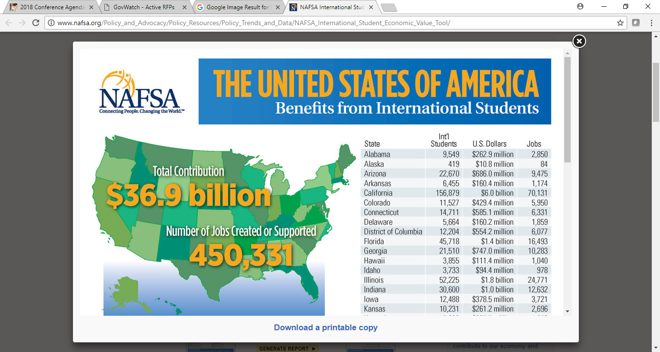

Rise in International Students
Cedar Financial
TCM USA
Notes:
We understand where and how international students get their source of funds.
The 64% of funds that come from personal and family funds are often gone uncollected by 3rd party billers as they do not know the culture (i.e. India).
Must show bank statements, etc – where funds are coming from.
International house – needs to be cooperative with regards to furnishing info to finance dept for collections.
The institutional part showing 20% is on a need to grow basis, but the risk factor does not have a viable safety net solution for intl students.
SOURCE AND FAMILY – makes sense to work with an agency like ours – students – stay –some return-
We work the source of the local funding at home (family or embassy) as well as here in the states.
RAY
Also add alternative funding most need U.S. Co-signer – Peer to peer – credit unions –
Major lenders are drying up – Sallie Mae – Discover and Wells…
Limited funding – institution – can fund…. Often U.S. students deal with Social Pressures…
New slide - alternative
Major lenders – scaled back
Alternatives – Alumni Funding
Credit Union Guarantee
Graduate High quality global journalism requires investment. Please share this article with others using the link below, do not cut & paste the article. See our Ts&Cs and Copyright Policy for more detail. Email ftsales.support@ft.com to buy additional rights. http://www.ft.com/cms/s/2/c39906f6-a035-11e2-a6e1-00144feabdc0.html#ixzz2SdONKn4r
the Graduate Management Admission Council facilitated the creation of the Affiliated Loan Programme for Students, or Alps, which has made about $600m in loans funded by Deutsche Bank and guaranteed by schools.

Slide 6
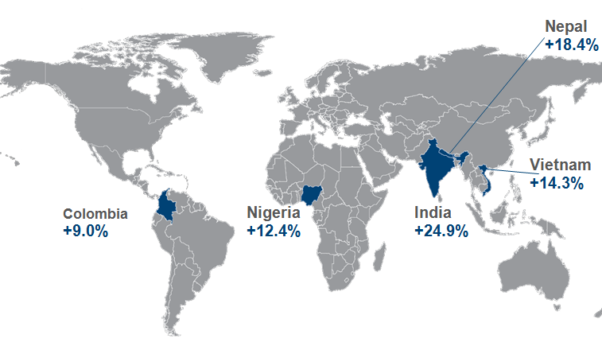
Rise in International Students
Where is the growth coming from?
Notes:
Growth from Kuwait + 37% Saudi Araibia +31% China + 21% Brazil + 20%
Iran+ 25%
Also Increased in numbers from Colombia, France, Germany, Indonesia, Malaysia, Mexico, Nigeria, Spain, the United Kingdom, and Vietnam

Slide 7
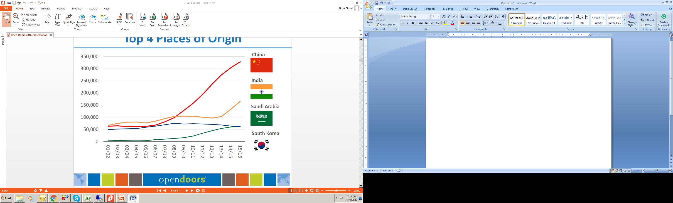
Rise in International Students
Top Sending Countries to USA

Slide 8
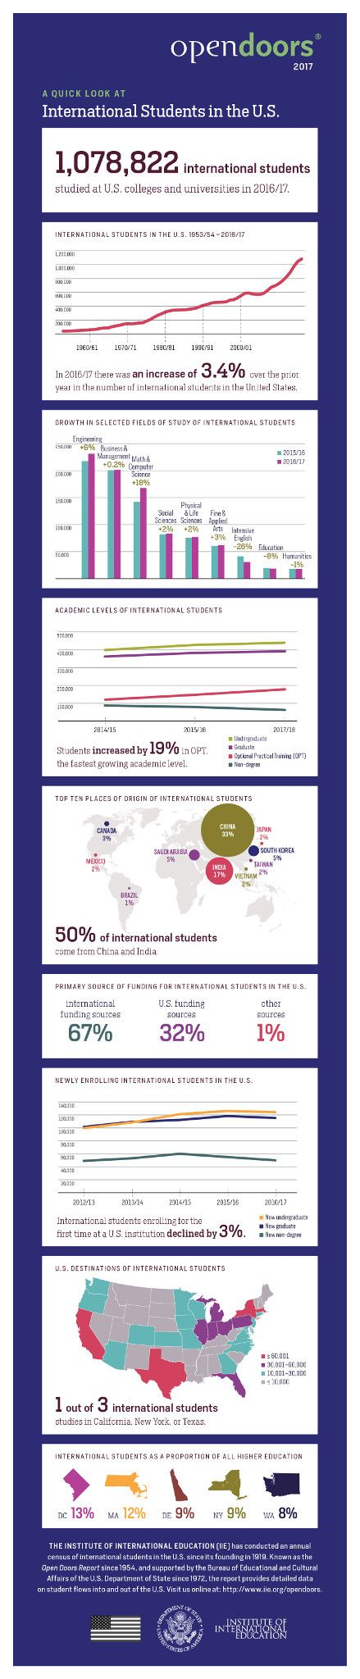
Understanding the International Students
Notes:
Top increased – CA, NY, TX, MA and IL. Among the top 10 include PA and IN.

Slide 9
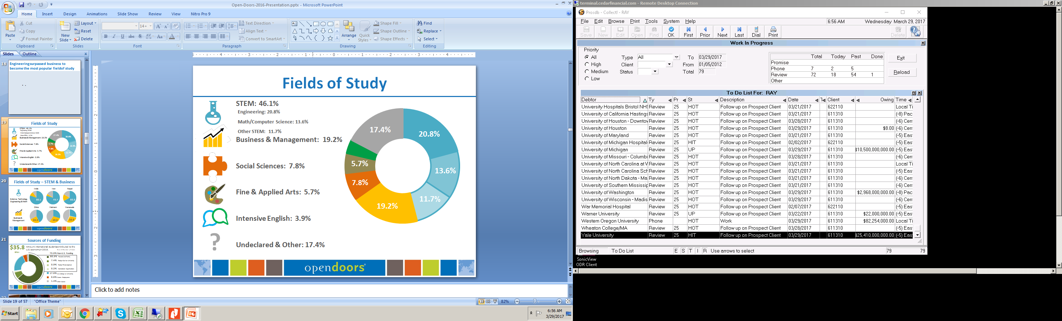
Understanding the International Students
Notes:
The top 4 fields of study clearly place many students into a lucrative field of specialty. Business & Management/Engineering Math and Computer
We are seeing a large influx international students with high end careers in their home countries.
Business Management –
STEM (science- technology – engineering and mgmt ) more stable fields
education in high end careers

Slide 10
Understanding the International Student
Life Cycle of International Student
Returning
Home
F1
J1
Graduate
International Student
Stay in US
H1B
STEM
STAY IN U.S.
TO WORK*
Return home
prior to graduation
*Permanent
Resident Alien or Dual Citizenship
Notes:
You must have a student visa to study in the United States. Your course of study and the type of school you plan to attend determine whether you need an F-1 *academic visa or an M-1 *vocational visa.
F1 – ‘Foreign Students’ nonimmigrant's admitted temp to pursue full time academics
US Embassy must ensure that the student can live in the US and pay his own tuition w/o working.
FORM I-20
The uncollected student accounts with a H1B status, Dual Citizen status, Perm Res status are often back in their country of origin.
J1 Visa – allows the student to work & study

Slide 11
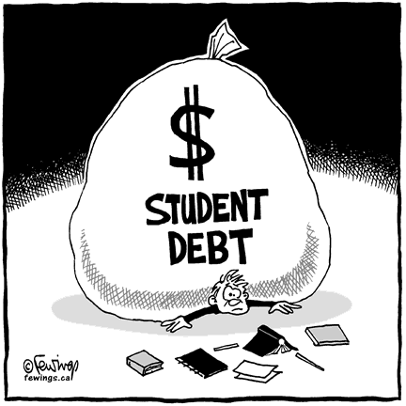
Understanding the International Student
Default Rates on the Rise
Student Loan Default Rates Rise for Sixth Year - US News
New data show more than 600,000 borrowers have defaulted on their loans in the last few years
Student-Loan Default Rates Continue Steady Climb –
The Chronicle of Higher Education
More Than Half Of Student Loans Are Now In Deferral Or Delinquent –
Forbes.com
Notes:
Steady increase in defaults since 2005
Student loan debt 13.4% - is over $1 Trillion, overtaking credit card debt
DEFAULT IS 10%
Tho’ there are no numbers available for the Int’l Student accts/loans, our clients w/international accounts/loans - share defaults are growing as well.
This is AND will become an ongoing AND growing problem for universities with international students
Reasons – non-pymt
no longer here – hardships at home – low currencies

Slide 12
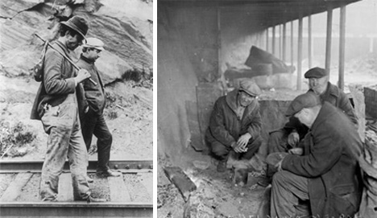
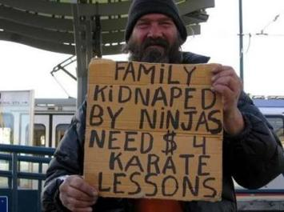
Understanding the International Student
Transient
Notes:
The Northwestern Flipside a Student Group at Northwestern.

Slide 13



Understanding the International Student
Transient

Slide 14

Challenges and Risks
LANGUAGE
Current Model Solutions
TIME ZONES
U.S. Agency vs. International Agency
U.S. agency not licensed outside of the U.S. puts both the agency, as well as the school, at risk.
LAWS
COMPLIANCE
REGULATIONS
CULTURE
Notes:
Universities still place the international student accounts in the same portfolio with their domestic student population to traditional agencies.
There is a proper and thorough way to segment the intl population (i.e.: perm res, H1B’s, F1’s, Dual Citz’s, coll notes)
Traditional agencies do not know how to deal with diff cultures, practices
Time barriers – It’s 3AM in Chennai, India right now!
COMPLIANCE …. Avoid negative PR to your univ
Maintaining FDCPA compliance here WHILE maintaining compliance overseas.

Slide 15
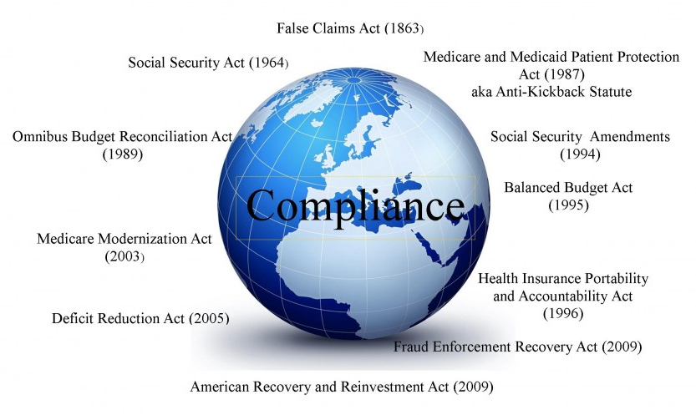
Challenges and Risks
Notes:
Universities still place the international student accounts in the same portfolio with their domestic student population to traditional agencies.
There is a proper and thorough way to segment the intl population (i.e.: perm res, H1B’s, F1’s, Dual Citz’s, coll notes)
Traditional agencies do not know how to deal with diff cultures, practices
Time barriers – It’s 3AM in Chennai, India right now!
COMPLIANCE …. Avoid negative PR to your univ
Maintaining FDCPA compliance here WHILE maintaining compliance overseas.

Slide 16

Challenges and Risks
Compliance
CANADA
“A common misconception in the U.S. is that accounts located in Canada are not international accounts.”
Provincial laws with respect to engaging an agency not licensed in Ontario are very clear…
Other provincial laws require agencies to have an office
within the providence.
Penalties up to $250,000
Notes:
R.S.O. 1990, CHAPTER C.14
Use of unregistered collection agency
24. (1) No person shall knowingly engage or use the services of a collection agency that is not registered under this Act. R.S.O. 1990, c. C.14, s. 24 (1).
28. (1) Every person who, knowingly,
(a) furnishes false information in any application under this Act or in any statement or return required to be furnished under this Act or the regulations;
(b) fails to comply with any order, direction or other requirement made under this Act; or
(c) contravenes this Act or the regulations,
and every director or officer of a corporation who knowingly concurs in such furnishing, failure or contravention is guilty of an offence and on conviction is liable to a fine of not more than $50,000 or to imprisonment for a term of not more than two years less one day, or to both. R.S.O. 1990, c. C.14, s. 28 (1); 2004, c. 19, s. 6 (2).
Corporations
(2) Where a corporation is convicted of an offence under subsection (1), the maximum penalty that may be imposed upon the corporation is $250,000 and not as provided therein. R.S.O. 1990, c. C.14, s. 28 (2); 2004, c. 19, s

Slide 17
International Collections
Why Do Students Fail to Pay
  Lack of understanding
  Communications breakdowns/failures
  Financial difficulties (Is the money seasoned to qualify for a Visa?)
  Institutional issues/problems
  Fee on Fee

Slide 18
International Collections – Lack of Understanding
What are expectations for making payments?
    When?
    Where?
    How?
Who’s Involved?
  Students
  Parents
  Third parties
    Governments
    Relatives
    Sponsors

Slide 19
International Collections – Lack of Understanding
Lack of coordination among offices
  Bursar/Student Accounts
  International Services (ISO)
  Registrar
  Student Affairs

Slide 20


Solutions
Communication
  International Student Office (ISO)
Copy of Passport / Visa
I-20 Form & SEVIS Form
Declaration and Certification of Finances
FERPA (Bursars Office has the right to see these documents)
  RFP’s & Working With Procurement
    By-Pass?
    Threshold?
    Special RFP?
    Current RFP Verbiage Containing Intl?

Slide 21
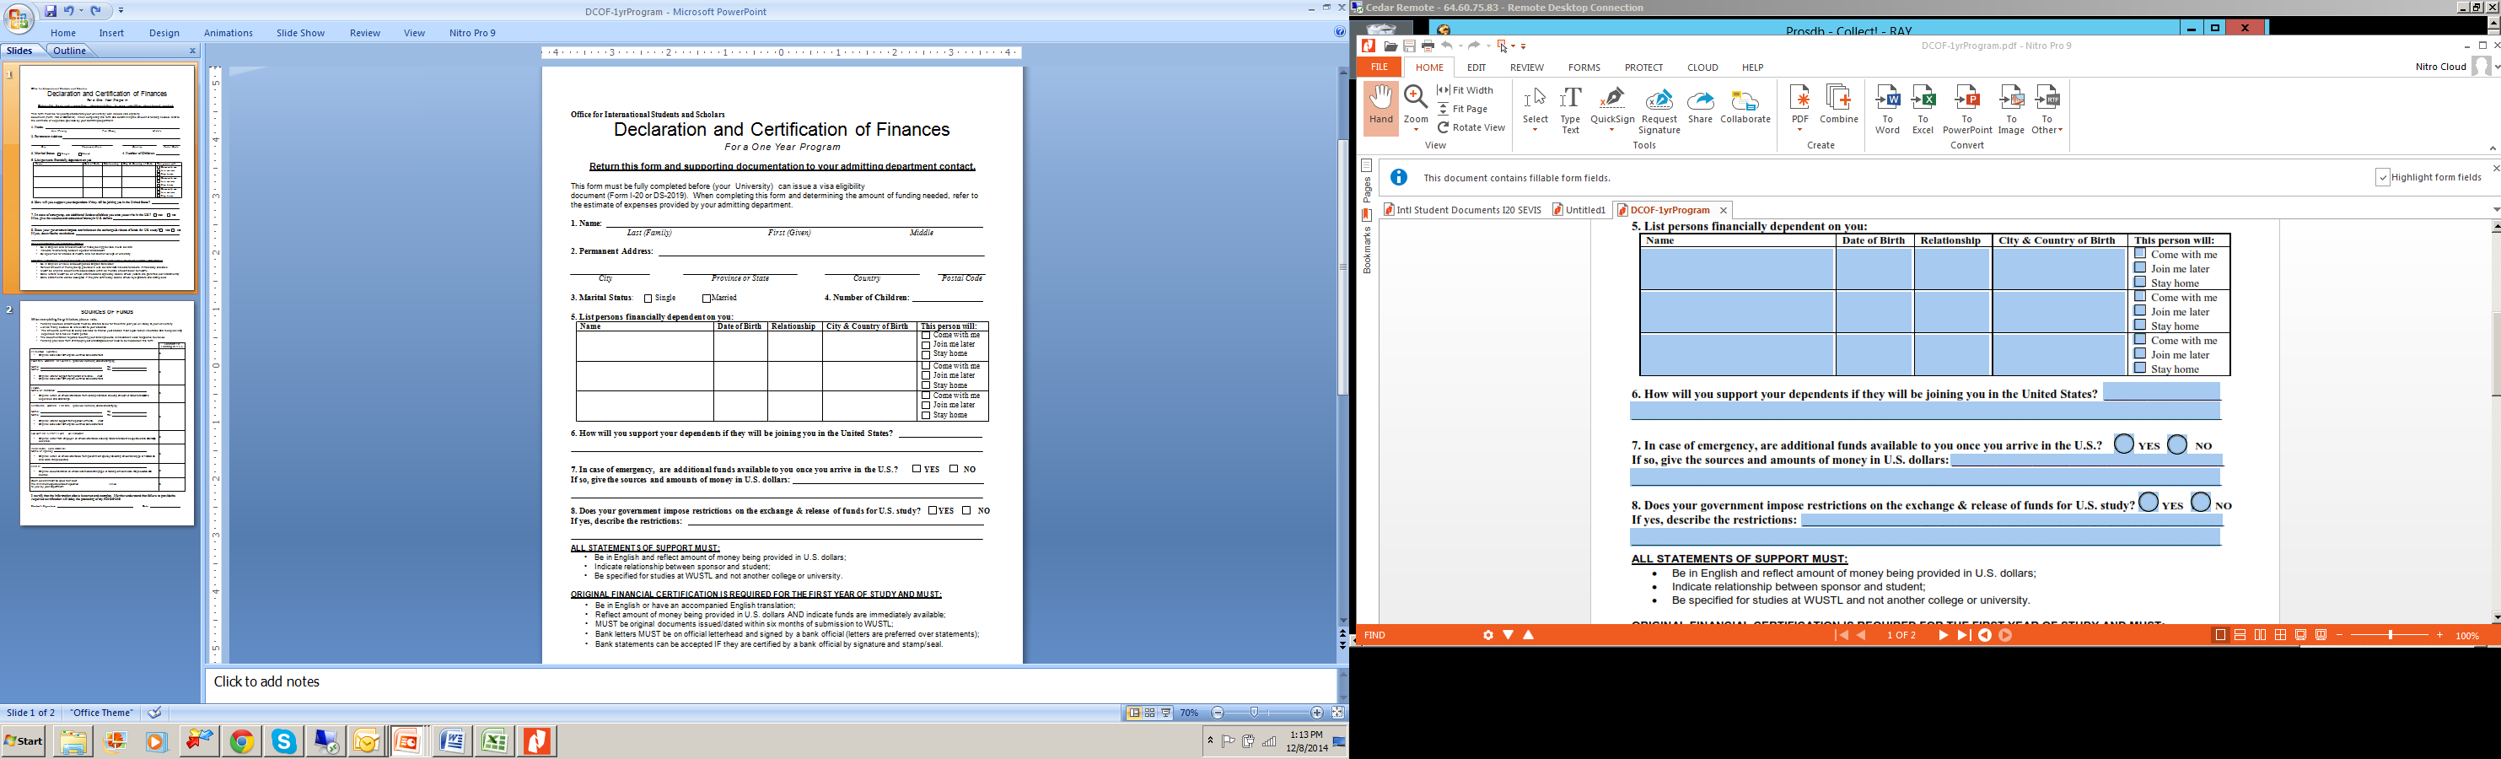
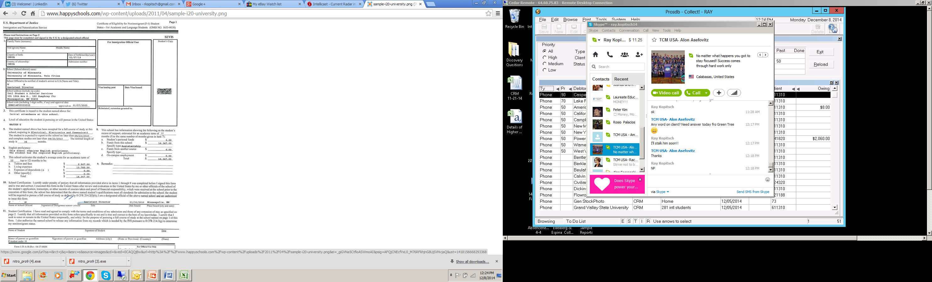
Solutions

Slide 22
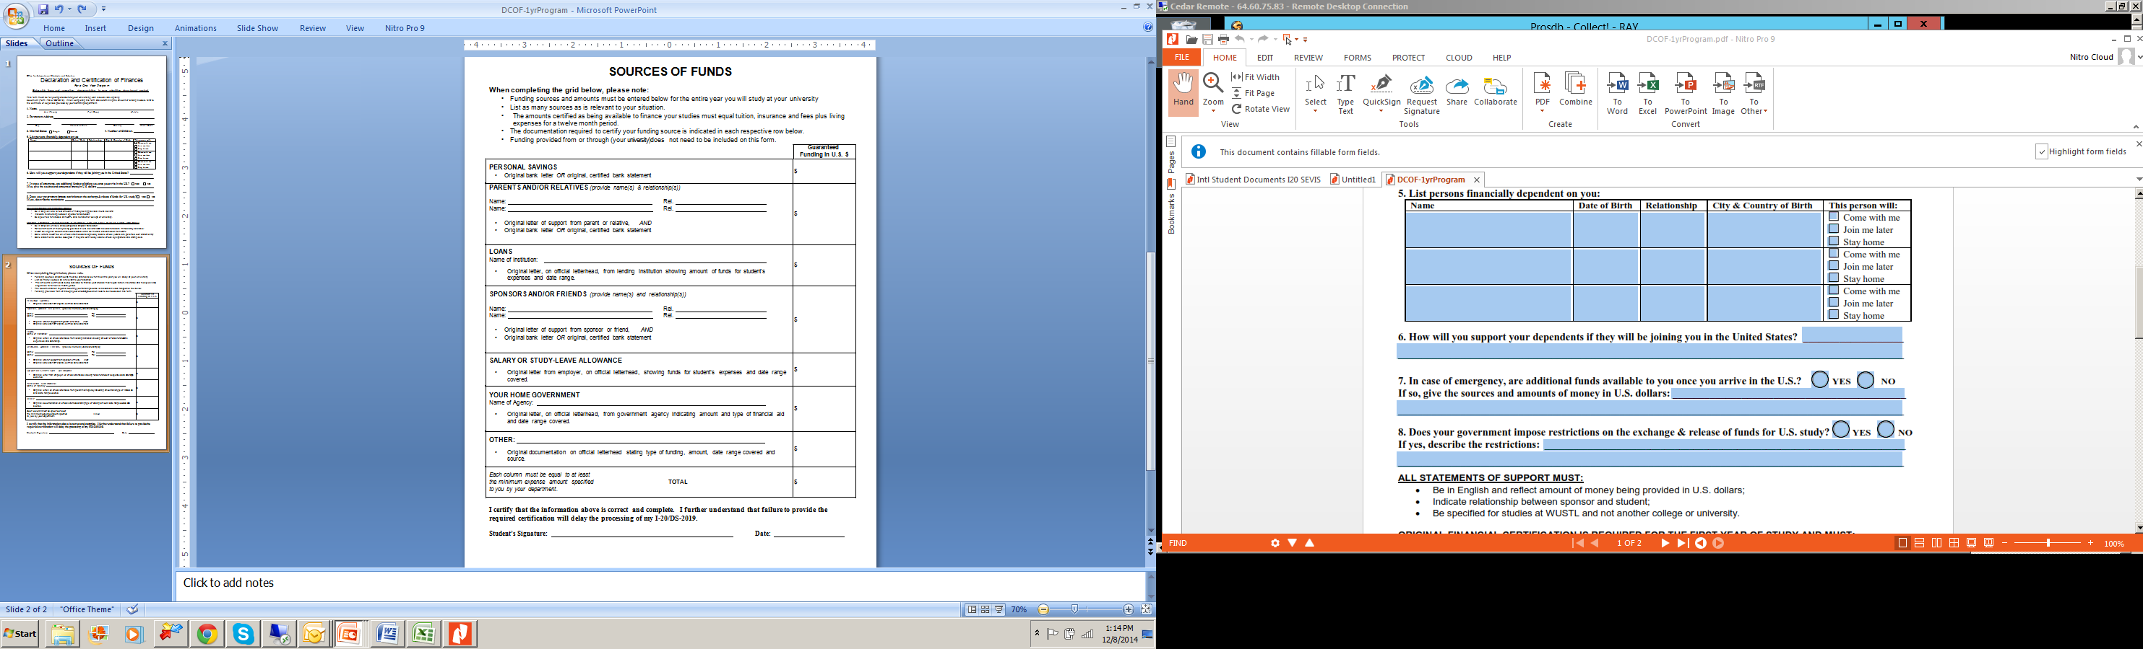
Solutions

Slide 23

Solutions
Be Proactive
Student Intake:
Ask for more points of contact with complete information (Immediate Family, Relatives, Friends )
Seasoned Funds
Copy of Passport / Visa
Re-enforce the understanding that if it does go to a third party that the debt can be domesticated in their country.
I-20 Form & SEVIS Form

Slide 24
Solutions
Be Proactive
Student Intake:
Give Students more payment options
  Online payments
  Partner with a transfer company that specialize in intl. payments
Bonus’s for staff
Statements in the correct language
Reporting to Credit Bureaus abroad when possible
Notes:
Payment Options 80% plus of Americans were paying bills online and that travel are going to be that much more technically inclined to use high tech payment options as well as transfer co. that specialize in international payments
Bonus’s For instance, say each collector at your practice brings in $2,000 in unpaid expenses each month on average. If you offer staff members a $100 gift card…..you can be very creative and if some employees don’t, there’s no harm done.
Billing in the correct language: Because of a smaller portfolio Simple solution….use Google translate. Not only that they can understand the statement it shows that your taking time to connect with a personal touch.
Reporting to credit: When possible and your Standard set policy states to report the delinquency. This will be a real mixed bag from Western Europe (similar to the US) to Black list systems, and having to pay higher prices to report and all will be from country to country.
Google Translate plans to take on Skype with real-time translation feature

Slide 25
Work the Plan
Identify
the
need
Be
Pro-active
International
Students
BE
INFORMED
Create a
solution
Notes:
If your school currently has international students:
Identify your need – How many – write off’s? skips?
Be ProActive – get ahead of what could become a problem
Create a solution – internal? – trust a professional - outsource?
Be informed – know your agency – how do they handle the int’l accts??
Work the Plan – Let your agency do the work! The RIGHT WAY!

Slide 26


Ray Kopitsch
Cedar Financial
rkopitsch@cedarfinancial.com
Office: 818-936-6211
Cell: 906-440-0178
Notes:
QUESTIONS…. Answers…
Thank you – Thank

