Slide 1
Hot Topics in the Collection Industry & The Evolution of Student Agreements May 15, 2015
Chad V. Echols
chad.echols@theecholsfirm.com
The Echols Firm, LLC, Owner
Williams & Fudge, Inc., Outside General Counsel

Slide 2
Disclaimer
This presentation should be construed as an overview of the issues discussed. The presentation is not legal advice to anyone attending this presentation or reading the accompanying handout. Specific legal questions regarding the concepts and their application to any institution of higher education should be directed to the institution’s legal counsel.

Slide 3
Lawyers, and Regulators, and Congress… OH MY!

Slide 4
Hot Topics:
The current legal status of the collection industry;
TCPA;
CFPB;
FDCPA litigation and trends;
Recent cases on point; and
SOL (higher education needs to pay attention).

Slide 5
TCPA
The Telephone Consumer Protection Act, 47 U.S.C. § 227, et seq.;
1991 – think about cell phones in 1991;
First & third party liability; and
Significant penalties.
Remember – manually dialing a cellular telephone is okay!

Slide 6
TCPA
Per violation liability;
No class cap;
Defense strategies:
Land-line;
Definition of dialer;
Legislative fix;
Scrubbing;
Motion to Stay (pending FCC);
Etc..
Insurance issues;
CONSENT – your help (we will discuss language in the next presentation)

Slide 7
FDCPA vs. TCPA
The FDCPA may equal death by a thousand cuts!
While the TCPA may =

Slide 8
Collection Industry Litigation Statistics dev.webrecon.com/debt-collection-litigation-cfpb-complaint-statistics-december-2014-and-year-in-review/

Slide 9
FDCPA
Fair Debt Collection Practices Act, 15 U.S.C. § 1692, et seq.
Foti cases – the problem with voicemails;
Call volume litigation;
McMahon/Delgado;
Douglass v. Convergent;
Etc…

Slide 10
FDCPA
http://www.denverpost.com/fdcp?unique=1301323052004
This article about a consumer attorney in Colorado does a great job of bringing some light to the difficult situation that agencies face in the current litigation environment.

Slide 11
FDCPA
Round peg in a square hole – how does legislation from 1978 address the issues of technology in 2011?
Cell phones;
Smart phones;
Email;
Apps;
Voice mail;
Texting;
Etc….

Slide 12
McMahon/Delgado

Slide 13
Douglass v. Convergent

Slide 14
CFPB
The Consumer Financial Protection Bureau;
www.consumerfinance.gov;
The Dodd-Frank Wall Street Reform and Consumer Protection Act of 2010 established the CFPB.
The CFPB has some very unique structural and funding aspects that are concerning to the collection industry and others.

Slide 15
CFPB
Prior to the CFPB, the FTC oversaw the FDCPA and did not have the authority to promulgate rules and regulations interpreting and implementing the FDCPA. The CFPB has rule making authority and will therefore have a major impact on the FDCPA going forward.
There were a series of articles in the Wall Street Journal when the CFPB was being formed that articulated many of the industry’s concerns with the oversight and funding of the CFPB.

Slide 16
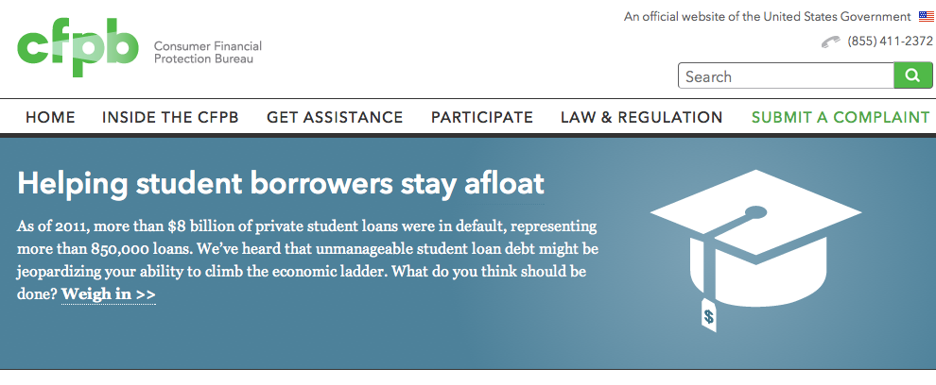
CFPB

Slide 17
CFPB http://files.consumerfinance.gov/f/201410_cfpb_report_annual-report-of-the-student-loan-ombudsman.pdf

Slide 18
Other state specific issues
North Carolina, for example, has a bi-furcated collection statutory structure. One portion of North Carolina’s law is specifically drafted to govern the actions of entities defined as “collection agencies”, but the other portion of the statute (which was recently changed in ways that should be important to creditors) contains very specific collection prohibitions which apply to creditors (schools would, based upon my reading of the statute, be governed by this statute). See N.C. Gen. Stat. § 75-50, et seq.

Slide 19
The web presence of the consumer bar
One issue that is driving the massive increase in consumer litigation against the industry is the savvy and growing online marketing efforts of the consumer bar. In the process of drafting the previous slide I went to the web to be certain my citation to North Carolina law would be accurate. I searched “North Carolina Debt Collection Statute” and the very first hit was the following website: http://www.northcarolinadebtcollectionact.com/
The address appears very plain, but this is a site developed by Weisberg & Meyers who are a national consumer law firm that are committed to suing debt collection agencies. I have personally defended numerous lawsuits filed by this firm.

Slide 20
Assessing Collection Fees
It is critical that institutions of higher education understand their role as a “lender”, and how that role requires a proper contractual relationship between the institution and the student. Also, schools should be aware of state laws that impact the assessment of fees.

Slide 21
Collection Cost Terms
Collection Costs – The mutually agreed upon contract amount that the institution pays the collection agency for collecting accounts on the school’s behalf.
Institutionally Assessed Fees – The amount charged to a student subject to an agreement between the student and the school or the amount permitted by law (i.e. the Higher Education Act and Perkins Regulations).

Slide 22
What are some common misconceptions??
Collection costs = the amount the student pays the agency;
The federal regulations allow for collection costs on Perkins loans so it is okay to set up institutional debt the same way;
Agreements have to be promissory notes;
Notifying the student in collection letters that a fee will be added if the account is sent to an agency is sufficient;
BPCC applies to institutional debt; and
There is a “right”to be “made whole”on institutional debt.

Slide 23
Collection Fee Compliance
The Fair Debt Collection Practices Act states that it is a violation to collect any amount that is not “expressly authorized by the agreement creating the debt or permitted by law.” See 15 U.S.C. 1692f.
Further, state consumer protection statutes and unfair trade practices statutes may implicate creditors (schools) that are not compliant with state requirements regarding the addition of student paid fees.
Agencies and Schools demand compliance in the contracts that govern the relationship.

Slide 24
Examples of “permitted by law”
The Higher Education Act creating the Perkins Loan program and the regulations promulgated pursuant to the act specifically provide that the student be responsible for the fees associated with the collection of his/her defaulted loan. See 20 USC §§ 1087aa et seq. (1998) and 52 Fed. Reg. 45552(1987).
Hawaii – the law initially has some prohibitions on fees, but states in HI Code § 443B-9(b) that the prohibition section “shall not prohibit a collection agency from collecting, or attempting to collect, from a debtor, a commission authorized under a contract with the University of Hawaii.”
West Virginia – specifically allows for the addition of student paid costs on educational loans and states those costs may not exceed 33.3% of the amount due and owing – See W.V. Code § 46A-2-128 – the AG has made clear that “education loans” do NOT include general tuition receivables.

Slide 25
Student Agreement FAQs????
Does a handbook count?
What should it say?
Do electronic signatures count?
Can the agreement be in writing and not be a contract?
How should we proceed to get compliant?

Slide 26
Bradley v. Franklin Collection Service, Inc.
The opinion in the Bradley case was issued by the 11th Circuit Court of Appeals in January of 2014.
The only federal court higher than a federal appellate court is the U.S. Supreme Court.

Slide 27
Bradley

Slide 28
Bradley Issues
The core of the Bradley opinion is about contract language.
The case involved the collection of medical accounts, but the contract issues in the case apply to tuition, institutional loans, and other receivables owed to colleges and universities.
It would be a mistake to assert that Bradley is not applicable to your institution because the debt originated as a medical account. The medical/education issue is a distinction without a difference. The issue is contract law.

Slide 29
Contract Language
The contract language discussed in the Bradley case was as follows:
“costs of collection” (ruled problematic);
“reasonable collection agency fees” (not specifically addressed because the applicable plaintiff did not appeal the issue); and
“[y]ou agree to reimburse us the fees of any collection agency, which may be based on a percentage at a maximum of 33% of the debt, and all costs and expenses, including reasonable attorney’s fees, we incur in such collection efforts.” (court suggests this may be appropriate) (terms were highlighted for emphasis)

Slide 30
Fees vs. Costs
The common use of the term “collection costs” along with the term “attorney’s fees” creates a contractual distinction on the face of the document.
If the intent in both circumstances is to assess a “fee,” then the term should be used in both places.

Slide 31
Increased Creditor Litigation
I am beginning to see creditors included in traditional consumer litigation that was once reserved only for agencies. This is an important trend. The inclusion of the creditor is most often the result of state statutes that can create creditor liability. There are contracting issues that should be considered regarding this issue.

Slide 32
THE EVOLUTION OF STUDENT AGREEMENTS

Slide 33
Topics for Discussion
The student agreement;
TCPA;
Collection fees;
Venue selection;
Choice of law provision;
TILA issues;
Electronic signatures;
Change of information clause; and
Arbitration (pros/cons).
Proof of Claim;
Bankruptcy language in student agreements

Slide 34
Institutional Leverage
Binding contract language is increasingly important. Additionally, the ever-rising use of on-line registration should make it much easier for schools to craft and implement better contract language.
Often people discuss the student agreement with me as if the agreement is similar to an adhesion contract. It is not.

Slide 35
A Strong Student Agreement
The weakest position a school can be in with their students is a student relationship that ends with a tuition account receivable based solely upon the student’s attendance or lack thereof.
“A verbal contract isn't worth the paper it is written on.” -Sam Goldwyn

Slide 36
The current view of higher education & debt

Slide 37
Scary Statistics and Trends www.motherjones.com/politics/2013/05/student-loan-interest-rate-plan-obama-republican-warren

Slide 38
Telephone Consumer Protection Act
There is nothing that we will discuss today that can assist your partnering collection agencies and your institution more than obtaining the consent from your students to be contacted on their cellular telephone by automated dialing devices governed by the Telephone Consumer Protection Act (“TCPA”).

Slide 39
Telephone Consumer Protection Act
The Department of Education understands the necessity of this consent and includes language in its Perkins loan master promissory note that attempts to obtain the necessary consent.

Slide 40
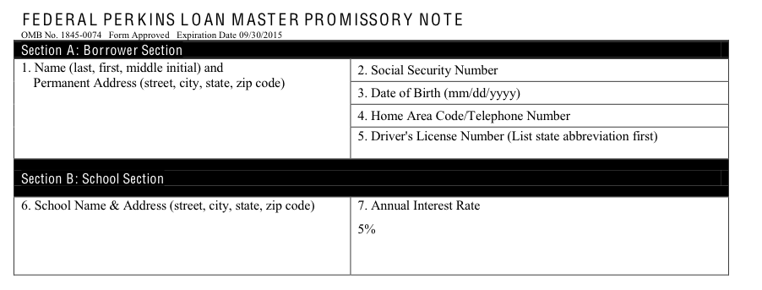
Telephone Consumer Protection Act

Slide 41
DOE - MPN
“I authorize the school, the Department, and their respective agents and contractors to contact me regarding my loan request or my loan(s), including repayment of my loan(s), at the current or any future number that I provide for my cellular number or other wireless device using automated telephone dialing equipment or artificial or pre-recorded voice or text messages.” – This MPN is set to expire on 9/30/2015.

Slide 42
Meyer v. Portfolio Recovery Assoc. (Oct. 2012)

Slide 43
Meyer v. Portfolio Recovery Assoc. (Dec. 2012)

Slide 44
TCPA

Slide 45
TCPA problems are expensive!

Slide 46
The Assessment of Collection Fees
If a reasonable contingency fee is allowed, then I suggest language similar to:
“I understand and agree that if I default on my obligation to ABC University, then my account(s), loan(s), and/or any amounts due to the school may be placed with a collection agency, and that I am responsible for the fees (collection fees and/or attorney’s fees) associated with any collection effort. Fees resulting from a default will not exceed X% of my outstanding obligation to the school.”

Slide 47
The Assessment of Collection Fees
There have been individual and class action cases advanced against the collection industry on this issue.
Based upon the current view of student debt, any amount above the principal obligation should be expressly allowed by the contract between the school/student and appropriate pursuant to any applicable law (i.e. – collection fees/late fees/interest/attorney’s fees/etc…).

Slide 48
The Assessment of Collection Fees
Liquidated Damages Clause – The contractual provision that determines in advance the measure of damages if a party breaches the agreement.
Liquidated Damages Clause cannot = a penalty.
This slide is included for states like California.

Slide 49
Venue/Forum Selection Clause
The FDCPA limits debt collection entities when they bring suit on an account to the location where the consumer signed the contract sued upon or the location where the consumer resides at the commencement of the action. 15 U.S.C. § 1692i(a)(2).
While there may be other applicable limitations, this FDCPA limitation does not apply to creditors.

Slide 50
Venue/Forum Selection Clause
My suggestion is to use language that allows for an action to be brought in a specific venue without excluding other venue options. This can generally be accomplished by using the word “may” rather than “shall” or “will”.
Courts may be resistant to an exclusive venue provision when one party to the litigation is a recent student.

Slide 51
Venue/Forum Selection Clause
I understand and agree that any legal action brought to enforce the terms of this agreement and/or any other legal action involving the parties to this agreement may be brought in (the applicable court) in (the applicable county) in (the applicable state). I hereby unconditionally consent to the aforementioned forum for the above-described purposes.

Slide 52
Venue/Forum Selection Clause
This type of clause allows the institution to implement a much more efficient litigation strategy, and it often provides the institution with a more friendly forum to litigate these matters.

Slide 53
Choice of Law Provision
Often, this is a simple provision that states the agreement will be governed by laws of the state of X. I would caution a school in using such a provision if the laws of that school’s state are not favorable (see S.C. re: garnishment for example).
Also, there are important statute of limitation considerations with this type of provision.

Slide 54
The Truth in Lending Act (TILA)
We would need a significant amount of time to cover the implications of TILA when creating student agreements. It is critical that any agreement whereby the school is attempting to create a loan be reviewed for compliance with TILA and specifically TILA’s disclosure requirements.
TILA is meant to provide consumers certain disclosures at the time a consumer enters certain loan or consumer credit agreement.

Slide 55
The Truth in Lending Act (TILA)
Indiana’s website contains user friendly TILA disclosure examples. See http://www.in.gov/dfi/2583.htm
The exceptions for private education loans can be found at 12 C.F.R. § 226.3(b)(1)(i)(B) and 12 C.F.R. § 226.46(b)(5).

Slide 56
The Truth in Lending Act (TILA)
Link regarding private student loans:
http://www.law.cornell.edu/cfr/text/12/226/3
This link also contains a link following the term private education loan to § 226.46(b)(5).

Slide 57
Electronic Signatures
The E-Sign Act
The Uniform Electronic Transaction Act (UETA)

Slide 58
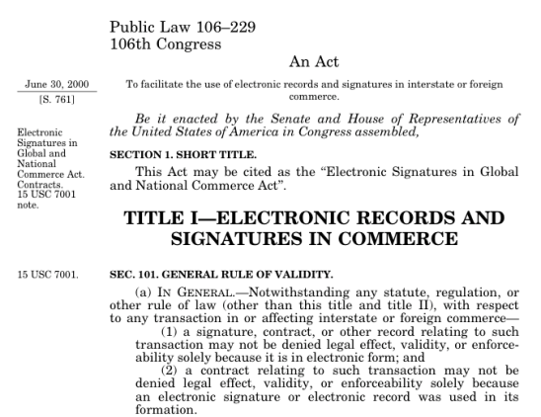
The E-Sign Act

Slide 59
Change of Information Clause
I would encourage the addition of a contractual provision that expressly places the burden of keeping contact information current on the student. This is the type of thing that seems reasonable, but is better if the contract specifically identifies who has the burden.

Slide 60
Arbitration Clause
PRO - An arbitration clause can be extremely helpful when trying to avoid class action litigation and/or keep litigation confidential.
CON – If you bring an action to recover outstanding debt, then the consumer can force arbitration. If you do not litigate against consumers, this is not much of a problem.

Slide 61
Merger Clause
This is an important provision to understand and properly utilize.
The use of a merger clause is highly dependent upon how you are set up to have students enter into an agreement with the school.

Slide 62
Include your vendors, affiliates, etc… in your contract language
In the definition section or in the body of applicable provisions you should make sure to include your vendors, affiliates, or anyone else working on your behalf.
If the contract is specifically limited to the school, then very well drafted provisions may leave your vendor partners exposed to unnecessary liabilities.

Slide 63
Proof of Claim Forms
The form can be found at: http://www.uscourts.gov/uscourts/RulesAndPolicies/rules/BK_Forms_Current/B_010.pdf
Why file a proof of claim?
Does this influence the student’s effort to receive a discharge?

Slide 64
Is the Agreement a “Student Loan”
Whether or not your institution’s agreement will be protected by Section 523(a)(8) of the bankruptcy code will be based upon the case law.
I think it can be helpful to have language that courts have recognized creates a Section 523(a)(8) “student loan.”

Slide 65
“Student Loan”
“This agreement is entered into contemporaneously with or prior to ABC University providing educational services. I understand and agree that ABC University is providing me educational services and that ABC University is deferring some or all of the payment due for those services. Therefore, I understand and agree the resulting debt is a student loan as that term is used and defined in 11 U.S.C. § 523(a)(8) of the United States Bankruptcy Code.”

Slide 66
Questions

Slide 67
Thank you for attending this presentation
I hope that you have a stronger understanding of the current legal issues facing creditors and your partnering collection agencies.
Chad V. Echols
The Echols Firm, LLC
chad.echols@theecholsfirm.com
803.329.8970

