Slide 1
Over in 80 Seconds: The Challenge of Preventing School Shootings
Presented by Anne P. Glavin
Chief of Police
California State University, Northridge
PacWest SFS Conference Conference – San Diego
May 13, 2015
Notes:
On February 14, 2009 at 3pm, Steven Kazmierczak, 27, armed with a shotgun and three handguns, began shooting in the Cole Hall Auditorium at Northern Illinois University in DeKalb, Illinois. He had attended graduate school at the university.
Five people were killed, 16 were wounded, including the three who were injured as they fled. Kazmierczak committed suicide before police arrived.
A few years later I was talking to Northern Illinois Police Chief Donald Grady about the incident. I have always remembered how he stressed how fast the whole incident went. At one point in our conversation he said, “It felt like it was said and done in 80 seconds.” In actuality, it was said and done in exactly 5 minutes.
Chief Grady told me Kazmierczak was actually a good student but had stopped taking psychiatric meds not long before the shooting and had been behaving erratically. Not an unusal turn of events for someone who becomes an active shooter.

Slide 2
From Columbine in April of 1999…
Notes:
Most people will remember Columbine High School in Littleton, Colorado in 1999 – Eric Harris and Dylan Klebold killed 15 and injured 25 before they committed suicide.
It was after Columbine that the term, “Active Shooter” began to be used to describe these mass murder shooting events.
The earliest college attack goes back to August of 1966 when Charles Whitman climbed up to the observation deck of the clocktower on the campus of the University of Texas at Austin.
After reaching the top of the tower, he began a homicidal rampage killing 16 and wounding 31.
Before the shootings, he had killed his wife and mother.

Slide 3
To Recently…
Notes:
None of us wants one of these events on our campus – and we don’t want to see the name of our campus in the headlines. Not for the tragedy, not for the reputational damage and certainly not for the residual fear that it leaves within a community.
Sadly, these types of incidents are increasing around the country. This morning I am going to talk about the scope of the problem, the characteristics of so called Active Shooter incidents, the typical kinds of crimes of violence on college campuses, the mental health issues we are dealing with and the kinds of persons of concern cases that now take up so much of university police departments time.
And then I am going to show you the components of the Workplace Violence program that we created at Cal State Northridge.
Last I am going to tell you the story of David Everson at Cal State Northridge and how training was paramount in stopping a bad thing from happening at our university.
I hope by the time I am finished, you will see just how important training and awareness is to this subject matter. If it does happen, we need to have a survival mindset and know what to do in order to live through something like this.

Slide 4
Definition of Active Shooter
An active shooter is an individual actively engaged in killing or attempting to kill people in a populated area, typically through the use of firearms, and has not been contained.
Notes:
Let’s start with the definition of Active Shooter as the FBI defines it.
This differs from a hostage situation in which the shooter, in those types of incidents, is threatening to kill a person or persons but not actually doing so unless his demands are not met.

Slide 5
Active Shooter Incidents 2000-2013
Notes:
This slide and the next several slides covers statistics from the FBI’s latest study on Active Shooter Incidents in the United States Between 2000 and 2013. There were 160 incidents in this time period – that’s 11.4 incidents annually and that is up substantially from the last study that covered 2000-2007 – in that period there were 6.4 active shooter incidents annually. (REVIEW CASUALTY NUMBERS)
Before 2007, the number of casualties in any given year peaked at 51. In 2012, casualties peaked at 208.
The FBI has recently published an updated study of Active Shooter incidents in the US between 2000 and 2013. This chart is from that study. The bad news is that there is definitely an increase in these types of catastrophic incidents.
In 64 incidents (40%), the crime would have fallen within the federal definition of “mass killing” – which is defined as “three or more” killed.

Slide 6
Location of Active Shooter Incidents 2000-2012
Notes:
The largest group is business: that includes places open to pedestrians, closed to pedestrians and malls.
Educational environment is the second largest: with K-12 having the majority of incidents – somewhere around 20% - the remainder is higher education.
Other is government property, military bases, health care facilities, religious houses of worship and so forth.
Outdoors is open space.

Slide 7
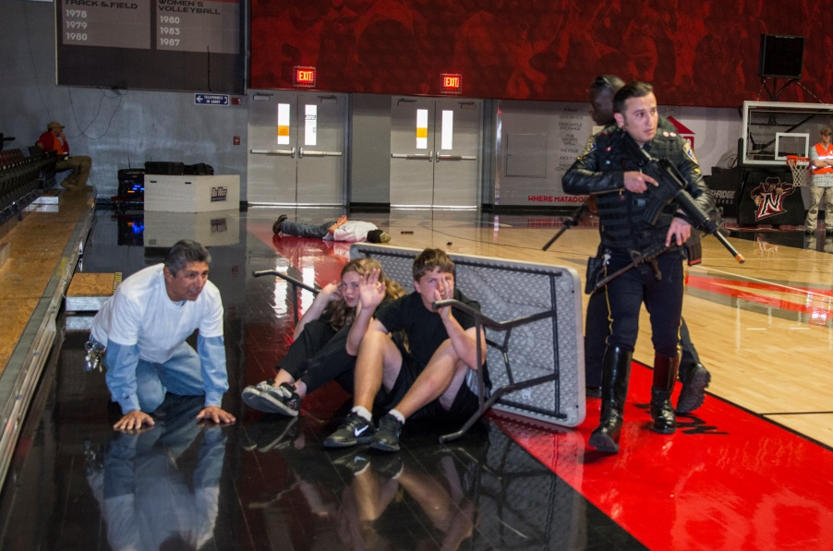
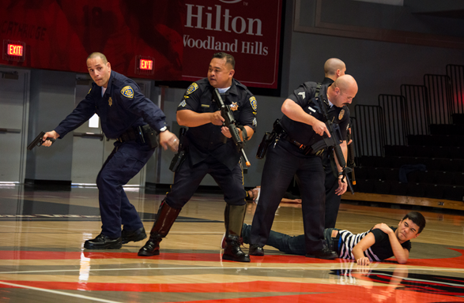
The Speed of Active Shooter Incidents 2000-2012
Median response time for law enforcement: 3 minutes
Duration of most incidents: 5 minutes or less
Approximately 40% of incidents: 2 minutes or less
Majority of incidents end on shooter’s initiative before police arrive: suicide, stop shooting, shooter fled scene
Notes:
Remember I mentioned that the Northern Illinois University shooting was over in 5 minutes. These are extremely fast paced incidents. The shooters goal is to kill as many people as possible before he/she is killed .
The photos here are from last year’s Active Shooter training for police at Northridge.

Slide 8
Characteristics of the Incident 2000-2012
The vast majority of incidents involve a single shooter.
Over 90% of the shooters were male.
In 55% of the incidents, the shooter had a connection with the attack location.
Nearly half of the incidents ended before police arrived.
For incidents still in progress when the police arrived, they ended when the shooter committed suicide, surrendered to police or were stopped by police with use of force.
Notes:
These are some interesting characteristics from the most recent FBI study of the Active Shooter events.
These characteristics actually do not vary from findings of an earlier FBI study that covered the period 2000-2007

Slide 9
Incidents in the Higher Education/K-12 Schools Environment
Of the top five incidents with the largest casualty counts, 3 were at education institutions.
Virginia Polytechnical Institute, April 16, 2007: 32 killed and 58 wounded
Northern Illinois University, February 14, 2008: 5 killed and 16 wounded
Sandy Hook Elementary School and a residence in Newtown, Conn. – December 14, 2012: 27 killed, 2 wounded
Notes:
READ SLIDE
The other two in the top 5 were Ft. Hood Army Base in Texas in November of 2009 with 13 killed and 32 wounded and the Cinemark Theatre in Aurora, Colorado where 12 were killed and 58 wounded.

Slide 10
Typical Crimes of Violence on College Campuses in the US
Sexual Violence
Robbery
Aggravated Assault
Injurious Hate Crimes
Domestic Abuse
Stalking
Harassment and Bullying
Illegal Weapons Arrests
Notes:
The reality is that those of us in campus law enforcement and public safety deal with some type of violence every day.
This list is typical of some of the more common violent crimes reported on college campuses in the US.
This is what we are used to dealing with and pretty much have under control.

Slide 11
Mental Health Issues in the Campus Community
Crisis Requiring Immediate Response
Psychiatric Medication Issues
Learning Disabilities
Illicit Drug Use (Other than alcohol)
Self-injury issues (i.e. cutting to relieve anxiety)
Alcohol Abuse
Problems Related to Earlier Sexual Abuse
Sexual Assault Concerns (On Campus)
Eating Disorders
Career Planning Issues
Source: 2012 National Survey of University
Counseling Center Directors
Notes:
Active shooters often have had some contact with mental health professionals. While a common factor, the functional role that mental illness plays in causing the massacre is indeterminate according to FBI analysis.
In cases analyzed by the FBI very few of the shooters had "previous arrests for violent crimes, though many had encountered a significant emotional hardship prior to the attack such as loss of significant relationships, changes in financial status, loss of a job, changes in living arrangements, major adverse changes to life circumstances, and/or feelings of humiliation or rejection on the part of the shooter.”
These types of changes in the lives of so called “persons of concern” are what Threat Management Units look at when conducting threat assessments for dangerousness.

Slide 12
Common Concerns and Fear of Violence
Physical assault of a co-worker
Post-doc obsessed with a faculty member (or vice versa!)
Hate mail from a student in an intense course
Female student being threatened and stalked by a male student
Librarian making inappropriate comments about shooting people
Student terminated from a work-study program after threatening his supervisor and saying he admires Timothy McVeigh
Student upset with Registrar’s bureaucracy says no wonder Virginia Tech happened
Notes:
So what do we see on our campuses that often cause concern or fear in co-workers, fellow students, faculty and so forth??
These are actual cases from CSUN Police files. Sometimes these types of cases are in the moment bad behavior - such as the one with the Librarian’s remark.
And sometimes they are not – they are red flags of someone moving along the violence continuum and their behavior needs to be checked – they need intervention to understand what is going on. An example of that would be the second example with the post-doc .
And sometimes they are a matter of perception.
For example, the last item, this student stood in a long line the opening week of school and became agitated and impatient. He made his displeasure known in a loud voice. Finally, when his displeasure peaked, he made a loud comment about Virginia Tech. Front counter staff called police and reported “a threat”.

Slide 13
Persons of Concern
Threat to kill University President
Posed as a concerned citizen claiming a current student had planted a bomb in the library
Made threat to bring a gun to housing mail room to settle a dispute over a mailbox
Posted threatening messages on the internet about killing other students and himself
Notes:
Here are a few more.
Re: the fist situation – this individual is now in the psychiatric ward of a prison and he had been there over a year. He started agitating with emails and veiled threats and ultimately an actual threat to kill. For a number of months before we could locate him and arrest him, I was my President’s shadow at all public events.
The third example just took place about 3 weeks ago.

Slide 14
Persons of Concern/Interest
CSUN Police Threat Management Unit (created 2005)
2013-2015 – 51 cases: includes faculty, students, former students, staff (internet threats to kill, peculiar behavior, angry over grades-throwing furniture, stalking behavior, threat to bring a gun to a mailroom, harassment of women, unprovoked violence, suicidal ideation, etc.)
Notes:
So I created CSUN’s Threat Management Unit in 2005- two years before Virginia Tech.
It is a 5 person law enforcement team that reports up to me - they assesses dangerousness, analyze behavior and conduct over time, look at patterns of behavior and look at intent and capacity of the individual of concern to carry out an act of violence.
They are very well trained – all have had a host of training including graduating from Gavin DeBecker’s Advanced Threat Assessment training academy.
Does anyone recognize the name Gavin DeBecker?? Has anyone read the book, The Gift of Fear? If you have not and this subject interests you and you want to protect yourself, there is no better book to read.
deBecker studied violence for decades and in this book, written around 1998 he unravels the complexity of violent behavior. He says there are discernible motives preceded by clear warning signs. It exploded the myth that violent acts are random and unpredictable.
Read slide on number of cases – case load has been going up.

Slide 15
Targeted Violence on Campus
About the incidents:
Occur on and off-campus
80% on-campus (residence, grounds, class/admin)
20% off-campus (residence, public areas)
Precipitating events present: 83%
Pre-incident threat/aggression to target: 29%
Pre-incident concerns reported by others: 31%
Source: “Campus Attacks Targeted Violence Affecting Institutions of Higher Education” , April, 2010, United States Secret Service, United States Dept. of Education, FBI
Notes:
Perpetrators of serious violence don’t just snap. This is a point that we make in our presentation to our campus community. People don’t just “go crazy”, “go postal”, or “go off the deep end” in a moment because these incidents are not impulsive or random.
Over 75% of perpetrators consider, plan, and prepare before engaging in violent behavior. And most discuss their plans with others before the attack.
So in our campus presentation we use this fact to highlight the criticality of recognizing the red flag warning signs of potentially violent behavior and the importance of taking steps at intervention before it is too late.
Look at the percentage of precipitating events and then combine the last two – well over half the incidents had warning signs.

Slide 16
Virginia Tech (2007) Was the Game Changer
Cal State Northridge assessed its needs, including formally with a “President’s Working Group”
We Knew We Needed To:
Teach Life Skills
Communicate Shared Responsibility
Provide a Greater Sense of Security and Safety
Manage Fear
Formalize the Police Threat Assessment Team
Notes:
This was the game changer for us and we knew we had to develop more substantial training. So back in 2007 we worked on a training plan as part of our President’s Working Group. Even back then we were on a track that is now recognized as one of the best preventative methods.
Interestingly in the most recent FBI study the conclusion is, and I quote: “Recognizing the increased active shooter threat and the swiftness with which active shooter incidents unfold, these study results support the importance of training and exercises – not only for law enforcement but also for citizens. It is important, too, that training and exercises include not only an understanding of the threats faced but also the risks and options available in active shooter incidents.”

Slide 17
Evolution of the Workplace Violence Program at CSUN
Workplace Behavior Consultation Team (WBCT)
Established by the University President, Jolene Koester in January of 2008
Chaired by Chief of Police and included representatives from HR, Health Center, Faculty Affairs, Provost’s Office, Environmental Health & Safety, Counseling Services and Student Affairs
Notes:
The cross divisional support is extremely helpful with perspective. This group looks at the topic from the 30,000 foot level in terms of what is best for the campus as a whole.
Our training program, which I will discuss in a moment, was vetted by this group and the concept of doing it in two parts came from these varying perspectives.

Slide 18
Components of Prevention Training Program
Part I:
Acknowledgement of Fears
Setting the Stage through Scenario
First Response Assessment
Personal Conduct
Red-flag Warning Signs
Zero-tolerance Policy
Campus Support Network
Part II:
Worst Case Scenario
“Shots Fired” Video
Dynamics of an Active Shooter Situation
Survival Mindset
Notes:
Program is presented in two parts – must take part one in order to attend part II – no exceptions. Why do we do it this way??
Because Part I is about every day life at the university – the student who disrupts a class, the co-worker who gets infuriated because someone left copies in the copy machine, the individual who spontaneously makes inappropriate comments and so forth. (REVIEW SLIDE)

Slide 19
First Response Assessment
Understand concept of “imminent danger”
Identify role in threatening situations
Consult early and provide progressive assistance
First Response: Assess the Whole Situation
Clarify Role
Gather information
Assess the urgency of the situation (speak individually with the person of concern)
Stabilize, don’t escalate
- Provide for safety
- Be Discreet
- Be Respectful
Consult early and provide progressive assistance
Document
Notes:
Let me show you some of the slides (in blue on the screen) from the actual program. After reading a scenario loaded with bad behavior and red flag warning signs we ask our audience, is this a 911 moment??
The idea of “imminent danger” or “imminent threat” is an important perspective piece. We have had co-workers call Police Services when someone yells at them. The University wants and needs to respond, but it’s not necessarily a 911 situation. This also helps add to the learning outcome that participants understand their role in any given situation – and again, frame expectations of shared responsibility.
The last bit is the conditioning layer – the concept of a support network. As we work through our scenario and response, we know that 911 is not necessary, however, reporting is and that begins to demonstrate the support network. Noone is expected to deal with these situations alone.

Slide 20
Personal Conduct and Response
Discuss what to do and what “not” to do
Respond to potentially violent situations
Experience through role play
Taking all threats seriously
Considerations When Looking at Potentially Violent Situations
Violence is the end result of a (usually discernible) process.
Some people who pose threats make threats. Some people who pose threats do not make threats.
Some people who make threats do pose threats.
A person who poses a threat to one person may pose a threat to others.
Take all threats seriously !!
Notes:
One of the most important life lessons that we can provide is teaching life skills. For instance, we describe the importance of paying attention, responding simply and respectfully.
We explain that its important to listen patiently, demonstrating interest in them; we discuss that its often helpful to repeat the message that you have heard, acknowledging that they are upset.
The importance of deployment of these strategies and de-escalation depends on the circumstances. We remind that its not about being “right” when dealing with an angry individual. Our goal is to get them out of the situation safely.
To really make the point, we then discuss what NOT to do:
-style of communication – rolling eyes, strict compliance to rules, brushing them off
-don’t pose in challenging stance
We act this out through a bit of role playing demonstrating an inproper response to an angry person and then a proper response. The slide in blue is designed to get all to understand that you must take all threats seriously as you cannot recognize, in advance, everyone who is going to commit an act of violence. You need to concentrate on the threat.

Slide 21
Red Flag Warning Signs
Many aspects such as: violent fantasies, anger management, suicidal and homicidal ideation, discipline problems, physical aggressiveness, etc.
Red Flag Warning Signs
A single warning sign by itself usually does not warrant overt action by a threat assessment specialist. However, if additional warning signs are present then more fact-finding is warranted to determine if there is a likelihood of danger.
Some warning signs carry more weight than others (i.e. fascination with and possession of firearms)
When there are multiple warning signs, the risk becomes more serious.
Consult early with appropriate campus support resources.
Notes:
We do caution our audience that we must respect our diversity and our differences. We all communicate differently and we respond to situations differently.
There are odd and eccentric people amongst us! And they have a right to be.
It is critical not to assume the worst from small bits of input, particularly through rumor. We discuss the danger of labeling….psycho, nuts, postal, wacko, not wound too tight.
So with all of this as context, we discuss the red flag warning signs. Reporting and trusting and the significance of the accumulation of warning signs.
REVIEW BLUE SLIDE

Slide 22
Cal State Northridge Resources
CAMPUS COMMITTEES:
Student Behavioral Intervention Team (SBIT)
(Meets every other week)
Sam Lingrosso: (Chair) Director, Student Conduct and Ethical Development - Student Affairs
Mark Stevens: Director - University Counseling Services
Anne Eipe: Staff Psychologist - University Counseling Services
Anne Glavin: Chief of Police and Director of Police Services -
University Police
Mark A Benavidez: Lieutenant, Patrol Operations - University Police
Scott Vanscoy: Captain, Patrol Operations - University Police
Workplace Behavior Consultation Team (WBCT)
(Meets Quarterly)
Anne Glavin: (Chair) Chief of Police and Director of Police Services
Linda Reid-Chassiakos: Director, Klotz Student Health Center
William Whiting : Associate Vice President Faculty Affairs
Michael Neubauer: Vice Provost
Susan Hua: Director, Equity & Diversity and Title IX Coordinator
Sam Lingrosso: Director, Student Conduct and Ethical Development - Student Affairs
Kristina de la Vega, Interim Associate Vice President Human Resources
Mark Stevens: Director, Counseling Services
William Watkins: Vice President for Student Affairs and Dean of Students
Ron Norton: Director, Environmental Health and Safety
THREAT MANAGEMENT UNIT
CSUN Police have a Threat Management Unit. The Unit operates as follows:
5 person law enforcement team
Specially trained in threat assessment and case management
Interacts with campus resources especially the campus Student Behavioral Intervention Team.
Has operating policy and procedure
Documents all cases and maintains special category statistics; annual analysis of cases
Notes:
These are our behind the scenes teams - they are not able to be accessed by the community. That differs from the resource list I just showed you. That one is designed to help someone struggling with a person of concern or an angry individual.
These groups look at things from different perspectives. These are the resource people who really track the problem persons and associated issues.
DESCRIBE EACH GROUP

Slide 23
Part II of Training: Worst Case Scenario
Includes:
“Shots Fired” Video
Developing the Survival Mindset
Actions of the Police: From SWAT to First Responder
Get Out, Hide Out, Help Out, Fight and why awareness, preparation and rehearsal are so important
Active Shooter Exercise: Imagine You Heard Shots Fired – What Do You Do???!!!!
Notes:
DISCUSS EACH
The film, “Shots Fired on Campus: When Lightening Strikes” – takes place on a college campus and goes through all the items on this slide
Survival Mindset – you must have a will to live – to be willing to take a chance in a very dangerous situation
On April 20th of 1999 Eric Harris, age 18 and Dylan Klebold, age 17, angry young men with much hate against the world, entered Columbine High School and committed one of the deadliest mass murders on a school campus. They killed 15 and injured 25.
They had planned to blow up Columbine High but the explosives did not work. So instead they used shotguns and rifles. This event changed the way law enforcement responds to active shooter incidents.
Actions of Police – from SWAT response to first responder training to first aid and rescue

Slide 24
Get Out, Hide Out, Help Out, Fight
Get Out!!!!!!!!!! When you hear gunshots, don’t second guess the situation. Get out immediately if at all possible. If you are out in the open, take cover or run away in a zig zag pattern.
Hide Out!!!!!!!! Find a location, lock or blockade the door, turn off the lights, spread out with others in the room and make a plan.
Help Out!! Help the injured as best you can until help arrives. Remain calm and quiet and be a calming influence for others.

Slide 25
Get Out, Hide Out, Help Out, Fight
Fight!! If neither running nor hiding is a safe option, as a last resort, when confronted by the shooter, consider trying to disrupt or incapacitate the shooter. This can be done by using aggressive force such as using items in the environment to throw at a shooter (fire extinguisher, chair, backpacks, etc.).
This is a life/death situation in which your “survival mindset” must take over!

Slide 26
“The World Is A Dangerous Place To Live; Not Because Of The People Who Are Evil, But Because Of The People Who Don’t Do Anything About It.”
Albert Einstein
Notes:
READ SLIDE, then say: The difference between a tragedy and a success story, when we speak about intervention on the violence continuum, is that somebody took red flag warning signs seriously.
The case I am about to tell you about is an actual CSUN case. It is a success story because of training and timely intervention.
Two months before this incident situation revealed itself, Jill Smith and I had just completed training of our Residence Life staff.
PUT UP NEXT SLIDE

Slide 28
Questions?

Slide 29
Thank You! Chief Anne P. Glavin Chief of Police California State University, Northridge

