Slide 1
The Trials of 1098-T Reporting
Gina Curry
California State University,
Sacramento
May 17, 2012

Slide 2
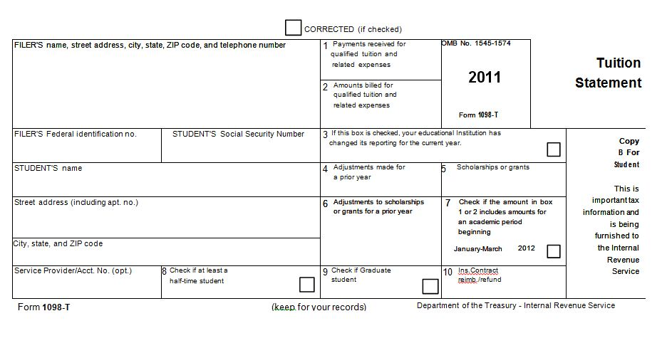
1098-T for 2011

Slide 3
Box 1 or Box 2
Box 1 – Payments Received for Qualified Tuition and Expenses
Pros
Reports in a way that most taxpayers claim (cash basis)
Reports in the year that installments are paid
Cons
May be harder to track and therefore report
Must also track refunds
Box 2 – Amounts Billed for Qualified Tuition and Expenses
Pros
Reporting can be easier for the university
Most schools are post-pay so it follows business process
Cons
Reports in a way that makes the taxpayer “calculate” their deduction
Cross of tax years’ confuses taxpayers (spring billing in Nov/Dec)

Slide 4
Social Security Numbers
Truncation
Pilot years are 2011 and 2012
No application to pilot, OK to just truncate
Require a SSN
Students must provide the university an SSN
University must attempt to get a SSN or TIN each year
University must still file a 1098-T without the SSN
“Filler SSN”
000-00-0000 or 999-99-9999
OK to report to IRS as long as you attempt to get a SSN from the student

Slide 5
International Students & ITINS
Non-Resident Aliens
Not required to provide 1098-T UNLESS it is requested
International Students
Not required to provide 1098-T but not prohibited
TINS
You can replace blank or “false” SSN with TIN if it has been collected from the student

Slide 6
Veteran’s Chapter 33 & Other 3rd Party Sponsors
Must be reporting in Box 5
Third party sponsorship or scholarship?
Any university administered payment must be reported
How do you work with your FA office to accomplish this?

Slide 7
Qualifying Expenses
Generally means tuition and fees required for enrollment or attendance
Exceptions for sports, hobbies or games unless it is part of a degree program
Non academic fees – term does not include student activity fees, athletic fees, insurance expense or other expenses not related to an individuals academic course of instruction

Slide 8
IRS Audits of Our Students
Cash basis filers can only deduct the amount paid
They are rejecting the deduction because the 1098-T cannot be the documentation to substantiate the deduction
Encourage student to retain cancelled checks, bank statements and credit card receipts

Slide 9
Resources
“FAQs on Form 1098-T Reporting” developed after the NACUBO webinar on November 17, 2011.
Audit clarification from Roberta McNiel, CPA and Manager of Internal Control & Compliance at the CSU Chancellor’s Office
1098-T Reporting Season Reminders from NACUBO October 20, 2011 – Mary Bachinger, Director Tax Policy (202) 861-2581

Slide 10
Contact Information
Gina Curry
Director, Student Financial Services Center & University Bursar
California State University, Sacramento
curryg@csus.edu
(916) 278-7433

