Slide 1
Social Mobility Technologies for Smart Campuses
PACWest Presentation
16th May 2012

Slide 2
UCSD
Our Problem Statement:
AR that didn’t communicate
I.D card with technology limitations
History of decentralized developments

Slide 3
Our Resolution Needs
Find :
a consultant
some independence with them
someone who had done this before
non proprietary software
a technology with stability and a life
a scapegoat in case it all fails

Slide 4
The STEPS thus far-
Started with investigations
No agenda, No product, No plan
Met with 24 organizations on campus
THE REPORT is the product.
Determine viability
Develop a strategy

Slide 5
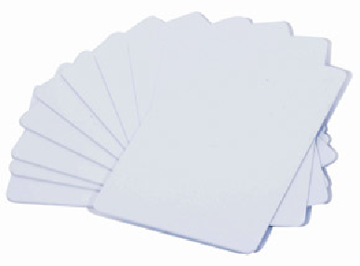
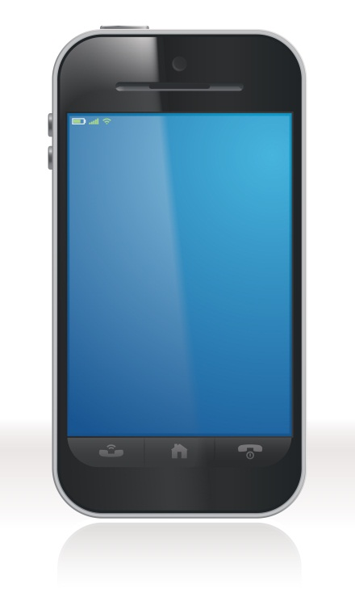
New Technology
Multiple-application contactless smart cards
Multiple-technology card readers
“Smart” mobile phones
NFC technology

Slide 6
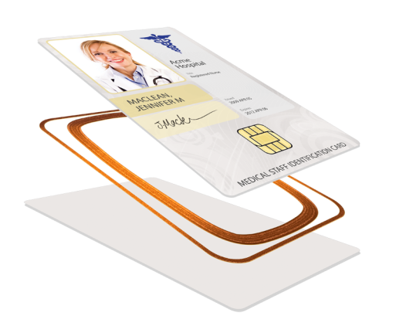
Smart Cards
Multiple-application, Non-Proprietary
Contactless Card Platforms
Secure
Versatile
Increased processing capacity

Slide 7
One-Card Systems
Print/Copy
Vending
Library Services
Public Transport
Bookstore
Event Tracking
Cafeteria Payment
CCTV & Access Control
Identification Data
Card Issuance
Enrollment
Data Integration

Slide 8
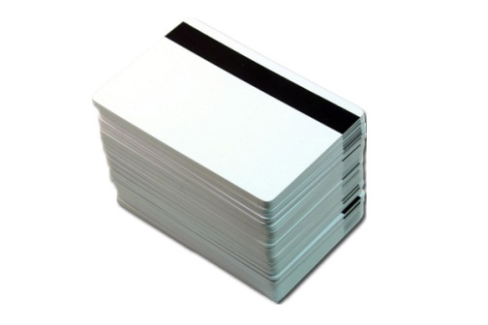
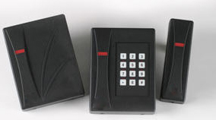
Multi-tech Card Readers
Readers that support
Multiple Technology Card Platforms
125 kHz, 13.56 MHz, magnetic stripe
Legacy card platforms can co-exist with new card technologies, allowing for thoughtful technology migrations.

Slide 9
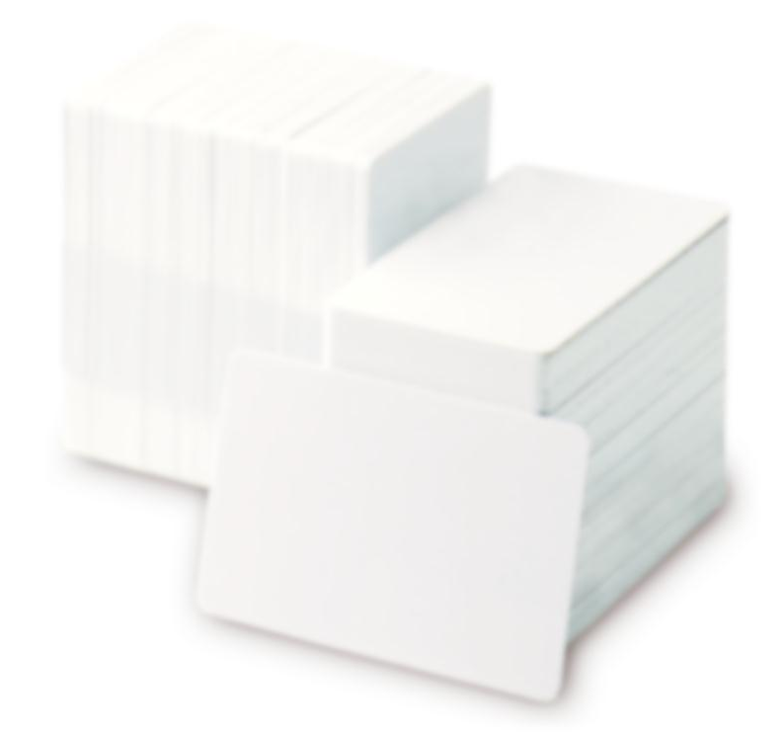
Multi-tech Card Readers
SUPPORT:
125 kHz
13.56 MHz
Proximity
Proxlite®
Lenel®
HID IClass®
MIFARE
MIFARE DESFIRE EV1®
ST Micro®
FIPS201

Slide 10
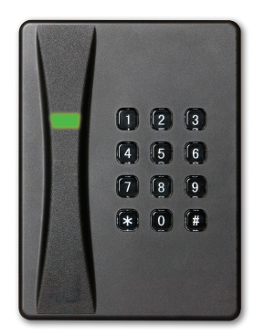
Multi-tech Card Readers
The newest reader technology allows proximity cards and secure smart cards (EV1,PIV, FIPS 201) to be read on the same reader, and even biometrics!

Slide 11
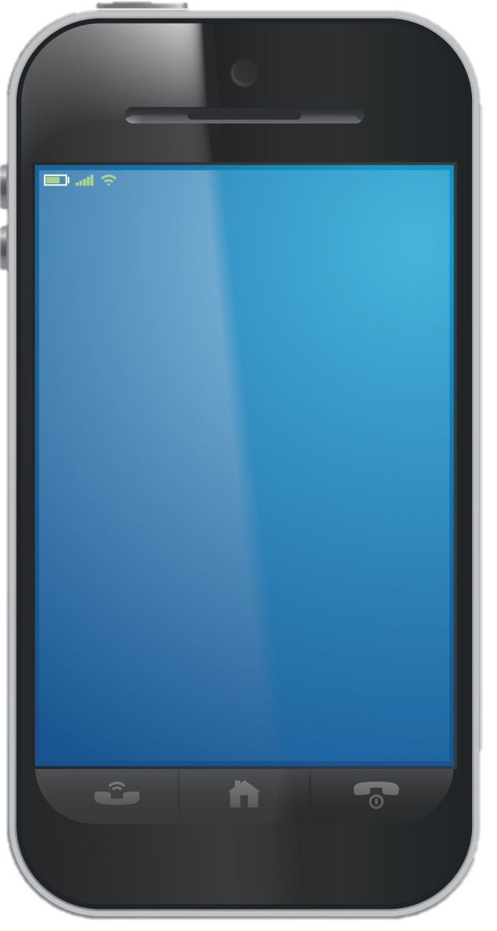
Mobile Phones for ID!
New technologies, such as mobile phones, are being used for more everyday! They communicate to readers by RFID technology.
Smart mobile phones can be used for:
Unique Identification
Access Control;
Purchasing goods or services;
Receiving information;
And more…

Slide 12
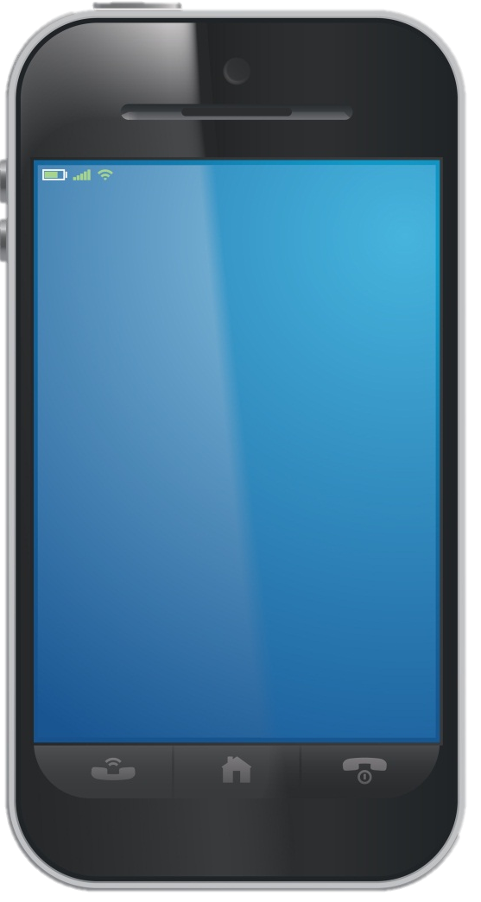
NFC Technology
Near-Field Communications
-Short-range wireless RFID technology which uses low speed signals to allow two devices to automatically start communicating when they are close to one another.

Slide 13
What is NFC?
THE TECHNOLOGY
NFC is “Near Field Communication”
Close proximity wireless technology
Fully standardized
Compatible with existing smart card infrastructure
Expected 2012 phone penetration 150M+
Intuitive, super easy to use
ENABLES
3 USE CASES:
Discovery
Transactions
Exchange

Slide 14
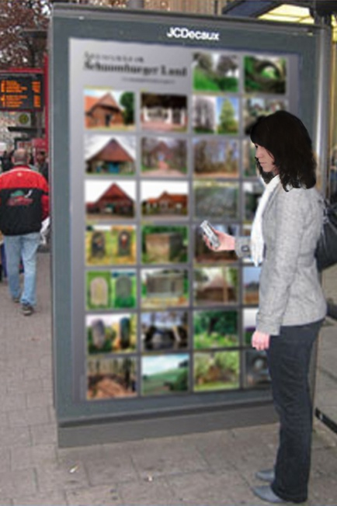
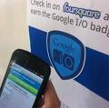
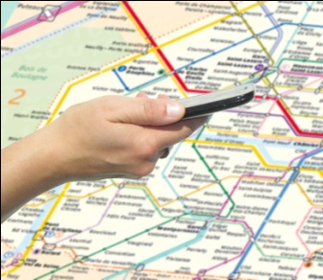
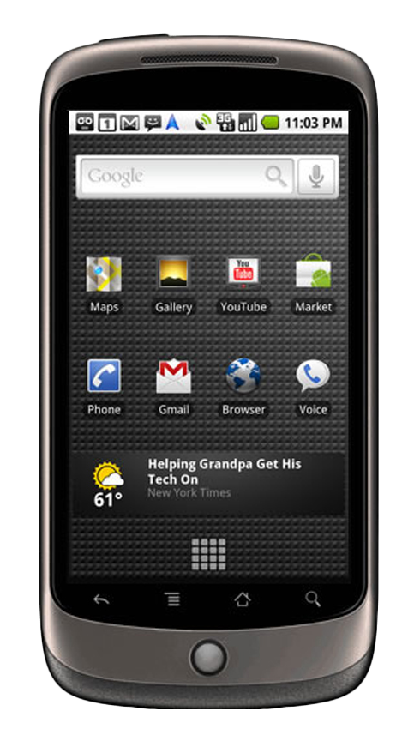
Discovery
Touch to…
learn more, get deals, be social...
“PICK UP”
“CHECK IN”
Offers / coupons
Directions
Mass transit schedules
Reviews/recommendations
On the spot services
Movie trailers
Social media updates
On the spot reviews

Slide 15
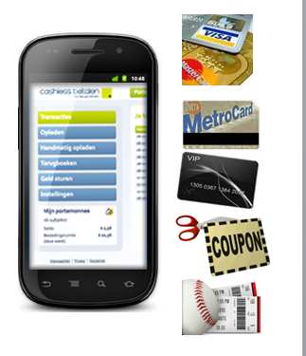
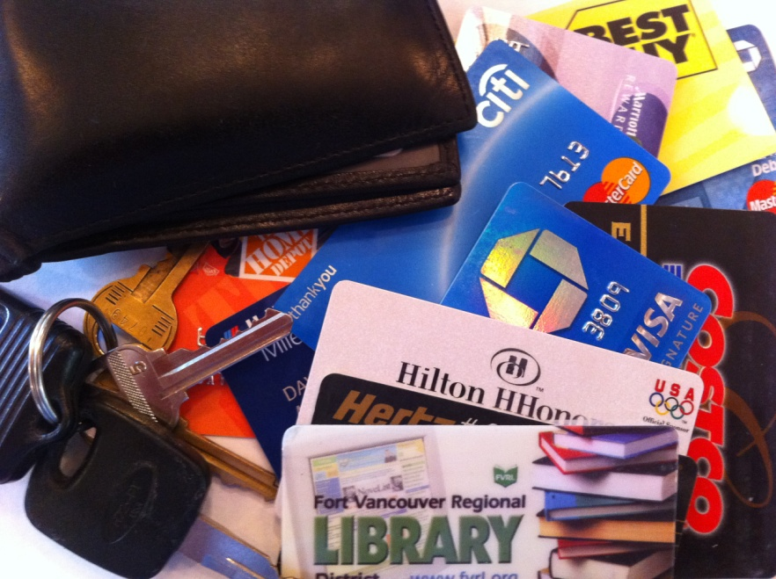
Transactions
Speed
Convenience
Ease of use
Existing infrastructure
Multitasking
Mobile computing power
Rich user interface

Slide 16
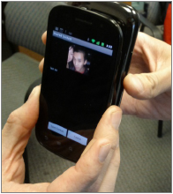
Exchange
Person to Person:
Contact info, photos, songs, playlists
Social networking
Gaming
Machine to Machine:
Touch setup of BT or WiFi for easy pairing and sharing

Slide 17
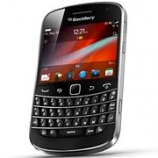
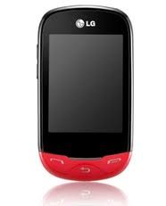
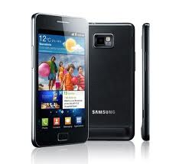
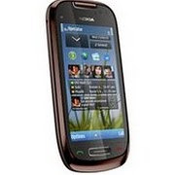
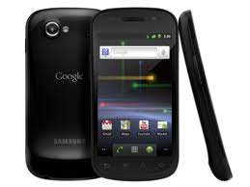
NFC Market Status
2011 35+M phones on the market
2012 150+M phones forecasted
100+ different models
All handset makers
All regions
Notes:
Identive Group member SCM is a large supplier into the global payment application market via it’s readers, terminals and oem components

Slide 18
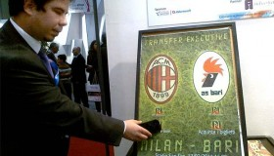
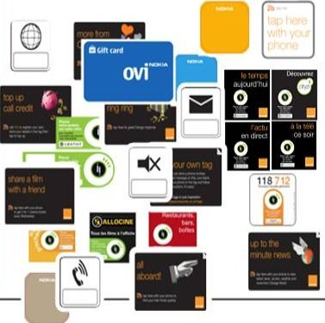
Smart Posters and Objects
Bringing ads & info to life…
PAST
Visual experience
TODAY
Rich, dimensional experience
Video
Sticky
Social
Guide student journey

Slide 19
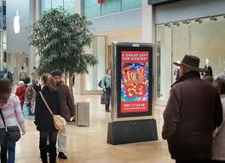
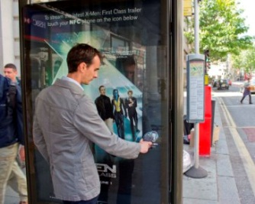
Attractive for brands & merchants
Precise and trackable analytics
Are people engaging?
What is working?
Changing content

Slide 20
Personalized
Dynamic content engine
- “Me Based Services”
Tailored content to me when I want it
Micro Opt-in

Slide 21
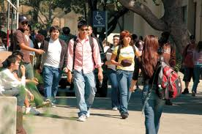
NFC on Campus
Digitizing the physical campus – people, places and things
NFC tags all over campus will enable…
Campus information services with a simple touch
Campus maps, event information
Class schedule, building/room schedules
Consumer friendly services around campus
Retail, bars, restaurants – touch to get offers
Check-in with your social media account with a tap
Smart advertising
Campus ROI opportunities
Easy connections to campus services
Touch for easy WiFi setup
Touch to print/copy, etc

Slide 22
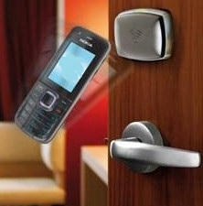
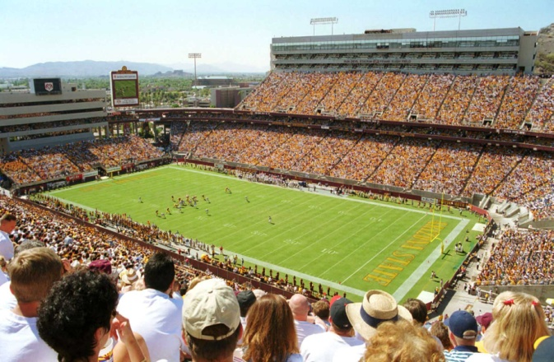
NFC on Campus continued
NFC enabled phones for building and IT access
Full over the air (OTA) management of credentials for NFC enabled phones
NFC stickers for phones that do not have NFC
Plug into existing infrastructure
Credentials on mobile phone for other services
Event tickets
Public transit pass
Payment – closed loop at campus stores and vending machines, etc

Slide 23
Where is this headed?
TAGS EVERYWHERE!!!
Link between physical & digital worlds
Quick roll outs
Diverse uses
Behavior change

