Slide 1



Challenges with Medical Withdrawal and Refund Processes
Confidential and proprietary information © 2024 GradGuard. All rights reserved.
1

Slide 2
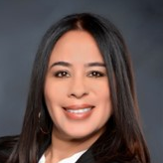



Meet The Panel
Natalie Cardenas
Chapman University
Asst Director, Business Services
Derrick Shy
GradGuard
Regional VP, Campus Sales
Monique Gonzalez
Point Loma Nazarene University
Director of Student Accounts
Confidential and proprietary information © 2024 GradGuard. All rights reserved.

Slide 3

Why are we here today?
Confidential and proprietary information © 2024 GradGuard. All rights reserved.

Slide 4


College is riskier than it looks.
What changes or trends have you seen over the past few years?
What changes has your office gone through to accommodate the rise in withdrawals?
1 out of 4
students who enroll don’t return for a second year.
70%
of schools report growth in withdrawals.
Confidential and proprietary information © 2024 GradGuard. All rights reserved.

Slide 5




Are mental health issues a worry on your campus?
Why are nearly half of today’s college students thinking of withdrawing?
41% of students have considered withdrawing in the past year.
say emotional stress
say mental health reasons
This is an increase from 37% in 2021 and 34% in 2020. And of those students, 55% say emotional stress is the reason.
69%
59%
Lumina Foundation - Gallup State of Higher Education 2023 Report
Confidential and proprietary information © 2024 GradGuard. All rights reserved.

Slide 6




How does your campus currently support students’ mental health?
Enrollment decline has led to a loss of almost 1.3M students since spring 2021
National Student Clearinghouse Research Center, May 2022
73% of presidents indicated student mental health is the most pressing issue
ACE Fall 2021 November Pulse Point Survey
Most adults 18-24 who have never enrolled in post-secondary education cite emotional stress (77%) and personal mental health (73%) as reasons why
Lumina-Gallup Poll 2022
Emotional stress is the most common reason for withdrawal. 69% of bachelor’s degree students have considered dropping because of emotional stress. 59% for personal mental health reasons.
Lumina-Gallup Poll 2022
Confidential and proprietary information © 2024 GradGuard. All rights reserved.

Slide 7
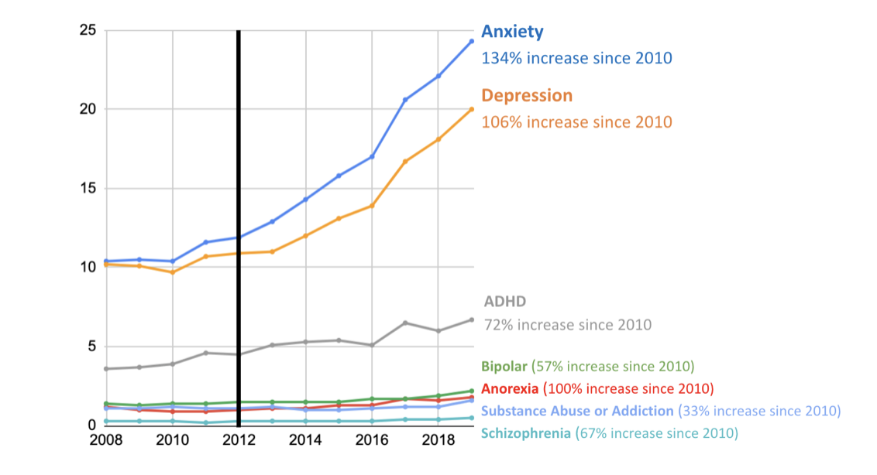
Undergraduates Diagnosed
with a Mental Health Condition
Schools are serving students with more diverse health conditions then ever before.
The growth in student withdrawals due to medical conditions should not be a surprise.
ACHA 2019, National College Health Assessment. Study 1.1.17, p. 36 of the Collaborative Review
Confidential and proprietary information © 2024 GradGuard. All rights reserved.

Slide 8




Universities and Colleges need help.
What is your current refund process?
Declining Confidence
Americans’ confidence in higher education has fallen to 36%, sharply lower than in two prior readings in 2015 (57%) and 2018 (48%) - Gallup Lumina
Growing financial losses
The cost of college increases creating greater need for schools to implement insurance requirements & collect COI.
Enrollment & financial challenges
Recruiting, enrolling and retaining high-quality students within a budget has never been harder.
New Restrictions on Accounts Receivables
New laws prohibit schools from withholding transcripts & from debt sales.
Confidential and proprietary information © 2024 GradGuard. All rights reserved.

Slide 9


And families are not prepared.
25%
of parents surveyed indicate that they could not pay for an additional semester of classes
Schools who do not provide 100% refunds are prudent to have an electronic verification that “notice” has been provided to each student of the institution refund policy.
46%
indicate that it would be difficult
81%
of parents do not know their school’s refund policy
*College Confidence Index, GradGuard/ College Pulse survey conducted June 2022
Confidential and proprietary information © 2024 GradGuard. All rights reserved.

Slide 10


JED Foundation recommends schools offer tuition insurance to reduce the financial stress on students.
Confidential and proprietary information © 2024 GradGuard. All rights reserved.

Slide 11









































































































GradGuard’s mission is to help schools educate and protect students from the risks of college life.
BILLINGS
BOZEMAN
Confidential and proprietary information © 2024 GradGuard. All rights reserved.

Slide 12











GradGuard is the #1 provider
of college renters and
tuition insurance.
Network of over 550 colleges and universities
Over 1.5 million students protected
Perfecting the art of educating and protecting college families since 2009
Confidential and proprietary information © 2024 GradGuard. All rights reserved.

Slide 13

No Degree + Debt = Worst Case Scenario
Protection is Necessary
113,000
COLLEGE STUDENTS WITHDREW IN 2021.
GradGuard’s Tuition Protection Plan
  Reduce the cost of refunds withdrawals
  Reduces the financial stress on students & families
  Pays schools for the account balances of students who are forced to withdraw or cause damages they cannot pay for.
Confidential and proprietary information © 2024 GradGuard. All rights reserved.

Slide 14

Nearly 75% of students with claims return to school or plan to.*
GradGuard’s Tuition Protection Plan provides a do over to students helping them to return to school when they are in good health.
*Study based on a June 2023 survey of GradGuard members with paid claims.
Confidential and proprietary information © 2024 GradGuard. All rights reserved.

Slide 15


Tuition Protection
GradGuard provides a refund so schools don’t have to.
Confidential and proprietary information ©2023 GradGuard. All rights reserved.
Confidential and proprietary information © 2024 GradGuard. All rights reserved.
15

Slide 16



GradGuard is The Only Form of Tuition Insurance for Students Nationwide
Tuition protection benefits can reimburse college costs when a student experiences a:
Serious Illness or Injury
Such as mononucleosis or a severe head injury
Mental Health Conditions
Like depression
Chronic Illness
Such as diabetes or an auto-immune disorder
Death of
a Tuition
Payer
Parent or other tuition payer
Loss of Employment
Parent or other tuition payer
The GradGuard Tuition Protection Plan provides peace of mind by reimbursing tuition & fees for a wide variety of covered reasons with rates at low as 1.20%.
Terms, conditions, and exclusions apply. Insurance benefits are underwritten by Jefferson Insurance Company (NY, Administrative Office: Richmond, VA), rated "A+" (Superior) by A.M. Best Co., under Jefferson Form No. 101-C series or 101-P series. Plan(s) may not be available in all jurisdictions. Allianz Global Assistance and Allianz Travel Insurance are brands of AGA Service Company. AGA Service Company is the licensed producer and administrator of [this plan] [these plans] and an affiliate of Jefferson Insurance Company. The insured shall not receive any special benefit or advantage due to the affiliation between AGA Service Company and Jefferson Insurance Company. Non-insurance benefits/products are provided and serviced by AGA Service Company. Contact AGA Service Company at 800-284-8300 or 9950 Mayland Drive, Richmond, VA 23233 or customerservice@allianzassistance.com.
Confidential and proprietary information © 2024 GradGuard. All rights reserved.

Slide 17




Tuition Protection Plan
Tuition protection benefits provide affordable protection that can reimburse college costs such as:
Tuition
The cost of enrollment
Other Non-Refundable Fees
This includes any other expenses aside from tuition and room and board. These may include but are not limited to books, supplies, instructional materials, and lab or activity fees.
On and Off-Campus Housing
On-campus housing includes any expenses incurred for school-provided housing during the covered term, as shown on the insured student’s school invoice. This does not include security deposits.
Off-Campus Housing expenses include early termination fees associated with vacating housing and terminating utility contracts during the covered term. This does not include security deposits.
Confidential and proprietary information © 2024 GradGuard. All rights reserved.

Slide 18



And we’re more than
tuition protection.
To fit your specific needs, our tuition insurance options offer varying levels of protection for:
Tuition costs
Room and board fees
Other non-refundable
college expenses.
Extended Coverage
Non-refundable expenses are included in what we can cover.
Flexibility
With individual policies, students can enroll or switch plans semester-by-semester.
Student Life Assistance
One-of-a-kind 24/7/365 emergency assistance services are included in every plan. Payout is up to designated percentage of covered losses. Price is based on total cost of non-refundable tuition, fees, room and board.
Confidential and proprietary information © 2024 GradGuard. All rights reserved.

Slide 19

Helping Schools to
Protect Students
How We Do It
Confidential and proprietary information © 2024 GradGuard. All rights reserved.

Slide 20



But for GradGuard’s Integrated partnerships, students would not have the opportunity to protect themselves.
Every student deserves to know the school refund policy & have the opportunity to protect themselves.
Financial Literacy
Voluntary
Active Choice
No Friction
With the right integrated solution, we can see up to 30% purchase rates and 100% refund policy acknowledgement. This is the Goal for GradGuard Schools in 2024.
Confidential and proprietary information © 2024 GradGuard. All rights reserved.

Slide 21
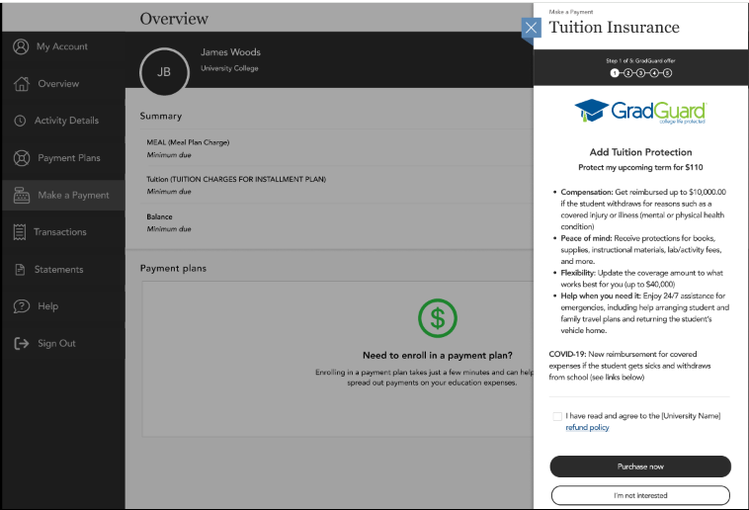
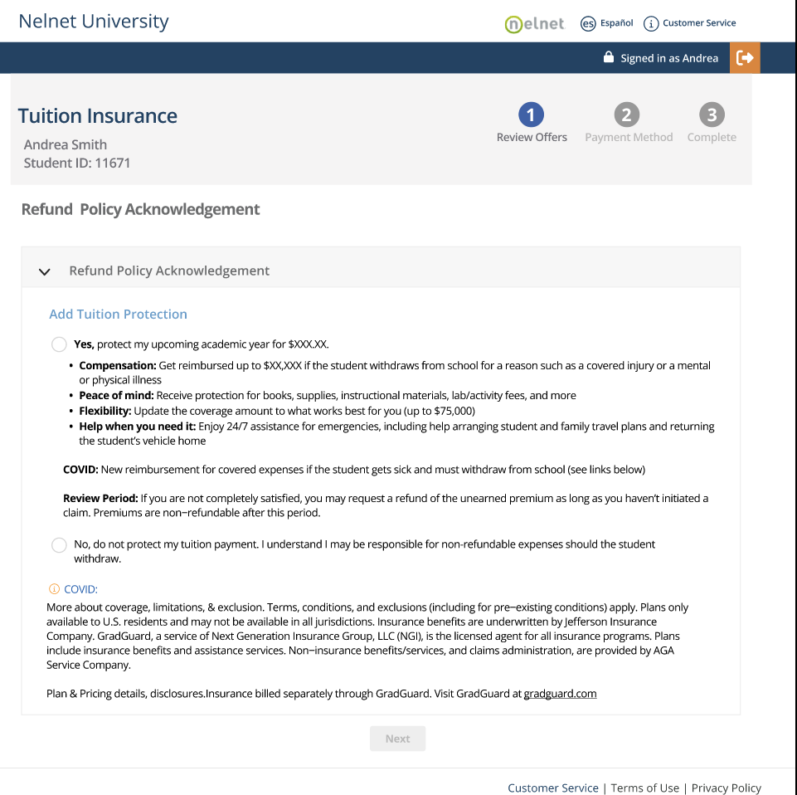
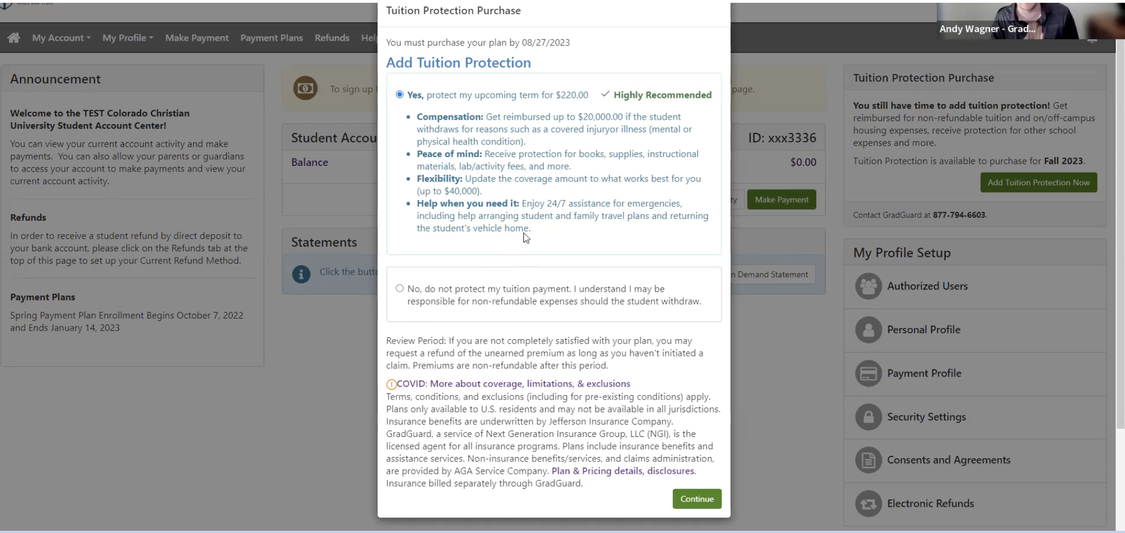
GradGuard and Integration
Make it Easy
Refund Policy Acknowledgement + Active Tuition Insurance Choice
Enables schools to provide notice as required under DOE guidelines of the institution’s refund policy.
Collects time and date of such notice if a student is later surprised by the refund policy.
Frictionless process educates students and families.
GradGuard currently fully integrates with TouchNet, Nelnet, and Transact Bill Pay Environments
Confidential and proprietary information © 2024 GradGuard. All rights reserved.

Slide 22


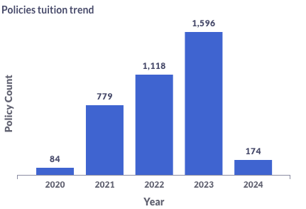
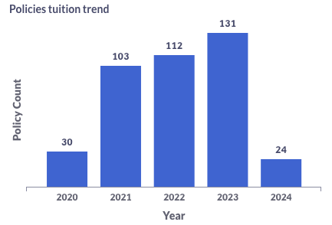
Insurance Protection
Contract – August 2019
Integrated Application opened – Fall 2021
With Integration we saw over a 900% increase
Over $400K paid in claims
Contract - April 2012
Integrated Application opened – Spring 2022
With integration we saw a 340% increase
Over $60K paid in claims
Confidential and proprietary information © 2024 GradGuard. All rights reserved.

Slide 23


Confidential and proprietary information © 2024 GradGuard. All rights reserved.

Slide 24


New regulations prevent schools from withholding transcripts. Can GradGuard help?
Starting in July 2024, schools will no longer be able to withhold transcripts from students who have an outstanding account balance.
In California, schools are no longer able to sell-student debt to third party collectors.
74653 of the Federal Register notice October 31, 2023. Page 86 - 34 CFR 668.14(b)
Confidential and proprietary information © 2024 GradGuard. All rights reserved.

Slide 25















More Than 500 School Partners
Have Integrated GradGuard
Confidential and proprietary information © 2024 GradGuard. All rights reserved.

Slide 26

Questions & Answers
Confidential and proprietary information ©2023 GradGuard. All rights reserved.
Confidential and proprietary information © 2024 GradGuard. All rights reserved.
26

Slide 27

Thank you!
Confidential and proprietary information © 2024 GradGuard. All rights reserved.

