Slide 1
Mitigating Financial Risks for International Students

Slide 2
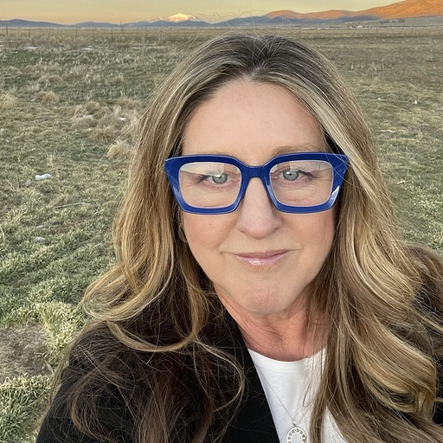
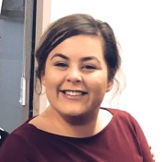
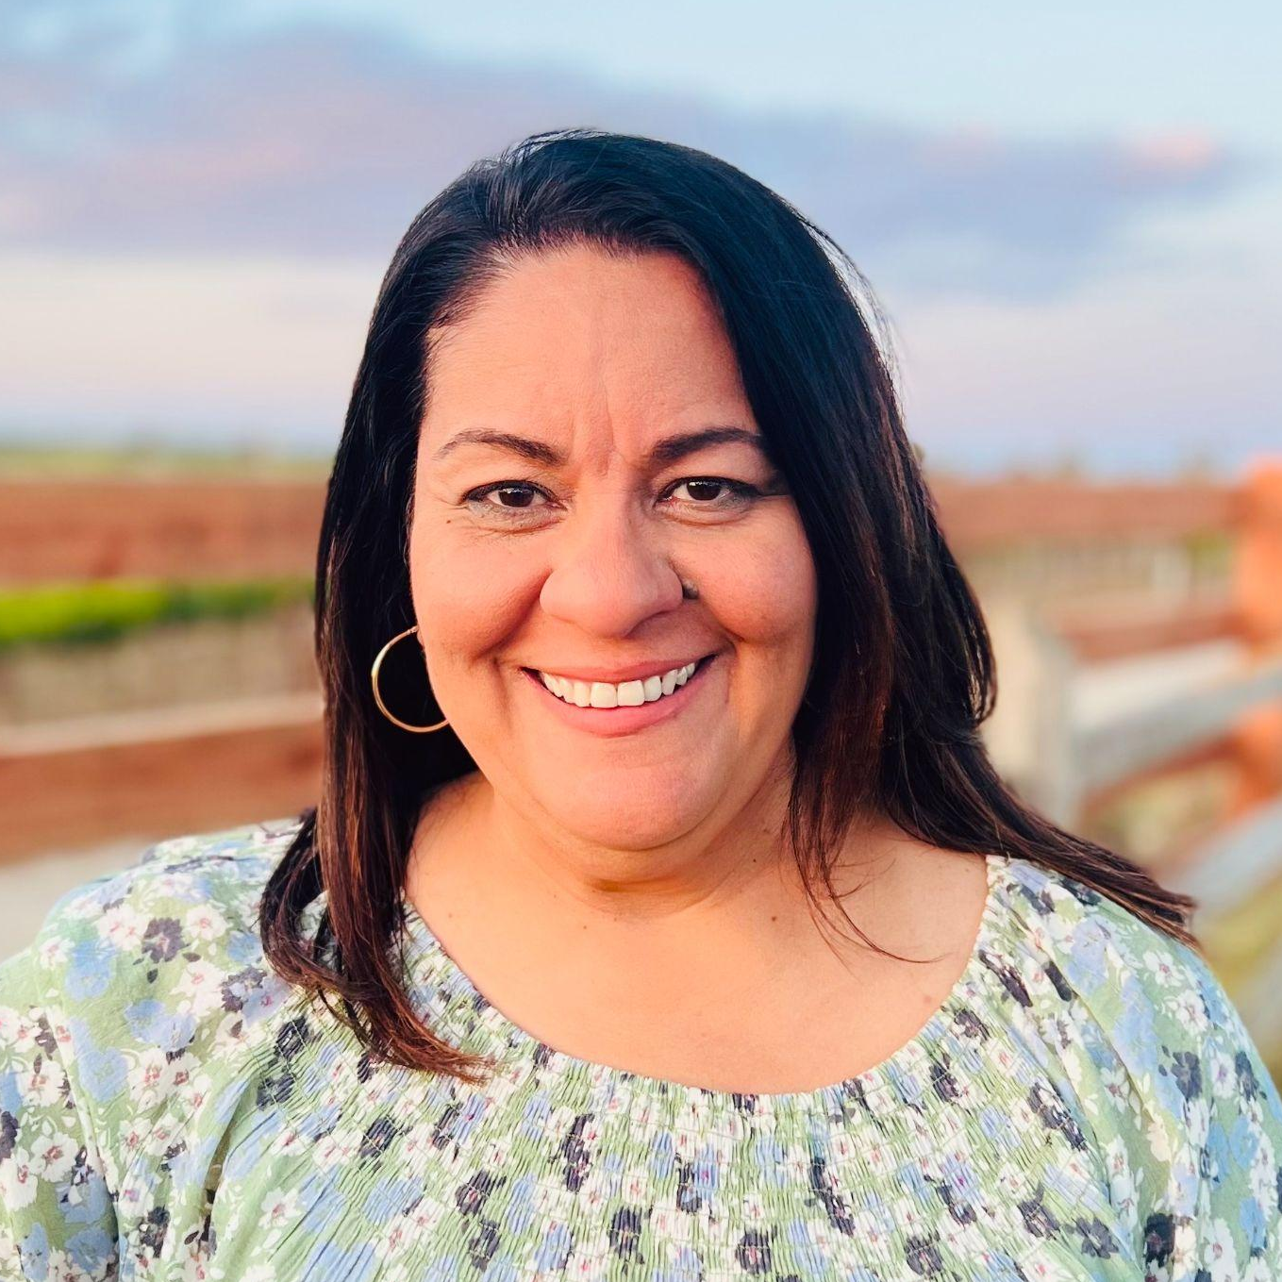
Stacy Sullivan
Director, Campus Solutions
Welcome & Introductions
Monique Gonzalez
Director
Ileana Acevedo
Director of Student Accounting and Campus Cashiering

Slide 3
Identifying Risk
CARRYING CASH
PAYMENT ISSUES
FRAUD & COMPLIANCE
Notes:
Identifying the Risk
Student's Safety Story: Stacy (and maybe Ileana) share stories about students experiences.
Highlighting the risks associated with carrying cash and keeping funds in dorms.
Issues with Payments: Challenges with proof of payment, clearing holds, and confusion with direct wires.
Fraud and Compliance Issues: Addressing risks related to chargebacks, compliance in conflict-affected regions, and handling refunds to prevent money laundering

Slide 4
Who can name a sanctioned country?
Poll
Notes:
Audience Engagement
Engaging the audience by testing their knowledge of sanction countries and popular countries for international students coming to the States.
Offer Prizes

Slide 5
And the answer* is:
Cuba
Iran
North Korea
Russia
Syria
Ukrainian territories of: Crimea, Donetsk People’s Republic (DNR) and Luhansk People’s Republic (LNR)
*Per the Office of Foreign Assets Control (OFAC)

Slide 6
What is the most popular country where students come from to study in the US?
Poll

Slide 7
And the answer is:
China
India
South Korea
Canada
Vietnam
*Per Open Doors, 2022/23 Academic Year

Slide 8
Identify Risks & Response: uncover payment and fraud & compliance issues
Standardize Policies: promote financial responsibility among students
Vet Payments: verify payment sources and navigate plans for payment
Be
responsible
Notes:
Ways to mitigate risk
Identified Risks & Response
Issues with Payments
Fraud & Compliance Issues
Being Responsible: Promoting financial responsibility among students and implementing standardized policies.
Vetting Payments: Strategies for verifying payment sources and navigating plans for payment.

Slide 9
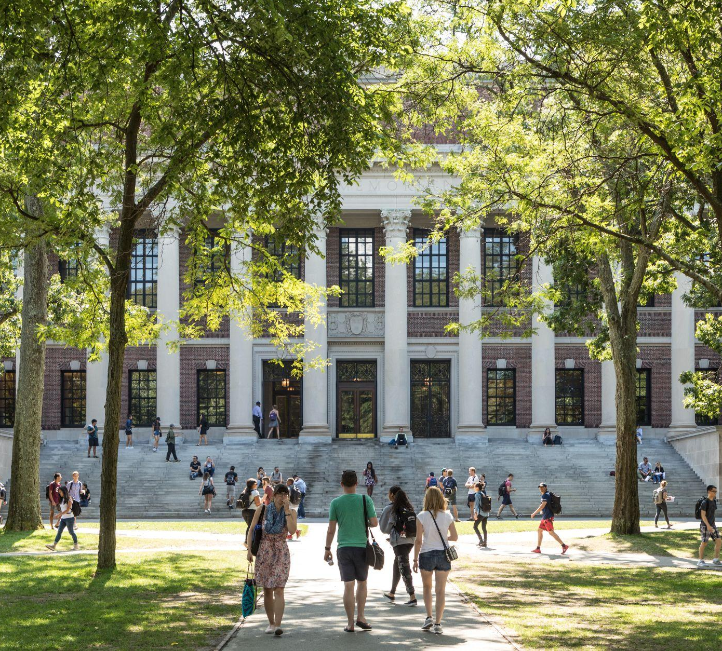
Build relationships
Early Collaboration: engage with International Services Office, recruitment, & families
Pre-Work: pre-arrival communication and orientation programs
International Conference Involvement: strengthen relationships with teams who support international students
Notes:
Ways to mitigate risk (cont’d)
Building Relationships: Collaboration with the International Services Office, recruitment strategies, and engagement with parents for support are essential.
PreWork: Discuss the significance of pre-arrival communication and orientation programs.
International Conference Involvement: Strengthening relationships with teams supporting international students.
Not to Do: Highlight common pitfalls and emphasize the importance of representing your institution positively.

Slide 10
What are key practices for handling refunds, sponsor payments, and embassy interactions?
Poll
Notes:
Pop Quiz at the End
What are key practices for handling refunds, sponsor payments, and embassy interactions?
Offer Prizes

Slide 11
Key Takeaways
STRATEGIES FOR MITIGATING RISK
Be responsible - identify risks, standardize policies, vet payments
Build relationships - early collaboration, pre-work, international conference involvement
Continued collaboration and learning among professionals in the field
Notes:
Key takeaways and strategies for mitigating financial risks for international students.
Encouragement for continued collaboration and learning among professionals in the field.
Open the floor for questions and discussion.

Slide 12
Questions?

Slide 13
Thank You
Stacy Sullivan
stacy.sullivan@flywire.com
Monique Gonzalez
moniquegonzalez@pointloma.edu
Ileana Acevedo iyacevedo@ucdavis.edu
Notes:
Thanks for your time today. If you have any follow-up questions, please feel free to contact me directly.

