Slide 1


Washington Update

Slide 2
Legal Disclaimer
The views and opinions expressed by the Presenter are those of the Presenter
This information is not intended as legal advice and may not be used as legal advice. Legal advise must be tailored to the specific circumstances of each case.
Every effort has been made to ensure this information is up-to-date as of the publication
This information is not intended to be a complete and exhaustive explanation of any laws or regulations, not should it be used to replace the advice of your campus legal counsel.
Notes:
Always consult with your campus legal counsel to ensure you are following federal, state, and local laws.

Slide 3
Agenda
118th Congress
  Appropriations
  Current Legislation
State Laws
CFPB
Department of Education
COHEAO Activity

Slide 4
118th Congress

Slide 5
118th Congress
In the Beginning…
  House: 221 Republicans – 214 Democrats
    Speaker Kevin McCarthy (15 ballots)
  Senate: 49 Democrats – 49 Republicans – 2 Independents
How it’s Going…
  House: 219 Republicans – 213 Democrats (3 vacancies)
    Speaker Mike Johnson (3rd speaker)
  Senate: 48 Democrats – 49 Republicans – 3 Independents
Notes:
Kevin McCarthy 1/7/23 – 10/3/23 15 ballots
Patrick McHenry (pro tempe) 10/3/23 – 10/25/23
Mike Johnson 10/25/23 – current
Currently only 430 voting members of the House. Majority to pass legislation is 216 only have one R padding.
Independent Senators: Bernie Sanders, Krysten Sinema & Angus King (Sanders and King Caucus with Dems)

Slide 6
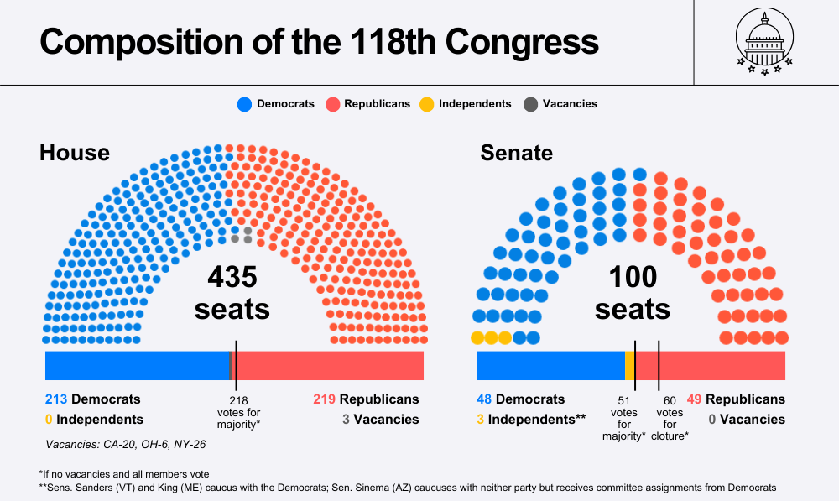

Slide 7
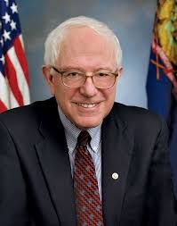
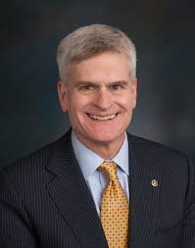
Senate Committees
Health, Education, Labor, & Pensions Committee:
11 D’s & 10 R’s
Bernie Sander (I-VT)
Chair
Dr. Bill Cassidy (R-LA)
Ranking
Notes:
We all know Senator Sanders…
What about Senator Cassidy? First physician to set at HELP Ranking member.

Slide 8
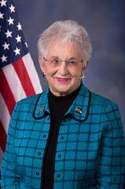
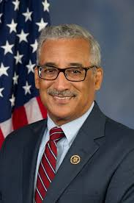
House Committees
Education & and the Workforce Committee:
25 R’s & 22 D’s
Dr. Virginia Foxx (R-NC)
Chair
Bobby Scott (D-VA)
Minority Leader
Subcommittee on Higher Education and Workforce Investment:
  Chair – Burgess Owens (R-UT)
  Ranking – Frederica Wilson (D- FL)

Slide 9
Biden Administration
Higher Ed Priorities:
  Student Loan Forgiveness
  Clarity and transparency on admission practices
  Convening national summit on educational opportunity
  Report on Strategies for increasing diversity and educational opportunity.
  Pell Increase
  Prioritize college completion
  Support minority-serving institutions
  Fix the broken student loan system
Notes:
9
Promote Educational Opportunities and diversity in college and universities

Slide 10

Current Fiscal Situation
Fiscal Year (FY) 2023
FY 2025
FY 2024

Slide 11
Current Fiscal Situation – Part I
Six bills were passed and signed into law (FY 2024)
  Agriculture – FDA
  Commerce, Justice and Science
  Energy and Water Development
  Interior
  Military Construction – Veterans Affairs
  Transportation – Housing and Urban Development
House: 339-85 Senate: 75-22
President signed on March 9.

Slide 12
Current Fiscal Situation – Part II
Final bills passed and signed into law for FY 24
  Defense
  Financial Services and General Government
  Homeland Security
  Labor, Health, and Humans Services, Education and Related Agencies
  Legislative Branch
  State, Foreign Operations, and Related Programs
House: 286 – 134 Senate: 72-24
President Signed on March 23
Notes:
Now keep in mind the 2024 fiscal year began on 10/1/2023. It was finally passed after several CRs, and splitting the package almost 7 months into the fiscal year.

Slide 13
President’s FY 2025 Budget
Modest increase to ED budget - $79.6 billion (Up $400M)
Max Pell Grant: $8,145
  $60 less than proposed last year
  Current: $7,395 (AY ’23 – ’24)
  AY ’24 – ’25: $7,395
Small increases to campus-based aid program
Free Community College - $90 billion
Advancing Affordability for Students - $30 billion
Reducing the Cost of College Funds - $12 billion
Notes:
President Biden’s 2025 FY proposal was published on March 11. This is the first time ever the President has published a budget BEFORE the current year’s budget has been passed.
Includes a 12 billion mandatory reducing the costs of college fund that will fund strategies to lower college costs for students.
Eliminate origination fees on federal student loans
Expands free community college through a federal-state partnership, and provides 2 years of subsidized tutition for student from families earning less than $125,000 enrolled in a HBCU, Tribal or Minority Serving Instition

Slide 14
Higher Education Act
House Bills
  H.R. 5933 – The Defending Education Transparency and Ending Rogue Regimes Engaging in Nefarious Transactions Act
    Sec. 117 – Foreign gifts
  H.R. 6585 – The Bipartisan Workforce Pell Act
    Allow Pell to be used for programs 150 clock hours or eight weeks
  H.R. 6951 – The College Cost Reduction Act
Notes:
HR 5933 – DETERRENT Act – expands oversight and disclosure requirements related to foreign sources and Institutions of higher education.
Disclose gifts from a foreign country of concern (China, Russia)
Revc. gift or contract of a foreign source that is valued at $50,000 of more or in combination of all other gifts in a calendar year (lowered from $250,000)
enters into a contract with a foreign country of concern or foreign entity of concern after recv. a waiver
Is substantially controlled by a foreign source.
Passed House 246 – 170 No movement in Senate
HR 6585 – introduced in the House by Rep. Stefanik in Dec 2023 – no movement

Slide 15
H.R. 6951 – College Cost Reduction Act
Uniform financial aid letters
Create a modified student record system
Revamp loan program
  Two repayment plans
  Sunsets PLUS Program
    Aggregate limits - $50K; $100K; $150K
      Individual has a total limit of $200K
      Annual limit = median cost of the program
Changes to accreditation
Notes:
Introduced by Rep Foxx on 1/11/24
Per the info sheet from the ED Workforce Committee:
Ensures that colleges have skin in the game by holding them financially responsible when they charge too much for degrees that leave students with debt they cannot afford.
ensures that college costs are clear, accessible and consumer friendly
Streamlines and enhances data collection and reporting
Prevents colleges from endlessly raising tuition – Sunsets the PLUS program
Protects student borrowers from unaffordable debt

Slide 16
Election Year
Presidential
All House Members
34 Senators – 33 regular, one special (NE)
  10 R’s, 20 D’s, 3 I’s
11 Gubernatorial elections
  8 R’s, 3 D’s
  NH, NC – a toss-up
Notes:
204 - # of days until general election on 11/5/24
Senate – 33 regular (this includes Feinstein’s seat as her re-election would have been this year) and 1 special to fill the last 2 years of Ben Sasse (NE)

Slide 17
How are Laws Created?
Notes:
KAREN

Slide 18
Here is how……………
Regulations
  CFPB
  DOE
Legislation
  Federal
  State Law
Judicial – Case Law
Notes:
KAREN

Slide 19
ED’s Negotiated Rulemaking Process
Intent to Establish Committee
Request for Nominations
Rounds of Negotiations
Proposed Rules Published
Comment Period
Final Rules Published
by Nov. 1
Effective
Next July 1
Public Hearings
Notes:
MARIA

Slide 20
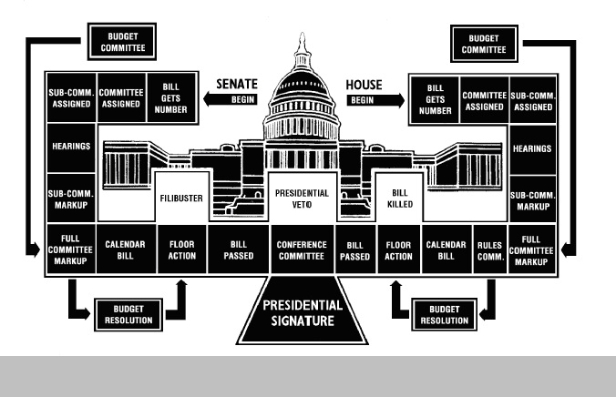
Legislative Process
Notes:
Karen

Slide 21
WHAT’S NEXT?
Notes:
Karen

Slide 22
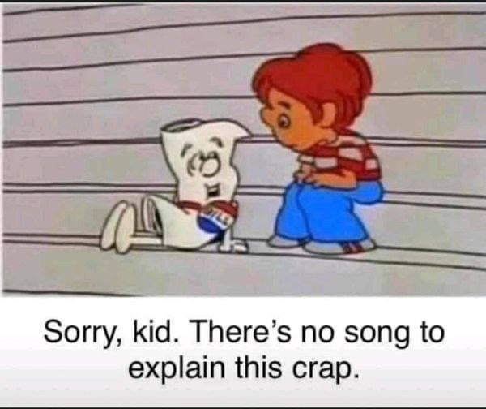
Notes:
Karen

Slide 23

Notes:
KAREN

Slide 24
Consumer Financial Protection Bureau
Created by the Dodd-Frank Wall Street Reform and Consumer Protection Act of 2010
Independent bureau within the Federal Reserve System, run by a Director who is a Presidential Appointee, confirmed by the Senate.
Authority to issue rules for all financial institutions, including rules under the Truth in Lending Act, Fair Debt Collection Practices Act, Equal Credit Opportunity and Real Estate Settlement Procedures Act.
Rohit Chopra confirmed as Director 10/1/21
  Former Student Loan Ombudsman
Notes:
Bureau has huge authority
Rulemaking – Perhaps the most significant authority of the Bureau
Supervisory
Enforcement*
Student Loans are a top priority
CFPB has access to consumer complaints within the FTC Consumer Sentinel database (In the past only accessible through law enforcement agencies.)
Funded by the US Treasury-No Appropriations
No oversight

Slide 25
CFPB
Bureau has huge authority
  Supervisory Rulemaking – Perhaps the most significant authority of the Bureau
  Enforcement (Student Loans are a top priority?
  CFPB has access to consumer complaints within the FTC Consumer Sentinel database (In the past, it was only accessible through law enforcement agencies).
  Funded by the US Treasury-No Appropriations
  No oversight
  SCOTUS Court Cases
    2020 decision director serves at the pleasure of the President
    Is the funding Constitutional?
Notes:
25
KAREN

Slide 26

Schools are “financial institutions” under federal law
NCM Presentation
RFP/RFI Presentation
NACUBO Advisory Report
Sample FRA
Notes:
KAREN

Slide 27

Compliance & Alphabet Soup
CFPB
DOE/FSA
ECOA – Reg B
FCRA
FDCPA- Reg F
FERPA
GLBA
HEA
HIPAA
PCI 4.0
Red Flag Rules
SCRA
SOL
TCPA
TILA - Reg. Z
UDAAP
Notes:
KAREN

Slide 28

CFPB Is The Chef
UDAAP
FDCPA
  Collection Costs
  New Debt Collection Rules-Reg F
  Statute Of Limitations
FCRA
Service Providers
Collections and Collection Agencies
Servicemembers Civil Relief Act (SCRA)
Safeguard Rules
Complaint Process
Financial Literacy
Etc.……
Notes:
KAREN

Slide 29
CFPB & UDAAP
It is unlawful to engage in any Unfair, Deceptive, or Abusive Acts or Practices
  FDCPA makes it illegal for debt collectors to engage in this activity
  CFPB has the authority to protect consumers against UDAAP violations
  Original creditor and debt collectors
Notes:
KAREN

Slide 30
Service Providers
Supervision of Service Providers
  Financial institutions under Bureau supervision may be held responsible for their contractors.
  Bureau expects that supervised financial institutions have an effective process for managing the risks of service provider relationships.
  A service provider is defined in the Dodd-Frank Act as “any person that provides a material service to a covered person in connection with the offering or provision by such covered person of a consumer financial product or service.”
  Institutions must ensure that business arrangements with service providers do not present unwarranted risks to consumers.”
  Solution: Oversee all third-party services, require audits and make sure requirements are all contract driven.
Notes:
30

Slide 31

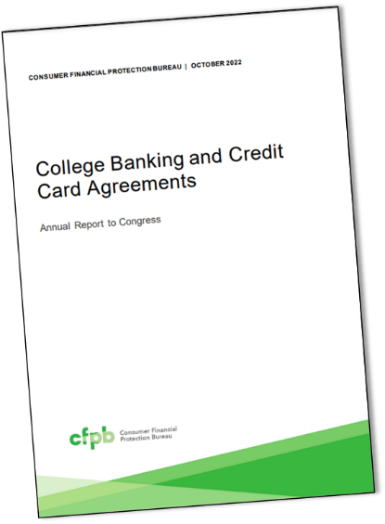
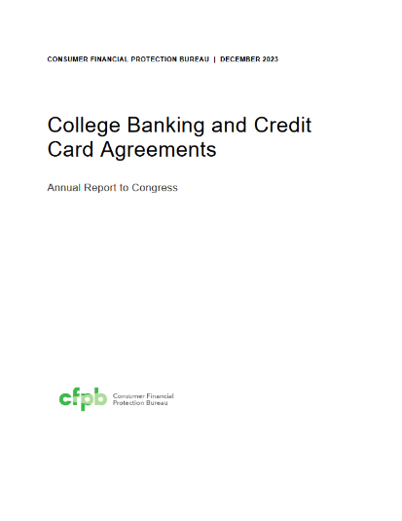
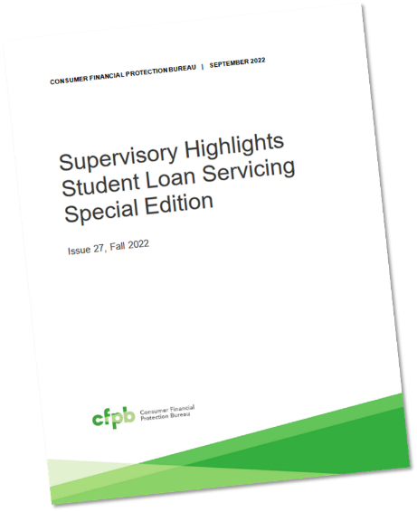
CFPB Reports
Sept. 2023
Denounces the Use of Payment Plans
Oct. 2022
Examines Compliance Cash Management Rules
Dec. 2023
14th annual report to Congress on college credit cards pursuant to the CARD Act
Feb. 2022
Describes Transcript Holds as “Abusive”
Notes:
KAREN

Slide 32
CFPB Examination
CFPB Supervisory Examinations
Find Violations of Federal Law by Student Loan Servicers and University-Owned Lenders
  The CFPB examines private student lenders of all sizes, including entities that operate school-based lenders that extend loans directly to students.
  Examination findings cover student loan servicers' practices and schools that lend to students directly.
  The exams found that these schools had improper blanket policies of withholding transcripts to force students to make payments
Notes:
KAREN

Slide 33
CFPB Examination
Specifically, CFPB Examiners will be looking at:
  Placing enrollment restrictions: Students who are late on their loan payments may be restricted from enrolling in or attending classes, which could delay their graduation and prevent them from finding employment.
  Withholding transcripts: When a school withholds academic transcripts from students that owe the school a debt, this prevents students from using their transcripts to demonstrate their education levels in the job market.
  Improperly accelerating payments: Schools that use acceleration clauses in their loans when a student withdraws from the program could be putting a heavy financial burden on the student by making the loan immediately due and collectible.
  Failing to issue refunds: If a borrower withdraws from a program early, they may be entitled to some refunds by the school.
  Maintaining improper lending relationships: Schools that have preferential relationships with certain lenders may pose risks to students because, for example, they may end up paying more for their loan.
Notes:
KAREN

Slide 34
Tuition Payment Plan Report
CFPB Report finds College tuition payment plans can put student borrower at risk.
Some payment plans can be confusing, carry expensive fees, and lead students further into debt.
  https://files.consumerfinance.gov/f/documents/cfpb_tuition_payment_plan_report_2023-09.pdf
Notes:
The CFPB’s Report: Tuition Payment Plans in Higher Education – published 9/14/2023
The CFPB reviewed 450 college websites to gather publicly available data on tuition payment plans and related contracts. In addition the CFPB analyzed consumer complaints, met with industry participants, and conducted interviews with current students.
On Monday @ 10:00 Sean Steinmarc is presenting on Payment Plan Best Practices – If you want to learn more this will be a very valuable session. Of course it’s opposite my session on Developing Effective Policies and Procedures, but I wont blame anyone if they skip mine and go to his.

Slide 35
CFPB Junk Fees
Supervisory Highlight – Published Oct. 2023
CFPB launched an initiative to scrutinize junk fees charged by banks and financial companies.
https://files.consumerfinance.gov/f/documents/cfpb_supervisory_highlights_junk_fees-update-special-ed_2023-09.pdf
Cap on Credit Card Late Fee of $8 was to take effect May 14, 2024
Notes:
Junk fees are typically not subjected to the normal forces of competition, leading to excessive costs for services that a consumer may not even want. For example, certain banks and financial companies might hide these unavoidable or surprise charges or disclose them only at a later stage in the consumer’s purchasing process, if at all.
While the CFPB’s Supervisory highlight did not mention Institutions of Higher Education, the White House did publish a Fact Sheet on 3/15/2024 indicating new action to crack down on junk fees in higher education. i.e. eliminating origination fees, putting an end to college banking junk fees, eliminating automatic charges for text books, stopping colleges from pocketing leftover meal plan dollars…

Slide 36
But wait……..
Judge Mark Pittman of the U.S. District Court for the Northern District of Texas on Friday granted an injunction sought by the banking industry and other business interests to freeze the restrictions
In his ruling, Pittman cited a 2022 decision by the U.S. Court of Appeals for the Fifth Circuit that found that funding for the Consumer Financial Protection Bureau (CFPB), the federal agency set to enforce the credit card rule, is unconstitutional.
Financial Advocates claim this exceeds the CFPB's statutory authority and will lead to more late payments, lower credit scores, increased debt, reduced credit access and higher APRs for all consumers
Likely will be overturned now.

Slide 37
The Department

Slide 38
Student Loan Repayment
First payments for borrowers started in October 2023
Grace period
  No credit bureau reporting
  Blind eye to delinquency
SAVE Repayment Program
  Increase discretionary cap to 225% of poverty
  Payment based on 5%
Improvements to current forgiveness programs
  4 million borrowers - $300 billion

Slide 39

Final Rules Published
Financial Value Transparency + Gainful Employment (9/28/23)
Financial Responsibility (10/31/23)
Certification Procedures (10/31/23)
Ability to Benefit (10/31/23)
Administrative Capability (10/31/23)
All Effective July 1, 2024

Slide 40
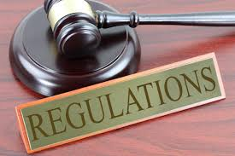
668.14(b)(33) To provide that an institution may not withhold official transcripts or take any other adverse action against a student related to a balance owed by the student that resulted from an error in the institution’s administration of the title IV, HEA programs, or any fraud or misconduct by the institution or its personnel;
668.14(b)(34) To require an institution to provide an official transcript that includes all the credit or clock hours for payment periods in which 1) the student received title IV, HEA funds; and (2) all institutional charges were paid, or included in an agreement to pay, at the time the request is made.
Regulatory Language

Slide 41
Proposed Rulemaking
Forgiveness
  October, November, and December
  Did not come to consensus
  4th Session (February) – Focus on “hardship”
Program Integrity and Institutional Quality
  January, February, and March
  Cash Management, State Authorization, Distance Education, R2T4, Accreditation and TRIO
  Did not come to consensus

Slide 42
Biden’s Current Student Loan Forgiveness PRM
Student Debt Relief for the William D. Ford Federal Direct Loan Program (Direct Loans), the Federal Family Education Loan (FFEL) Program, the Federal Perkins Loan (Perkins) Program, and the Health Education Assistance Loan (HEAL) Program
  $3.6 billion for nearly 206,800 borrowers through SAVE. This relief will go to borrowers enrolled in the SAVE Plan and with smaller loans for their post-secondary studies. Borrowers can receive relief after at least 10 years of payments if they originally borrowed $12,000 or less for college. Each additional $1,000 in borrowing adds 12 more months until forgiveness. All borrowers on SAVE receive forgiveness after 20 or 25 years, depending on whether they have loans for graduate school. The benefit is based upon the original principal balance of all Federal loans borrowed to attend school, not what a borrower currently owes or the amount of an individual loan. Today’s announcement brings total relief approved under SAVE to $4.8 billion for almost 360,000 borrowers.
  $3.5 billion for 65,800 borrowers through administrative adjustments to IDR payment counts that have brought borrowers closer to forgiveness and addressed longstanding concerns with loan servicers' misuse of forbearance. Including today’s announcement, the Biden-Harris Administration has approved $49.2 billion in IDR relief for more than 996,000 borrowers.
  $300 million for 4,600 borrowers through fixes to Public Service Loan Forgiveness (PSLF). This update comes shortly after the Department announced new PSLF discharges a few weeks ago. The Administration has approved $62.8 billion in forgiveness for almost 876,000 borrowers
  through PSLF.

Slide 43

Next Steps
Higher Education community to submit feedback to ED
  Hopeful for sub-regulatory guidance and clarifications
Schools will need to look at systems and policies
Begin conversations with campus stakeholders
Notes:
MARIA

Slide 44

FAFSA
Notes:
Also known as “the cluster”.

Slide 45
FAFSA
Toolkit For Institutions
HEA requires ED to issue FAFSA by January 1
The department met that requirement (beta)
Many issues – everyone needs FSA ID
  Individuals without SSN
ED devotes $50 million to help schools
ISIR delays – now being issued this month
Partial fix to SSN issue
Completion Tracker
Notes:
Colorado
-Completion Rate for High School Seniors 24.5%
-Down over 18,000 aps from same time last year
-National average for HS Seniors completion is down 40%
-Overall FAFSA submissions, which include forms that still need corrections, are down 27 percent year-over-year.

Slide 46
State Laws

Slide 47
COHEAO Current State Advocacy
MN bill – HF4100
NJ bill - A2121
CO bill – HB 24-1380
Student Loan Equity Act
  Carve out clarifications
CA bill – AB 1160
Notes:
AB1160 – amendments made and passed Assembly – off to Senate. Now it sits.
Minnesota bill -huge collection debt bill. Andy from ACA said there are a lot of amendments to the bill-including statue of limitations, it is staying at 6 years. Amendments should be out soon. Definition what a debt collector has been removed. COHEAO got a group with ACA to do a sign on opposition.
Minnesota 40663-transcript law will be expiring 6/30/2024 They are extending that bill.
New Jersey bill 82121: Introduced in January 2024 like the NY bill. Registration of private education lenders. COHEAO keeping an eye on the bill.
CO 24-1380 this Bill does 2 things. First, this Bill will bar a debt collector from pursuing judicial remedies in their own name – essentially barring assignments on all consumer debts – unless the collector becomes a debt buyer. Second, this Bill will prevent debt collectors from having the ability to get a bench warrant in any litigation.
Student Loan Equity Act- Schools after register in state of CO if they service Private Student Loans to CO residents-seeking clarification
To learn more detail on the state compliance issues join COHEAO participate in our bi weekly Advocacy Grass Roots Meetings. See me for details.

Slide 48

Cali had it again………………
CA – AB 1160 – protecting Students from Creditor Colleges Act.
  Author- Blanca Pacheco, First Year Dem.
  No other Co-Signers
  Introduced 3/2023 – Committee Hearing 4/18/2023
  Prohibit IHE from barring students registration/re-enrollment because they owe institutional debt
  Prohibit IHE from withholding degree or certificate because they owe institutional debt
  Prohibit the placement of institutional debts with for-profit third-party debt collectors
  Prohibits the state tax offset as a means to recoup monies owed to IHE

Slide 49
CA AB 1160 Amended
The Protecting Students from Creditor Colleges Act would expand the current transcript withholding prohibition on students who owe a debt, including diplomas and certificates. The bill would also restrict registration holds. The measure, as introduced, prohibited institutions from contracting with a third-party debt collection agency or selling debt to a collection agency to recover existing and future debt and restrict participation in the IIC.
Passed the House
Stalled in the Senate
Current legislation, as written so far,
  Removed the prohibition of placing with a third-party collection agency
  Instilled a 180-day waiting period from the date the institution first requested payment for a debt placed.
  Schools are required to send a “Good Bye Letter” before placement.
  Updated Registration Hold provision to a one-time
  exemption
Notes:
KAREN

Slide 50
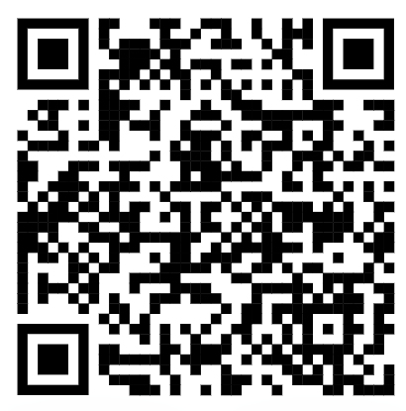
SIGN THE OPPOSITION LETTER
Notes:
AB1160 – amendments made and passed Assembly – off to Senate. Now it sits.
Minnesota bill -huge collection debt bill. Andy from ACA said there are a lot of amendments to the bill-including statue of limitations, it is staying at 6 years. Amendments should be out soon. Definition what a debt collector has been removed. COHEAO got a group with ACA to do a sign on opposition.
Minnesota 40663-transcript law will be expiring 6/30/2024 They are extending that bill.
New Jersey bill 82121: Introduced in January 2024 like the NY bill. Registration of private education lenders. COHEAO keeping an eye on the bill.
CO 24-1380 this Bill does 2 things. First, this Bill will bar a debt collector from pursuing judicial remedies in their own name – essentially barring assignments on all consumer debts – unless the collector becomes a debt buyer. Second, this Bill will prevent debt collectors from having the ability to get a bench warrant in any litigation.
Student Loan Equity Act- Schools after register in state of CO if they service Private Student Loans to CO residents-seeking clarification
To learn more detail on the state compliance issues join COHEAO participate in our bi weekly Advocacy Grass Roots Meetings. See me for details.

Slide 51

Minnesota
  SF 4065/HF4100
    A bill for an act relating to consumer protection, modifying various provisions governing debt collection, garnishment, and consumer finance; providing for debtor protections
    Massive Bill- Not just healthcare
    Effects garnishments, bank levies, etc.
    SOL from 6 to 3 years
Notes:
KAREN

Slide 52
State Laws To Watch (Current & Future)
Additional documentation, disclosure, and other collection requirements:
  D.C. (B24-357) – Law Passed and Effective August 2022
    limits on calls, electronic communications, etc.
  New York (A5286) - Private Education Debt Registry Bill- Vetoed Law By the Governor
    Required 1st party to register with the state and intensive reporting requirements
  New Jersey (A2121)- Introduced January 2024 & Referred to Assembly Higher Education Committee
    This bill requires registration of private education lenders and establishes protections for private education borrowers
  CO– HB 24-1380
    Regulation of Debt-Related SerChanging SOL from 6 to 5 years, originally proposed at 3-year
    vices
    Require Collection Agency to buy debt to litigate
  MA (S2638)-Rewrote S629
    Changing SOL from 6 to 5 years, originally proposed at 3-year
  MN (SF 4065/HF4100- Amended)
    Removed prohibition of judgment renewal
    Removed 1st party collection
    Removed 3 year SOL
Notes:
KAREN

Slide 53
State Laws To Watch (Current & Future)
  Privacy Laws (15 States)
    Ky House Bill 15 Kentucky Consumer Data Protection Act- effective Jan 2026
    California, Virginia, Colorado, Utahk Connecticut Iowa, Indiana, Tennessee, Montana, Texas, Oregon, Delaware, New Jersey, and New Hampshire
  Servicing Laws- licensing or registration requirements
    California, Colorado, Connecticut, District of Columbia, Illinois,
    Maine, Massachusetts, Montana, New Jersey, New York,
    Rhode Island and Washington
    IL is updating current Law to include cosigners and to publish flexible payment plans on the website
Notes:
KAREN

Slide 54
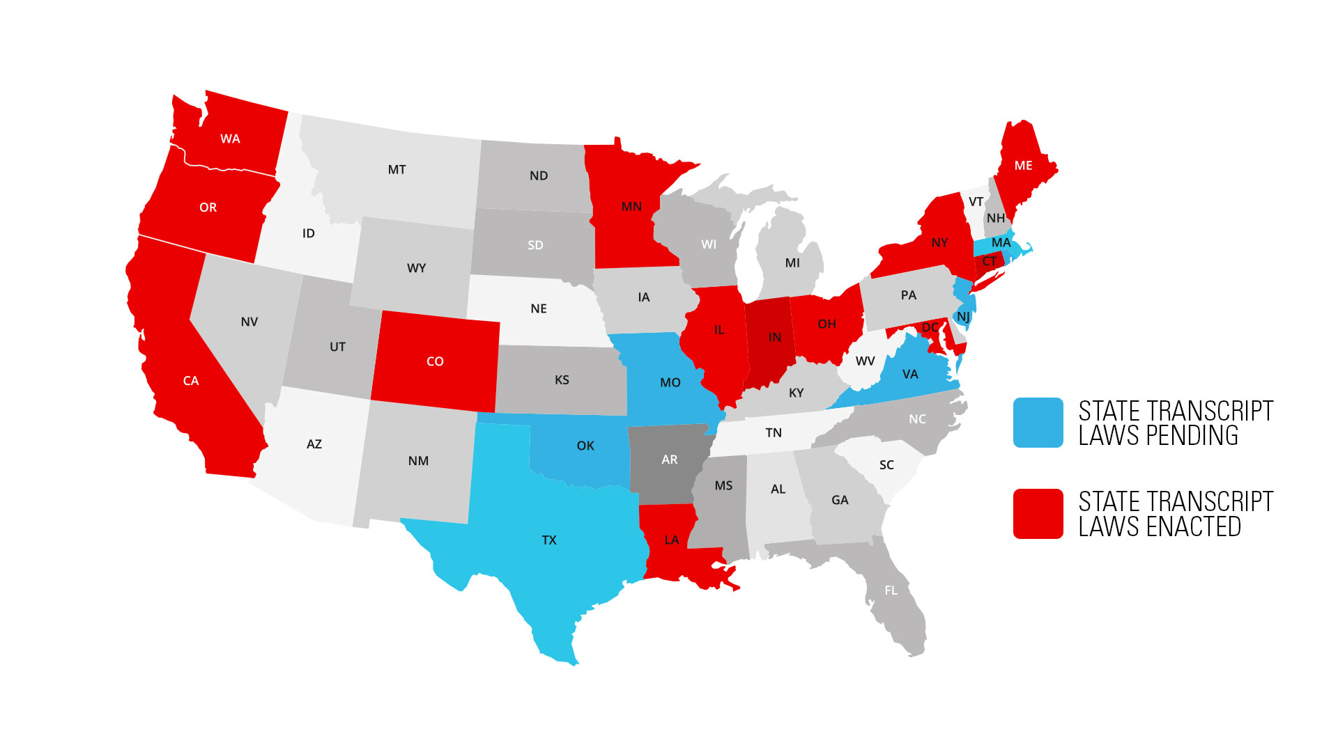
State Transcript Laws
Notes:
State Activity
Significant increase interest
13 states have passed laws
Range of impact
8 states debating legislation last year
Some revising existing law
There are several sessions that address transcript withholding: Today at 4:30pm Christina Cardinale and Caleb Rosenburg will be presenting Collecting Student Accounts Post Transcript Laws, and tomorrow there is a session presented by Annamaria Veneziano, and Robert Mirabel titled State or Provate: A Comparative Approach to the Ever-changing Transcript Withholding Regulation.

Slide 55
State Transcript Laws – Enacted
CA – A.B. 1313 – Effective date 1/1/2020
WA – HB 2513– Effective date 6/11/2020
LA – HB 676 – Effective date 8/1/2020
MN – H.F. 6 & 7 – Effective date 7/1/2021
  Expires 6/30/24
OH – HB 1110 – Effective date 9/1/2021
OH - New Appropriations Bill includes Private Schools
ME – LD 1838 – Effective date 3/31/2022
CO – HB 1049 – Effective date 4/21/2022
Notes:
KAREN

Slide 56
State Transcript Laws – Enacted
NY – S5924-C – Effective date 5/30/22
IL – SB3032 – Effective date 5/27/22
IN - Bill 404 – Effective date 4/20/23
IL - SB 49 – Effective date 6/9/223 (Amends 2022 law)
CT - SB922 – Effective date 6/9/23
MD - SB0248 – Effective date 7/1/23
OR - SB424 – Effective date 7/1/24
Notes:
KAREN
Newest Law- Oregon
Prohibits post-secondary institutions of education that are based in Oregon from refusing to provide transcript to current or former student because student owes debt to institution. Requires institutions to submit report to Higher Education Coordinating Commission by September 15, 2024, detailing policies relating to providing transcripts and transcript holds] number of current and former students who owe debt to institution and institution's policy and procedures on phasing out transcript holds

Slide 57
State Transcript Laws - Pending
LA HB183 – Introduced in 2022 (prior session)
MA H1277– Reintroduced 1/2023
MN bill - H400-4165 & H40663-Introduced 2024
  Extend current Law
MO HB 972 – Reintroduced 1/25/2023
NJ A1198 – Passed House, referred to Senate on 12/2022
S1115 – Introduced in Senate 1/2022 (prior session)
S3548 – Introduced 1/31/2022 – No action
OK B2785 – Introduced 2/8/2023
RI S696 – Introduced 3/22/2023 – Referred Commerce Comm.
TX HB 306 – Introduced 2/2023 – Original bill 11/2020
VA SB159 – Prior Session
  HB 732 – Prior Session
Notes:
KAREN

Slide 58
NOW WHAT?
Notes:
MARIA

Slide 59
Now What?
Higher Education Associations are talking with the CFPB to define "Blanket Policies."
Develop clear and concise policies based on state law
Make sure the policy is transparent
Update FRA’s
  New Advisory Report
Avoid policies that create inequitable outcomes
Waiting on further guidance from the department
Develop process and program systems to identify what terms were paid by federal monies
Run it by legal counsel

Slide 60
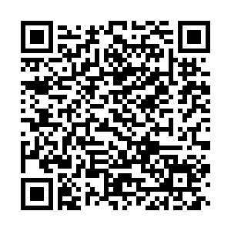
NACUBO
New FRA Advisory Report

Slide 61
Advocate
Monitor state legislation on both the assembly and senate website
Comment on Proposed Regulations
When legislation is introduced, reach out to your administration, legal counsel, public affairs, and other higher education associations
Work with legislators to make the legislation more palatable for all
Review the flagship larger universities policies to strategize on how and if you want to use your political capital

Slide 62
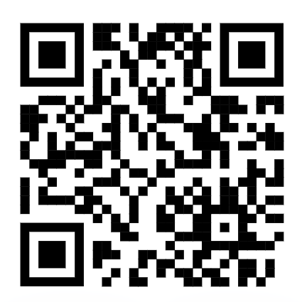
JOIN COHEAO

Slide 63

Register Today
Discount Code:
CONF2024

Slide 64
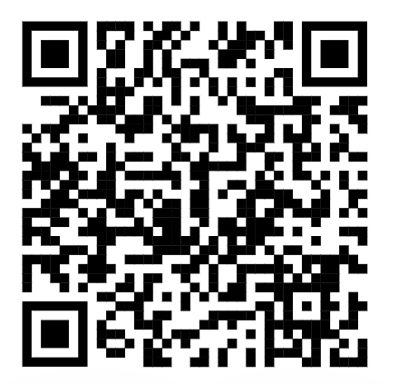
SIGN UP TODAY

Slide 65
Questions?
Presenter: Karen Reddick
COHEAO Legislative Chair
kreddick@ncmstl.com
314-603-9500

Slide 66
Resources
COHEAO
FSA PARTNER CONNECT
CFPB
NCM
ACA International
Notes:
KAREN

Slide 67

Notes:
BOTH

