Slide 1
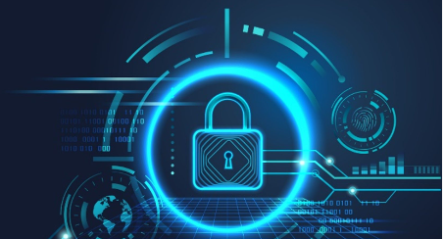
When, Not If The Realities of Cybersecurity in Higher Education
Virgil Lloyd, Sr. BDE
Nelnet Campus Commerce

Slide 2
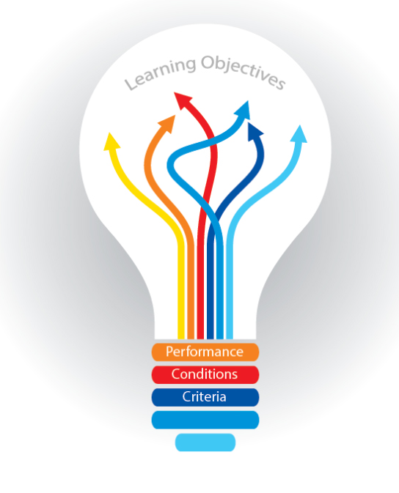
Learning Objectives
Unique Aspects of HE
Ransomware
What to Do?
PCI-DSS v4.0

Slide 3
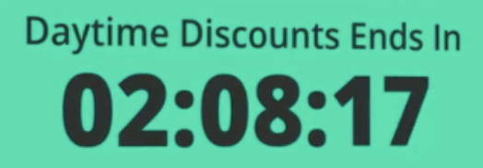
My cybersecurity story
Danner Boots mishap
Scam on IG
Formjacking
“Flash Sale”
Timestamp

Slide 4
Unique Aspects of Higher Ed
Valuable Data
Student/Staff PII
Patient Medical Records
Research Data
Lab Equipment
More Decentralized
Collaborative by design
Spending on Cyber lags other industries of similar size

Slide 5
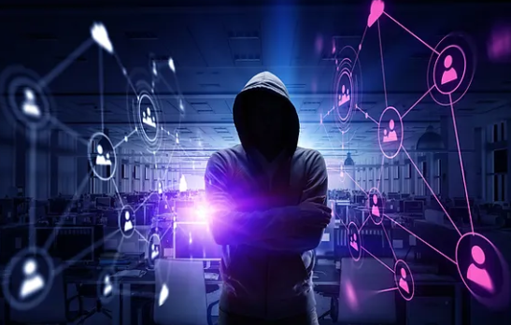
Current Threat Environment
Ransomware
Compromise as a Service/Cybercrime as a Service
Generative AI
Cloud intrusions
Nation State Actors
200 Institutions reported research data
and IP theft in 2021-2022
“Teenagers” (18-25)
Lapsus$
International extortion-focused hacker group
known for its various cyberattacks against companies and government agencies
Notes:
Generative AI is a type of artificial intelligence technology that can produce various types of content, including text, imagery, audio and synthetic data.

Slide 6
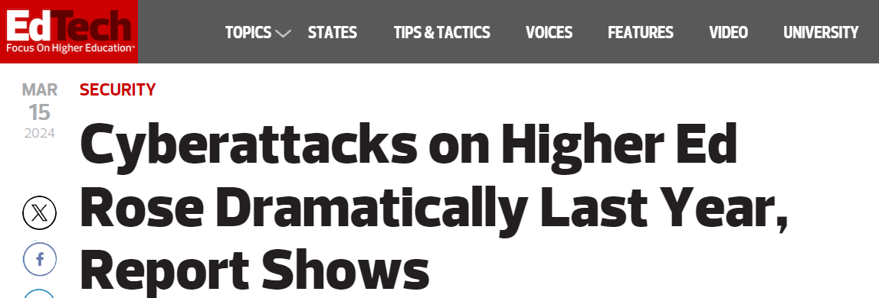
Current Landscape
higher education specifically, attacks were up 70 percent (68 in 2022 to 116 in 2023). Those numbers are based only on incidents in which a ransom was not paid, the report notes, meaning that the actual number of attacks was probably significantly higher.

Slide 7
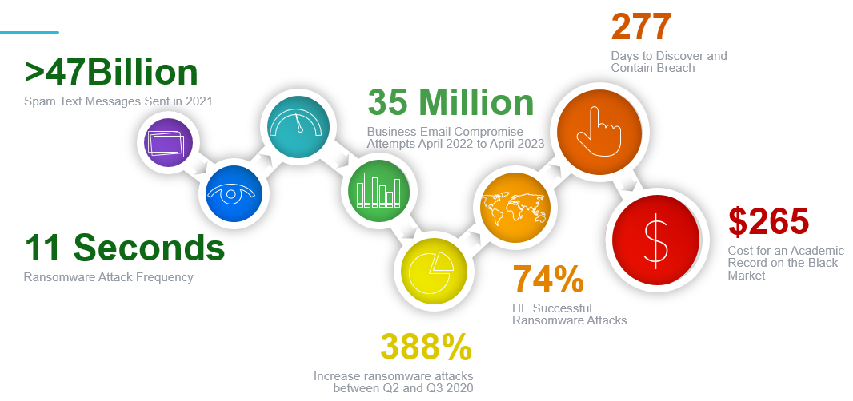
Current Landscape

Slide 8
Ransomware Growth HE 2023
Education Sector
19% growth in ransomware attacks in April 2023
35 unique victims in May
410 March
Attackers intentionally delayed until students had returned to school
163 January
Notes:
June – Colorado Dept of Education
LA Unified School District
Chattanooga State CC
Mercer University
52 Ransomware attacks to colleges and universities so far this year
$1.5M average cost
22 Days – average downtime

Slide 9
Why the Increase?
Ukraine War Effort
New entrants to the field
Akira
Ransomware-as-a-Service (RaaS) group that started operations in March 2023
Dozens of schools and businesses in March
Notable Attacks
CommScope
Network giant—schools, hospitals, federal
Specializes in network and telephony equipment for schools
Vice Society
Specifically targets schools
Responsible for LA School District Attack
“Success in Mediocrity”
Responsible for CommScope attack
“All of your files have been encrypted by Vice Society.”

Slide 10
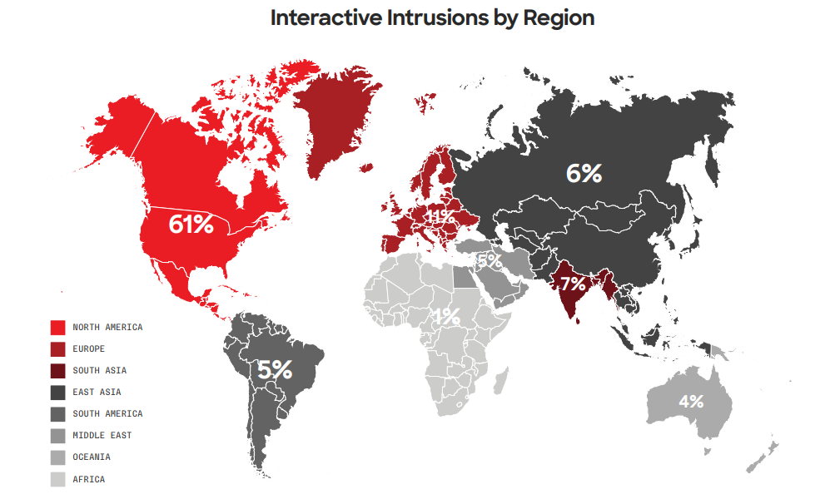
Data Exfiltration

Slide 11
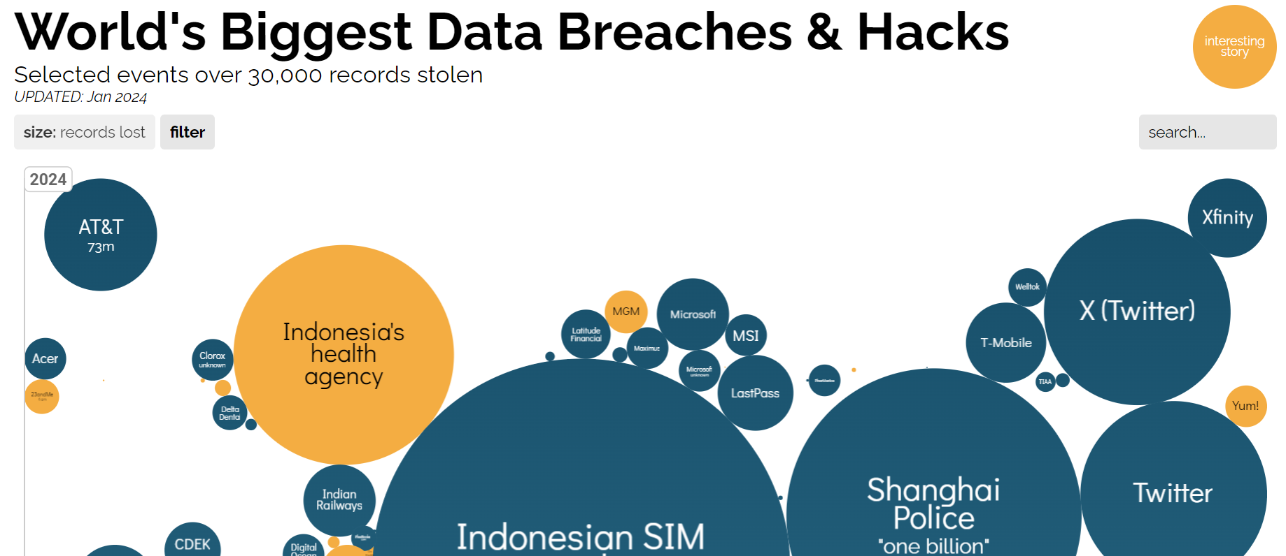
Current Landscape

Slide 12
Frequency
Experience repeat attack in 12 months
80%
A replay attack occurs when a cybercriminal eavesdrops on a secure network communication, intercepts it, and then fraudulently delays or resends it to misdirect the receiver into doing what the hacker wants.

Slide 13
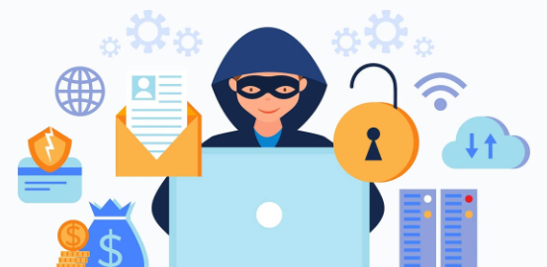
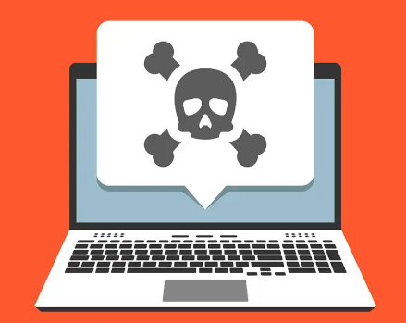
How they Infiltrate
41%
63%
Compromised by Social Engineering
Malware Targeting Education Sector
43% of all attacks against education sector were carried out by Social Engineering
63% of all malware written specifically targets education sector

Slide 14
Ransomware Payouts
The proportion of organizations paying seven-figure payouts
11%
40%
2022
2023

Slide 15
Responding to Ransomware
46%
Regained Data with Some or All Data Corrupted
51%
3%
Successfully Regained All data
Did Not Gain Access to Encrypted Data

Slide 16
Q&A
Do you have a cybersecurity story you’d like to share?

Slide 17
PCI-DSS v4.0
What is it?
PCI DSS v4.0
Next global standard
Driven by industry feedback
200+ companies
6,000+ items
New controls
Global standard
Protect payment data

Slide 18
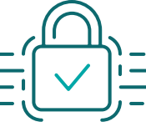
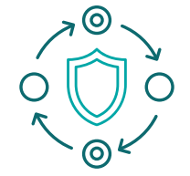
PCI-DSS v4.0
Promote security
Continuous Process
Increase flexibility
Validations methods

Slide 19
PCI-DSS v4.0
Security must evolve
Expand MFA • Updated password requirements • New e-commerce and phishing requirements
Criminals never sleep
Clear roles and responsibilities • Added guidance implement and maintain security • More transparency for report reviewers
Flexibility supports innovation
Allowance of shared accounts • Targeted risk • Customized approach to implement and validate
Transparency and granularity
Alignment between reporting and SAQ and info summarized in AOC

Slide 20
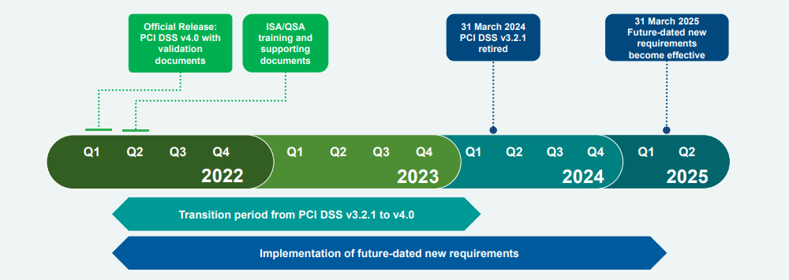
PCI-DSS v4.0

Slide 21
Q&A
How is your team prepping for the transition to PCI-DSS v4.0?
Reviewing our vendor partners and discussing their preparedness
We are applying new innovations including expanding our MFA
We are updating our password requirements
All of the above

Slide 22
PCI-DSS v4.0
Relieve PCI burden
Support
Vendor Partner
Outsourcing to third party
Are they maintaining compliance & gearing up for v4.0?
Applying innovations?
Embrace MFA
How are they working to prevent malicious code?

Slide 23
Compliance vs. Security
Compliance is not Security
Equifax was 100% compliant when they were breached

Slide 24
What to Do?
“The most effective Cyber Hygiene is fundamental and persistent end user training”

Slide 25
Q&A
Are you trained regularly on cybersecurity threats and how to spot and respond to them?
YES
NO

Slide 26
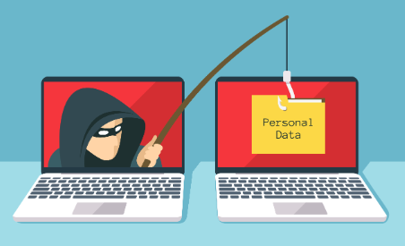
Phishing Training
Not just identifying Phishing Emails
Driving Awareness
Replicate Threats
80% of organizations that implement awareness training see a reduction in phishing susceptibility - Proofpoint
“Sutton’s law tells us ‘When diagnosing, first consider the obvious.’ Thus, if you wonder why criminals phish, it is because email is where their targets are reachable.” –Verizon 2022 Data Breach Report

Slide 27
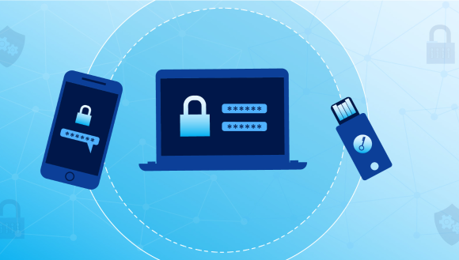
Practical Application
Utilize MFA on Everything
Consider a Password Manager
Use Passphrases vs. Passwords
I drive a 1998 Honda
HondadrivesMe?1998!

Slide 28
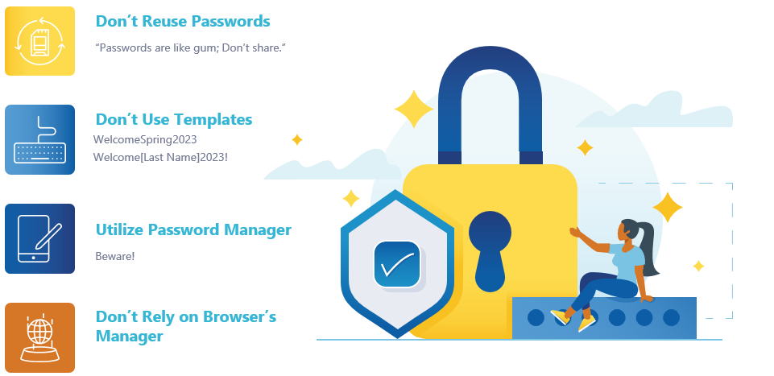
Passwords

Slide 29
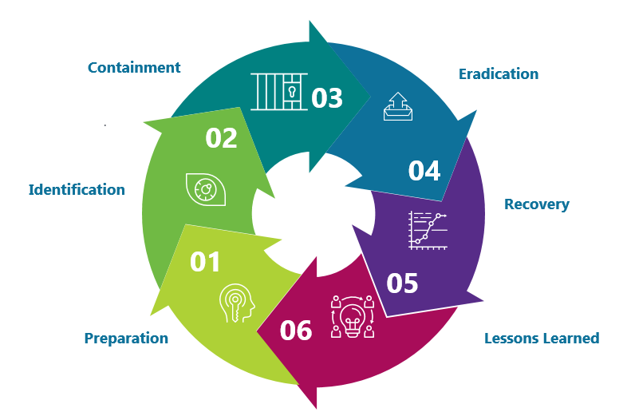
Response Plan
“By failing to plan you are preparing to fail.”
- Benjamin Franklin

Slide 30
Response Plan
Test Your Backups
Test Failures of Systems
Have Conversations w Faculty/Staff
Talk to Other Schools
SIS
Physical Security/Cameras
CRM
Payroll
What If?
What Scenarios can they think of?
Current Threats
Collaborate with Other Schools
User Organizations
How Long for Full Restore
Are the Backup Immutable?
How/Where Can You Access Backups?.

Slide 31
Tabletop Exercises
Combined exercise across multiple departments
Business Office
IT
Operations
HR
Compliance
Executive Leadership / Board
Don’t be afraid to develop “no win” scenarios

Slide 32
Burnout and Shortcuts
Cybersecurity requires attention to detail
Burnout compels people to engage in workarounds to retain energy
Cyber hygiene is most likely to deteriorate when a person is burned out

Slide 33
Artificial Intelligence
AI isn’t the “threat”
It’s a tool, nothing more
Phishing Threats
New Attack Landscape
Legacy Code Tools
Daily Tasks

Slide 34
Summary
1.
2.
3.
4.
5.
Training
Risk
Access
Patch
Plan
Make cyber awareness training standard across all users.
Consistent conversations about risk.
Develop a Risk Register.
Prioritize risk based on role and criticality.
Enable MFA for all accounts.
Encourage use of strong passwords.
Unique Passwords
Prioritize patch management as a standard practice.
Maintain accurate inventory of all systems.
Plan for the compromise.
Practice the plan regularly
Involve all levels

Slide 35
“10 Immutable Laws of Security”
Security success is ruining the attacker ROI
Not keeping up is falling behind
Productivity always wins
Attackers don’t care
Ruthless Prioritization is a survival skill
Cybersecurity is a team sport
Your network isn’t as trustworthy as you think it is
Isolated networks aren’t automatically secure
Encryption alone isn’t a deep protection solution
Technology doesn’t solve people and process problems

