Slide 1
Transitioning to a Cashless Environment
Student Financial Services
Dena Zlatunich, Stanford University

Slide 2
Our Time
Student Payments
Department Depositors
The Result

Slide 3
Student Payments
What do we do with our Cash payment?

Slide 4
Stanford Background
Private Institution
Approximately 16,000 students (UG & GR)
Currently bill ~ $1.0B per Academic Year

Slide 5
July 2013
Student Financial Advisory Board
770+

Slide 6
Why in 2013?
E-banking services
International Funds Transfer
Tracking and reconciliation of payments
Audit risks
Vulnerabilities of cash handling by staff

Slide 7
The Logistics
Collaboration with banks
Organized trainings
Go-live August 20th!!

Slide 8
Return of Investment (Benefit to the Community)
International Funds Transfer (IFT) payments
Extra security
Being cashless…

Slide 9
Outreach & Communication
Email
Website
Stanford ePay
Student “To-Do”
Campus Meetings
New Student Orientation

Slide 10
Department Depositors
What do we do with our Cash payment?

Slide 11
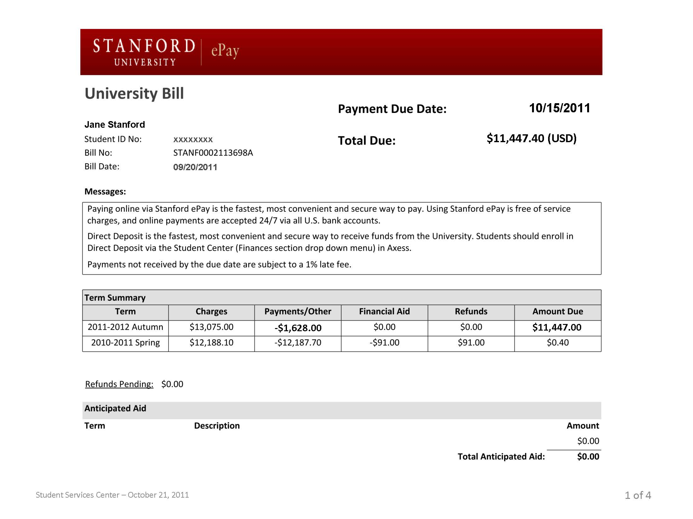
Department Deposits
Cashnet.com
Direct bank deposits
University bill additions
Course Fee module

Slide 12
The Result
How did it all turn out?

Slide 13
Initial Response
Student payments
First year = 60% reduction
Today = 90 cash payments (via bank deposit)
Department Deposits
Password frustration
Collaboration with Controller’s Office
Messaging to staff
Single sign-on (2016)
Do not touch cash at all!

Slide 14
Things to Consider
Technology and payment receivable evolvement = skill set of the staff evolvement
Ongoing training
Transaction focused to validating systems
Bank location

Slide 15
Contact
Dena Zlatunich – denamz@stanford.edu
Kelly Takahashi (project lead) – kellyt@stanford.edu

